Slide 1
Testicular cancer
Sam Schroeder
Head and Neck
Radiation Oncology
Dominic Moon, MD
Assistant Professor
Department of Radiation Oncology
UT Southwestern Medical Center

Slide 2
Disclosures
Research funding:
Gateway for Cancer Research
Cary Council

Slide 3
Objectives
Introduce the biological basis for radiation therapy
Review the radiation treatment process
Discuss the acute and late side effects of radiation therapy

Slide 4
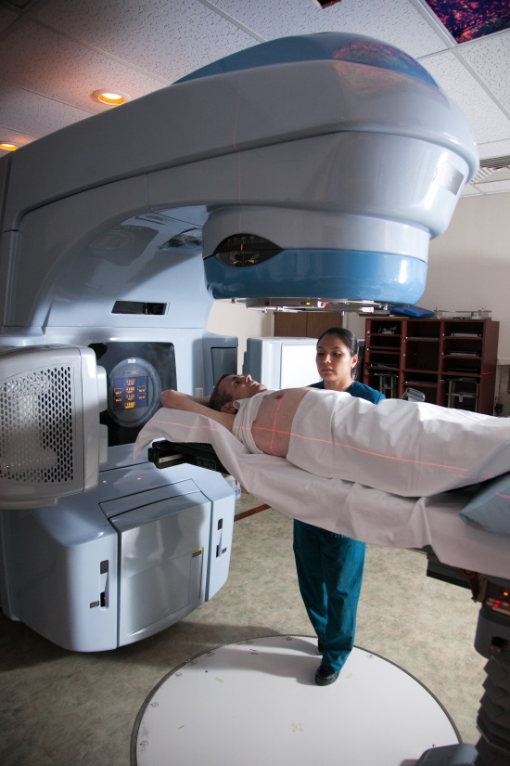
Introduction
Radiation has been an effective tool for treating cancer for more than 100 years
>60 percent of patients diagnosed with cancer will receive radiation therapy as part of their treatment
Radiation oncologists are specialists who manage the care of cancer patients with radiation for either cure or palliation

Slide 5
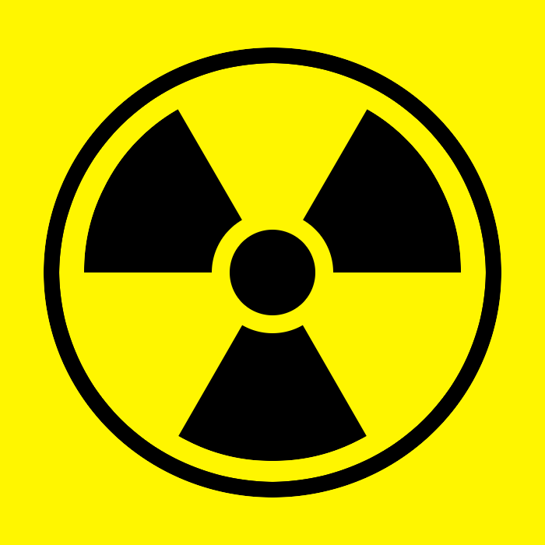
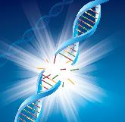
What Is the Biologic Basis for Radiation Therapy?
Radiation therapy works by damaging the DNA of cells and destroys their ability to reproduce
Both normal and cancer cells can be affected by radiation, but cancer cells generally have impaired ability to repair the damage, leading to cell death
All tissues have a tolerance level beyond which irreparable damage may occur
Ionizing radiation
Direct
damage
Indirect
damage
Free radicals/
Reactive
oxygen species
DNA strand
break
DNA strand
break
Cell death

Slide 6
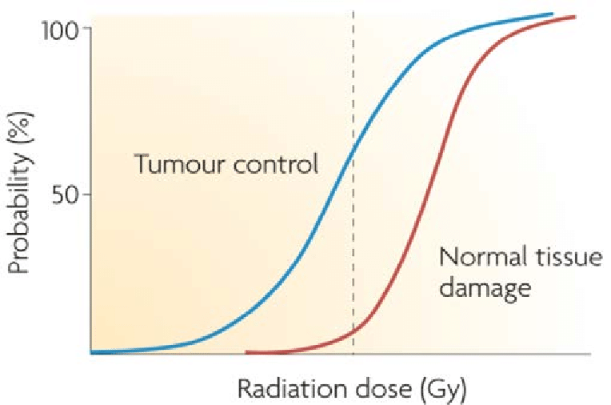
Fractionation: A Basic Radiobiologic Principle
Fractionation = dividing the total dose into small daily fractions over multiple weeks
Fractionation takes advantage of differential repair abilities of normal and malignant tissues
Spares normal tissue through repair and repopulation
Increases damage to tumor cells through redistribution and reoxygenation

Slide 7
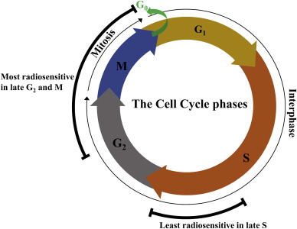
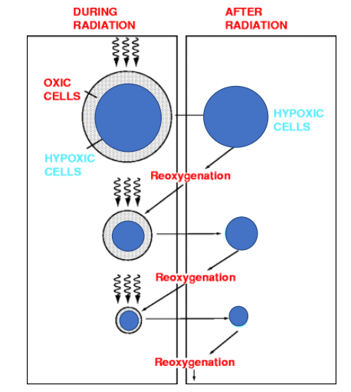
The Four R’s of Radiobiology
Four major factors are believed to affect tissue’s response to fractionated radiation:
Repair of sublethal damage to cells between fractions caused by radiation
Repopulation or regrowth of cells between fractions
Redistribution of cells into radiosensitive phases of cell cycle
Reoxygenation of hypoxic cells to make them more sensitive to radiation

Slide 8
Clinical Uses for Radiation Therapy
Therapeutic radiation serves two major functions
To cure cancer
Destroy tumors that have not spread
Kill residual microscopic disease left after other treatments, most commonly surgical resection
To reduce or palliate symptoms
Alleviate pain or neurologic symptoms by reducing the size of a tumor

Slide 9
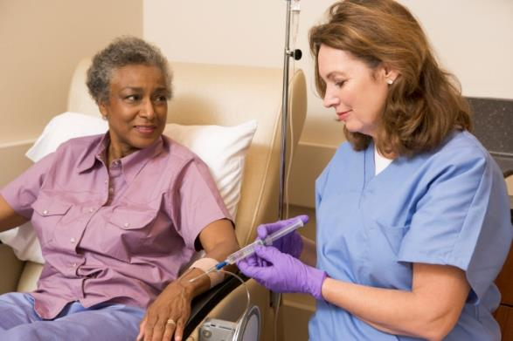
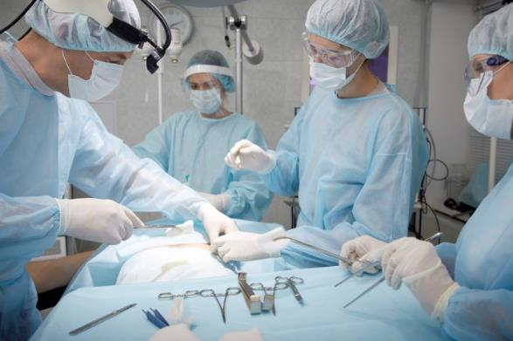
Radiation Therapy in Multidisciplinary Care
Radiation therapy plays a major role in the management of many common cancers either as definitive therapy with or without chemotherapy or as an adjuvant therapy to surgery
Radiation is also frequently used to treat metastatic disease to the brain, bone, and other organs

Slide 10
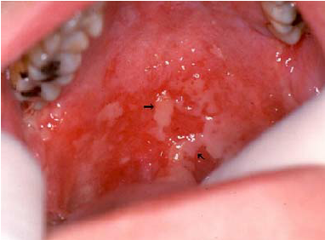
Radiation Therapy Basics
External beam radiation treatment is painless and usually scheduled five days a week for several weeks
The effects of radiation therapy are cumulative with most significant side effects occurring near the end of the treatment course
Side effects usually resolve over the course of a few weeks
Some side effects may be long term
Side effects depend on the site being treated
Modern radiation therapy techniques have decreased these side effects significantly

Slide 11
The Radiation Oncology Team
Radiation Oncologist
The doctor who prescribes and oversees the radiation therapy treatments
Medical Physicist
Ensures that treatment plans are properly tailored for each patient, and is responsible for the calibration and accuracy of treatment equipment
Dosimetrist
Works with the radiation oncologist and medical physicist to design and calculate the proper dose of radiation given to the tumor
Radiation Therapist
Administers the daily radiation under the doctor’s prescription and supervision
Radiation Oncology Nurse
Interacts with the patient and family at the time of consultation, throughout the treatment process and during follow-up care

Slide 12
Head and Neck Team
Head and neck surgeon
Medical oncologist
Speech language pathologist
Nutritionist
Dental
Audiology
Smoking cessation

Slide 13
The Treatment Process
Referral
Consultation
Simulation
Treatment Planning
Quality Assurance

Slide 14
Referral and Consultation
Tissue diagnosis has been established
Biopsy of primary site and/or lymph nodes
Referring physician reviews potential treatment options with patient and requests a consultation by a radiation oncologist
Radiation oncologist determines whether radiation therapy is appropriate
Surgery followed by adjuvant RT
Definitive RT +/- chemotherapy
Induction chemotherapy followed by RT
A treatment plan is developed
Care is coordinated with other members of patient’s oncology team

Slide 15
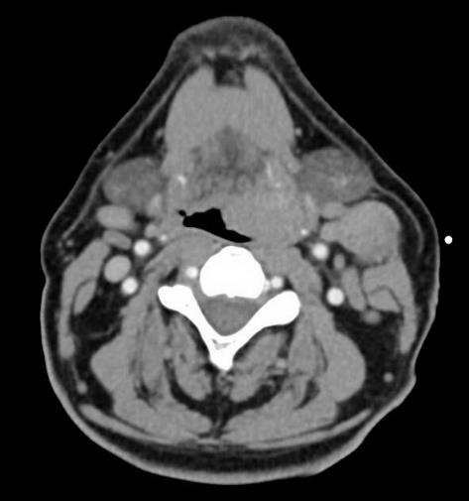
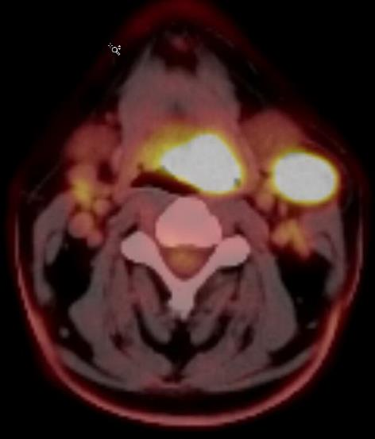
Head and Neck Consult
History
Pain, dysphagia, odynophagia, trismus, dysarthria, otalgia
Comorbidities that can affect the tolerability of treatments
Smoking, alcohol, and other risk factors
Physical exam
Location and size of the primary tumor
Presence and extent of cervical adenopathy
Cranial nerve deficits
Flexible endoscopy
Examine the nasopharynx, oropharynx, larynx, and hypopharynx
Imaging:
CT neck with contrast
PET/CT for staging
+/- MRI neck with contrast for invasion of skull base, concern for cranial nerve involvement, etc.
Pathology review

Slide 16
Simulation
Patient is set up in treatment position on a dedicated CT scanner
For H&N
Supine, neck extended
Thermoplastic mask
IV contrast
+/- bite block, bolus
CT simulation images are fused with diagnostic PET/CT or MRI scans for treatment planning

Slide 17
Treatment Planning
Physician outlines the target and organs at risk
Sophisticated software is used to carefully derive an appropriate treatment plan
Computerized algorithms enable the treatment plan to spare as much healthy tissue as possible
Medical physicist checks the chart and dose calculations
Radiation oncologist reviews and approves final plan

Slide 18
Safety and Quality Assurance
Each radiation therapy treatment plan goes through many safety checks
The medical physicist checks the calibration of the linear accelerator on a regular basis to assure the correct dose is being delivered
The radiation oncologist, along with the dosimetrist and medical physicist, go through a rigorous multi-step QA process to be sure the plan can be safely delivered
QA checks are done by the radiation therapist daily to ensure that each patient is receiving the treatment that was prescribed for them

Slide 19
Treatment Delivery
Linear accelerator delivers external beam radiation therapy
For H&N radiation therapy, patients generally receive daily treatment for 6-7 weeks to a dose of 60-70 Gy

Slide 20
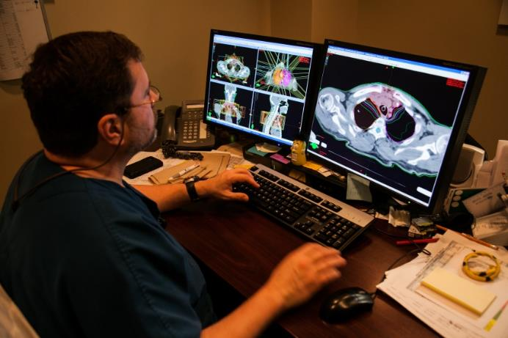
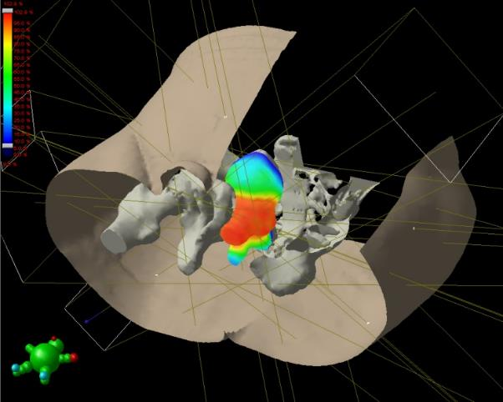
Intensity modulated radiation therapy (IMRT)
Uses CT, PET or MRI scans to create a 3-D picture of the tumor and surrounding anatomy
Radiation is broken into many “beamlets” and the intensity of each can be adjusted individually
IMRT allows higher doses of radiation to be delivered to the tumor while better sparing healthy surrounding tissue

Slide 21
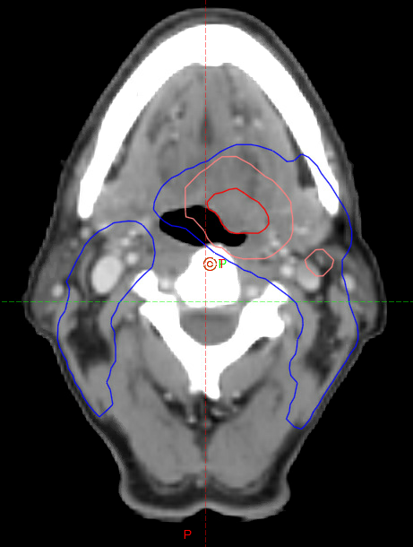
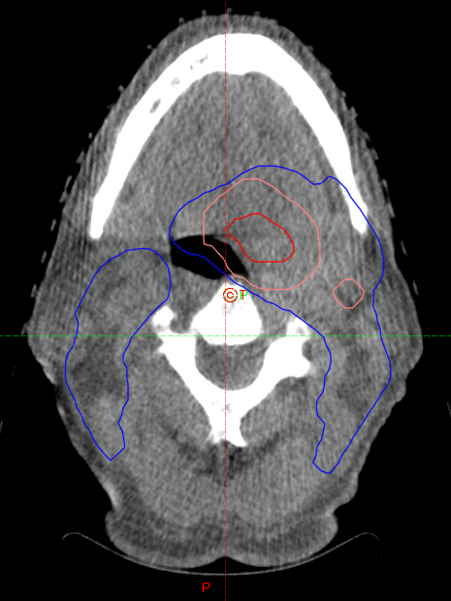
Image Guidance
Physicians use imaging of the tumor for daily set-up accuracy
Imaging performed using on-board X-rays, CT, and/or MRI
Day-of imaging is matched to the original plan to ensure agreement

Slide 22
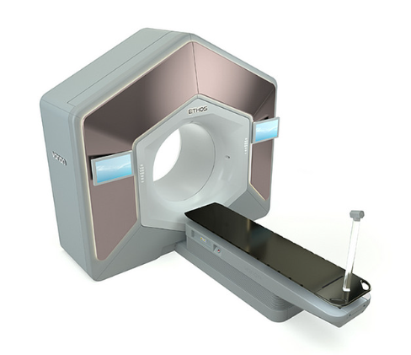
Adaptive Radiation Therapy (ART)
Anatomic changes occur during the treatment course
Patient weight loss
Tumor volume shrinkage
Day to day movement of organs
This leads to unintended under-dosing of targets and/or over-dosing of normal tissue
Adaptive radiation therapy updates the radiation plan to mitigate this issue
Technological advances have enable AI-assisted online ART to generate a new plan in real time while the patient is on the treatment table using on-board imaging

Slide 23
Head and Neck Radiation Oncologist
Radiation Oncologist specializing in the treatment of cancers in the head and neck area
Cancers treated
Nasopharynx
Oropharynx
Oral cavity
Larynx
Hypopharynx
Nasal cavity
Paranasal sinuses
Salivary gland
Skin of the head and neck
Non-cancerous conditions
Paraganglioma
Schwannoma
Keloid

Slide 24
Side Effects of Radiation Therapy

Slide 25
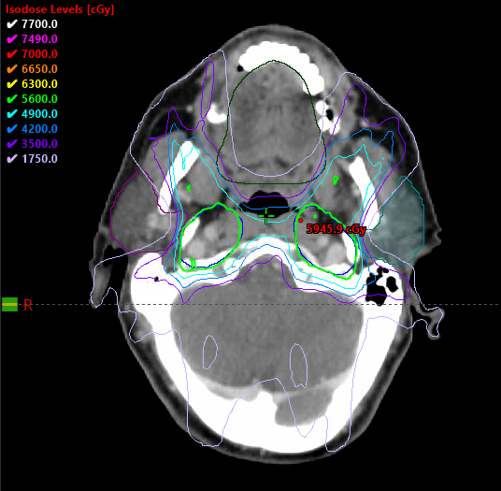
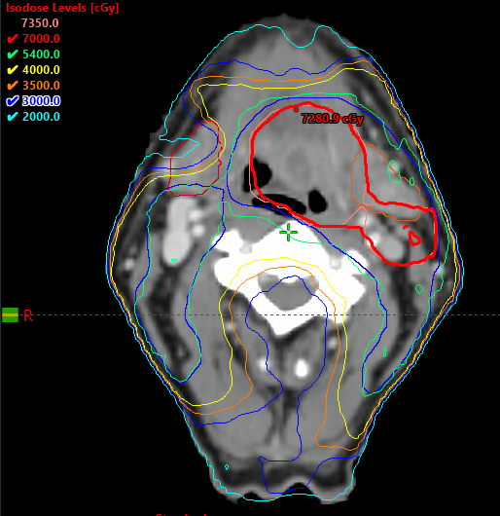
Preventing Toxicity
Radiation therapy is designed to focus the radiation dose to the target and minimize dose to the surrounding structures
Dose being “carved out” from
bilateral parotid glands
Dose being “carved out” from
right submandibular gland

Slide 26
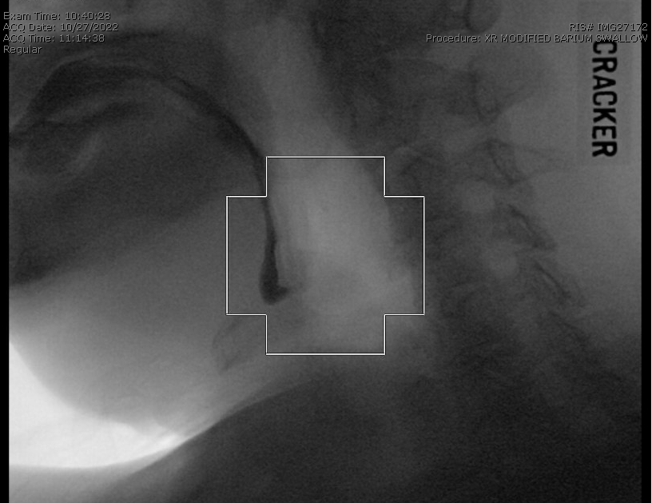
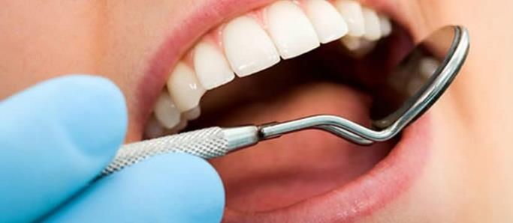
Preventing Toxicity
Evaluation and therapy with speech/swallowing therapists and nutritionists to ensure good nutrition
Dental evaluation prior to initiating radiation therapy to assess for cavities and dental disease requiring intervention
Oral care during and after treatment
Salt and soda rinses
Fluoride trays

Slide 27
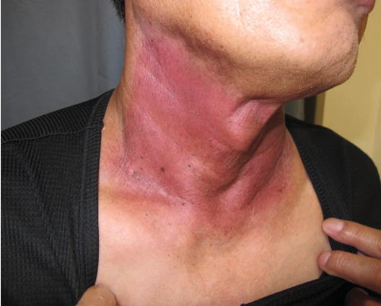
Treatment of Acute Side Effects
Skin irritation
Skin care: Aquaphor, Xeroform, etc.
Sore mouth, sore throat
Mouthwashes: Magic Mouthwash, doxepin mouthwash
Pain medications: gabapentin, oxycodone, hydrocodone, etc.
Dry mouth
Biotene, XyliMelts
Salagen
Thick or excess secretions/mucus
Mucinex, Robitussin
Robinul, Scopolamine patch
Poor nutrition/weight loss
Nutrition evaluation
Feeding tube for tube feeds

Slide 28
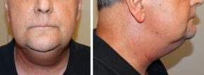
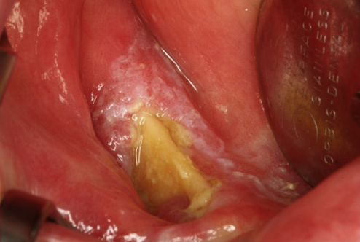
Treatment of Late Side Effects
Lymphedema and fibrosis of the neck
Lymphedema therapy
Physical therapy
Osteoradionecrosis
Vitamin E, pentoxifylline
Antibiotics
Debridement
Hyperbaric oxygen
Difficulty swallowing
Speech/swallow therapy
Esophageal dilation
Thyroid disease
Synthroid

Slide 29
Clinical Trials at UT Southwestern: HYPORT
Hypofractionated post-operative RT (HYPORT)
Eligibility: Patients with head and neck cancer who have undergone surgery with risk factors warranting post-operative radiation therapy
Trial design: Patients are randomized into two arms
Arm 1: Conventionally fractionated RT completed in 6 weeks (standard of care)
Arm 2: Hypofractionated RT completed in 3 weeks (experimental treatment)
Objective: To assess the novel RT technique delivering higher doses of RT each day to decrease the treatment time and ensure that it is as safe and effective as the standard RT
Why is the trial being done?
To see if we can half the treatment time from 6 weeks to 3 weeks to decrease the treatment burden associated with RT

Slide 30
Clinical Trials at UT Southwestern: DARTBOARD
Daily adaptive RT to better organ-at-risk doses (DARTBOARD)
Eligibility: Patients with oropharynx, larynx, and hypopharynx cancer
Trial design: Patients are randomized to two arms
Arm 1: involved nodal radiation therapy +/- chemotherapy as indicated
Arm 2: “margin-less” daily adaptive involved nodal radiation therapy +/- chemotherapy as indicated
Objectives:
To decrease the volume of RT targeting only involved and suspicious nodes
To further decrease volume of RT by eliminating margins using daily adaptive therapy
Why is the trial being done?
To decrease toxicity associated with RT by minimizing the volumes treated

Slide 31
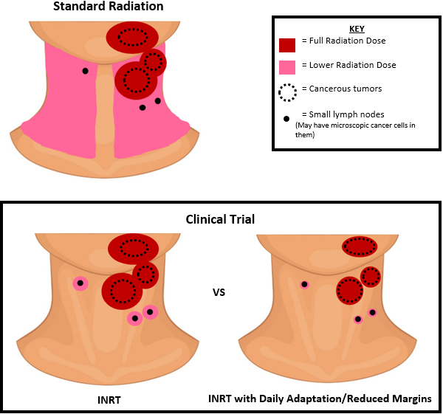
Clinical Trials at UT Southwestern: DARTBOARD

Slide 32
Summary
Radiation therapy takes advantage of the differential ability of cancer vs normal cells to repair damaged DNA to preferentially kill cancer cells
Cancer treatment plan is developed as a multidisciplinary team
Radiation therapy is carefully designed and checked to optimize dose to the target and minimize dose to normal tissues
Technological advances have allowed more accurate and focused radiation treatment to improve outcomes and decrease toxicity
The treatment team works together using various strategies to prevent and treat side effects from radiation therapy
Clinical trials are ongoing to find ways to decrease the treatment burden and side effects of radiation therapy

