Slide 1
Testicular cancer
Sam Schroeder
Radiation Effects in the
Treatment of Head and Neck Cancer
Dominic Moon, MD
Assistant Professor
Department of Radiation Oncology
UT Southwestern Medical Center
March 9, 2023

Slide 2
Disclosures
Research funding:
Gateway for Cancer Research
Cary Council

Slide 3
Objectives
Introduce the basic principles of radiation therapy
Discuss the acute and late side effects of radiation therapy
Discuss strategies to mitigate radiation treatment effects

Slide 4
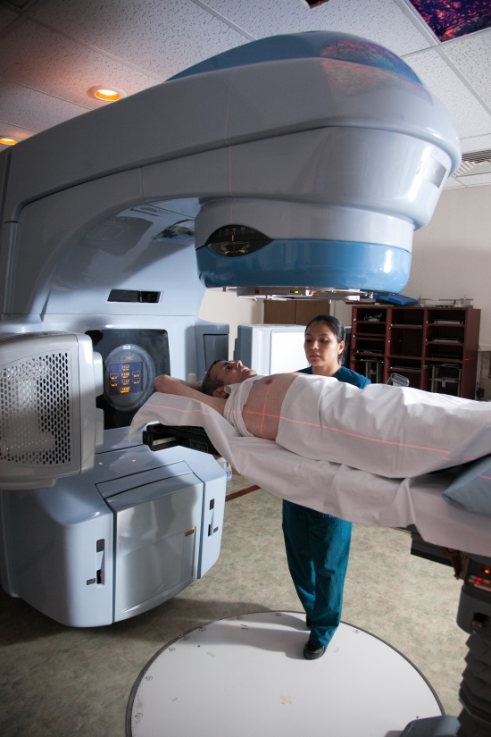
Introduction
Radiation has been an effective tool for treating cancer for more than 100 years
>60 percent of patients diagnosed with cancer will receive radiation therapy as part of their treatment
Radiation oncologists are specialists who manage the care of cancer patients with radiation for either cure or palliation

Slide 5
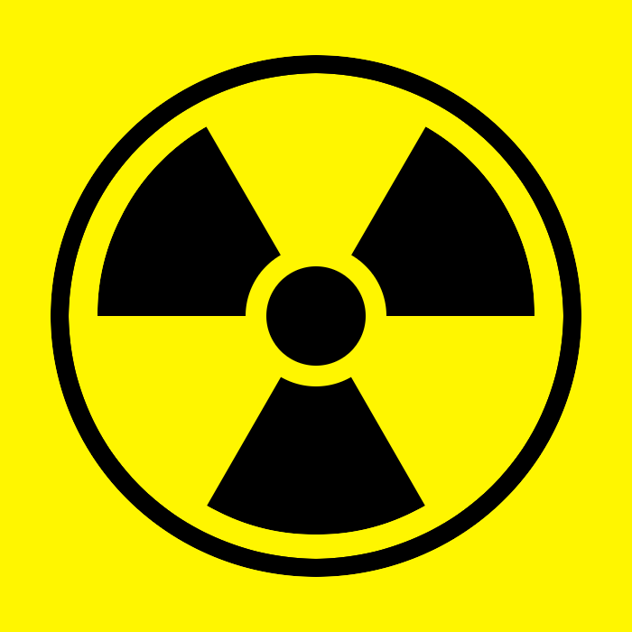
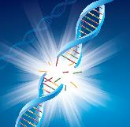
How Does Radiation Therapy Work?
Radiation therapy works by damaging the DNA of cells, and destroying their ability to reproduce
Both normal and cancer cells can be affected by radiation, but cancer cells generally have decreased ability to repair the damage, leading to cell death
All tissues have a tolerance level beyond which irreparable damage may occur
Ionizing radiation
Direct
damage
Indirect
damage
Free radicals/
Reactive
oxygen species
DNA strand
break
DNA strand
break
Cell death

Slide 6
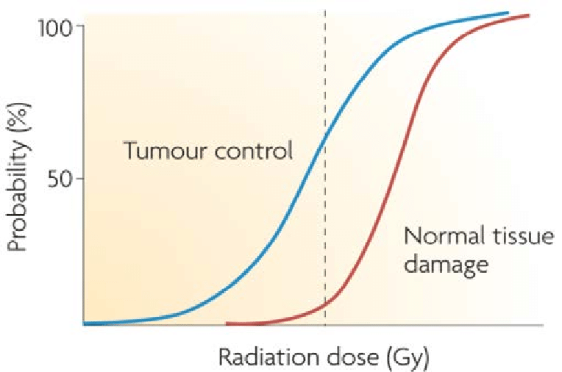
Fractionation: A Basic Radiobiologic Principle
Fractionation = dividing the total dose into small daily fractions over multiple weeks
Fractionation takes advantage of differential repair abilities of normal and malignant tissues
Allows sparing of normal tissue and increase damage to tumor cells

Slide 7
Radiation Therapy Basics
External beam radiation treatment is painless and usually scheduled five days a week for several weeks
The effects of radiation therapy are cumulative with most significant side effects occurring near the end of the treatment course
Side effects usually resolve over the course of a few weeks
Some side effects may be long term
Side effects depend on the site being treated

Slide 8
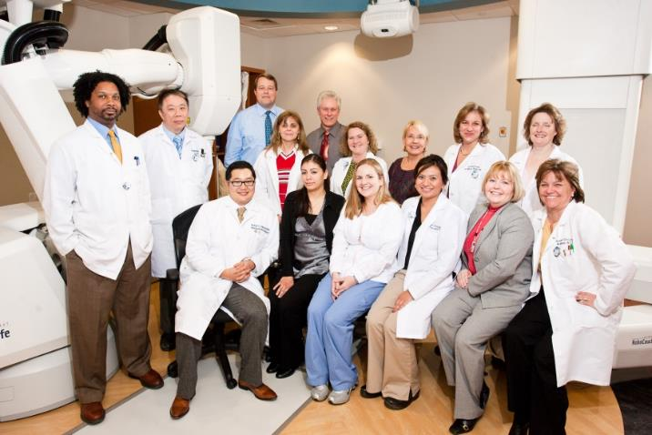
Is Radiation Therapy Safe?
New advances in technology and treatment delivery continue to make radiation safe and effective
A team of medical professionals develop and review the treatment plan for each patient to minimize side effects and assure that the area where the cancer is located is receiving the dose of radiation needed
The treatment plan and equipment are constantly reviewed to ensure the proper treatment is being given
Notes:
The radiation therapy treatment team is made up of highly trained professionals who are focused on delivering safe and effective care.

Slide 9
The Radiation Oncology Team
Radiation Oncologist
Prescribes and oversees the radiation therapy treatments
Medical Physicist
Ensures that treatment plans are properly tailored for each patient, and is responsible for the calibration and accuracy of treatment equipment
Dosimetrist
Works with the radiation oncologist and medical physicist to design and calculate the proper dose of radiation given to the tumor
Radiation Therapist
Administers the daily radiation under the doctor’s prescription and supervision
Radiation Oncology Nurse
Interacts with the patient and family at the time of consultation, throughout the treatment process and during follow-up care

Slide 10
Head and Neck Team
Head and neck surgeon
Medical oncologist
Speech language pathologist
Nutritionist
Dental
Audiology
Smoking cessation

Slide 11
Simulation
Patient is set up in treatment position on a dedicated CT scanner
For H&N
Supine, neck extended
Thermoplastic mask
IV contrast
+/- bite block, bolus
CT simulation images are fused with diagnostic PET/CT or MRI scans for treatment planning

Slide 12
Treatment Planning
Physician outlines the target and organs at risk
Sophisticated software is used to carefully derive an appropriate treatment plan
Computerized algorithms enable the treatment plan to spare as much healthy tissue as possible
Dosimetrist and/or medical physicist help design radiation beams to achieve the goals outlined by the physician
Medical physicist checks the chart and dose calculations
Radiation oncologist reviews and approves the final plan

Slide 13
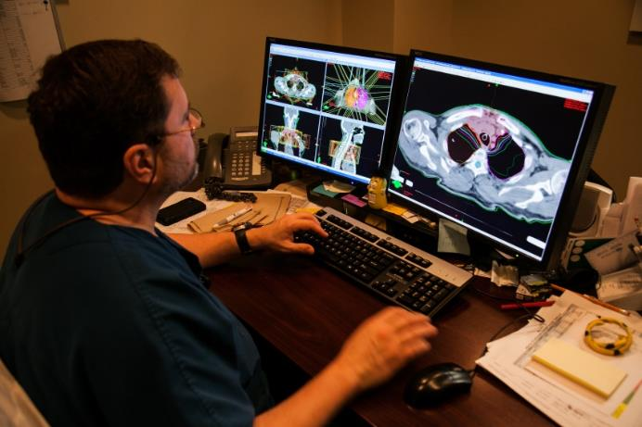
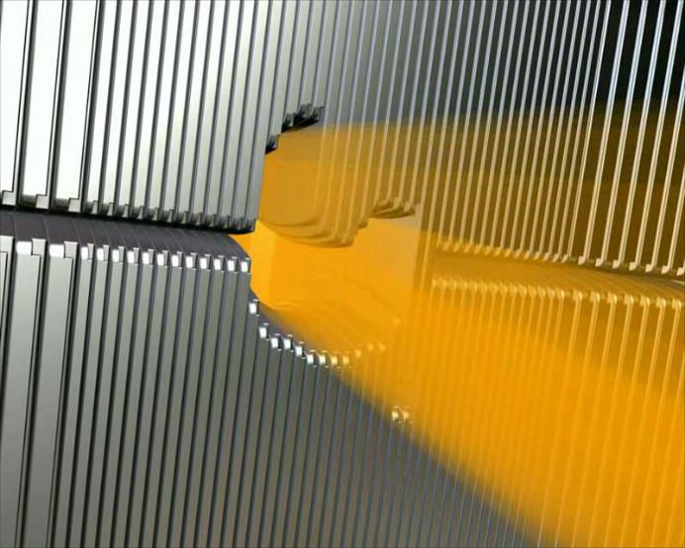
Intensity Modulated Radiation Therapy (IMRT)
For head and neck cancer treatment, IMRT is used
Uses CT, PET or MRI scans to create a 3-D picture of the tumor and surrounding anatomy
Radiation is broken into many “beamlets” and the intensity of each can be adjusted individually
IMRT allows higher doses of radiation to be delivered to the tumor while better sparing healthy surrounding tissue

Slide 14
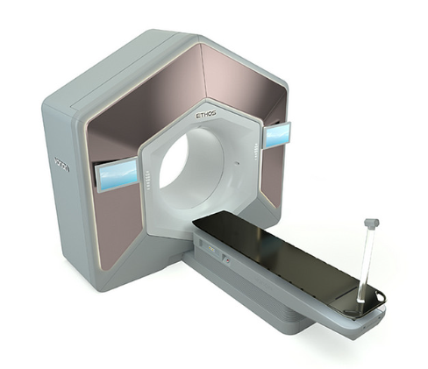
Adaptive Radiation Therapy (ART)
Anatomic changes occur during the treatment course
Patient weight loss
Tumor volume shrinkage
Day to day movement of organs
This leads to unintended under-dosing of targets and/or over-dosing of normal tissue
Adaptive radiation therapy updates the radiation plan to mitigate this issue
Technological advances have enabled AI-assisted online adaptive therapy to generate a new plan in real time while the patient is on the treatment table using on-board imaging

Slide 15
Side Effects of Radiation Therapy

Slide 16
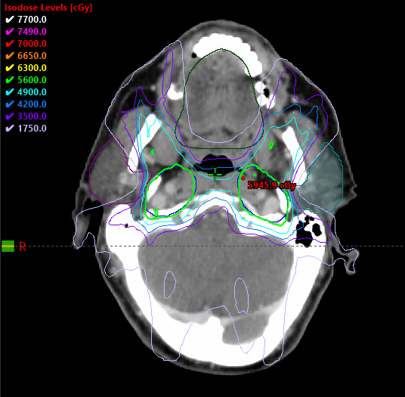
Dry Mouth/Decrease in Saliva
Due to radiation damage to salivary glands including parotid gland and submandibular gland
Onset within one to two weeks of initiation of RT
Prevention:
Conformal radiation techniques to minimize dose to salivary glands
Treatment:
Adequate hydration
Salt and baking soda mouth rinses
Biotene, XyliMelts
Mucinex, Robitussin
Pilocarpine (Salagen): stimulates saliva production
Artificial saliva
Sugar-free hard candy, chewing gum
Dose being “carved out” from
bilateral parotid glands

Slide 17
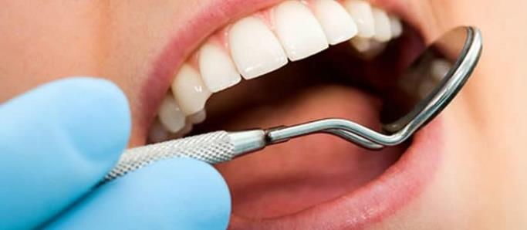
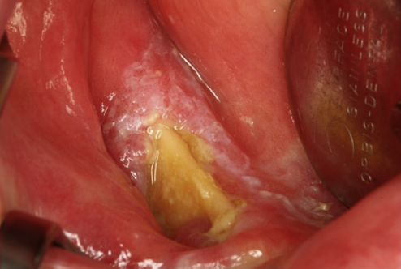
Dental Issues
Dry mouth can predispose to dental caries
Prevention:
Comprehensive dental evaluation prior to treatment
Extraction of compromised teeth beyond repair prior to treatment
Oral care during and after RT:
Salt and soda rinses
Fluoride trays
Treatment:
Regular dental follow-up and care
Osteoradionecrosis – exposed bone (of the jaw) related to radiation treatment
Debridement and antibiotics
Hyperbaric oxygen
Pentoxifylline and vitamin E
Resection and reconstruction

Slide 18
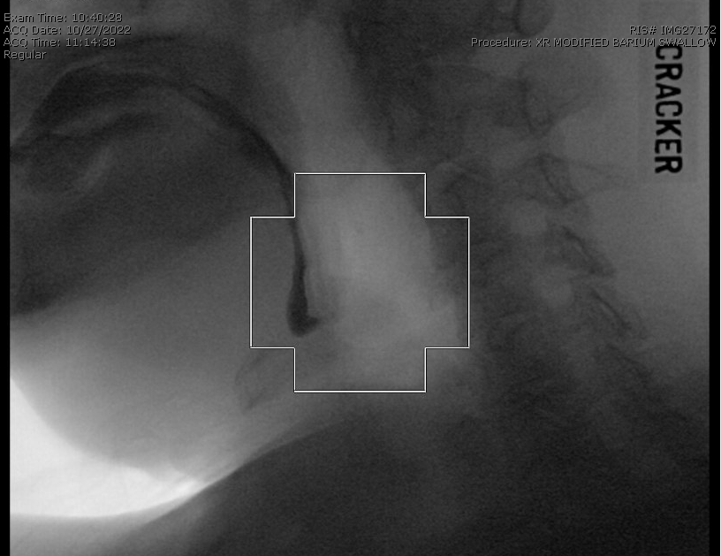
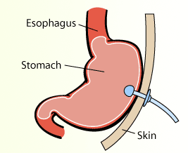
Difficulty Swallowing
Locally destructive effects of the primary tumor
Damage to swallowing structures by treatment
Stricture of swallowing structures (i.e. esophagus)
Prevention:
Evaluation and therapy with speech/swallowing therapists
Evaluation by nutritionists
Treatment:
Ongoing swallowing therapy and nutrition counseling
Feeding tube placement
Esophagus dilation

Slide 19
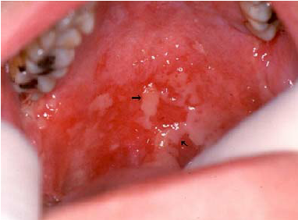
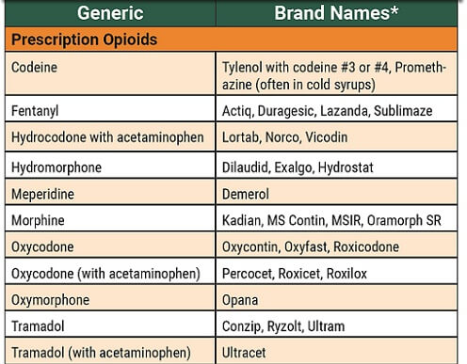
Pain
Mucositis
Irritation and pain due to mucosal damage
Causes sore mouth and throat
Starts 2nd to 3rd week of RT
Prevention:
Good oral hygiene
Change of diet to avoid acidic, spicy, sharp foods
Treatment:
Opioid pain medications
Topical anesthetic (i.e. Magic Mouthwash)
Doxepin rinses
Gabapentin

Slide 20
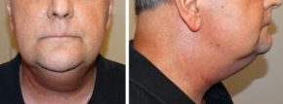
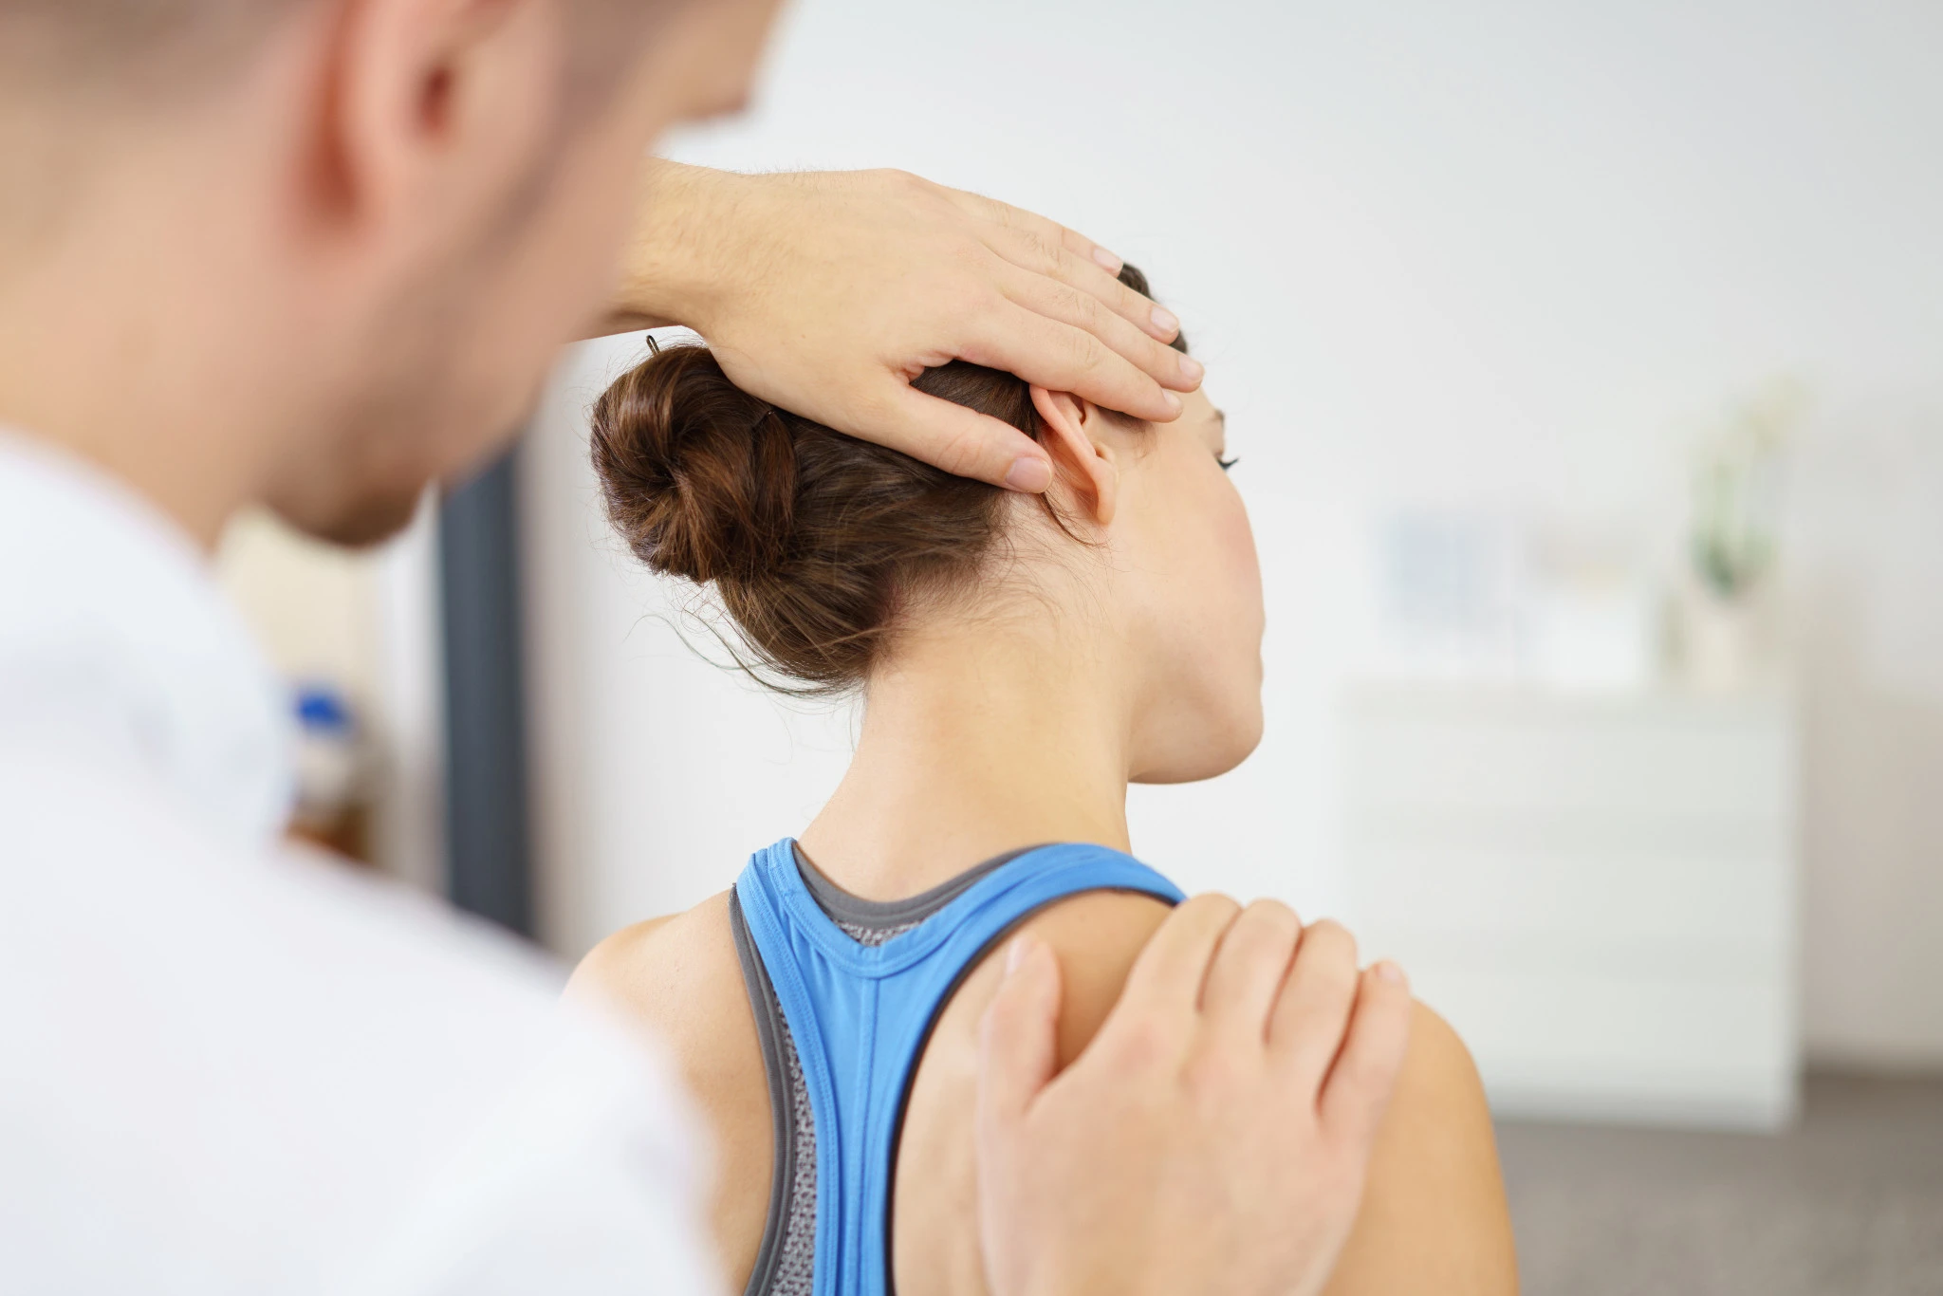
Lymphedema and Fibrosis
Lymphedema: swelling of the face and neck
Fibrosis: stiffness of the neck and shoulders
Treatment:
Lymphedema therapy
Massage therapy
Physical therapy
Botox injections (neck spasms)
Pentoxifylline and vitamin E

Slide 21
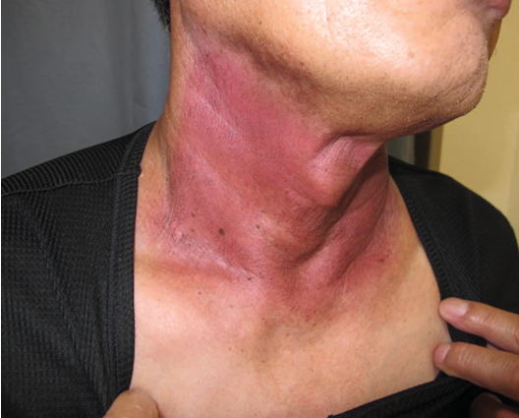
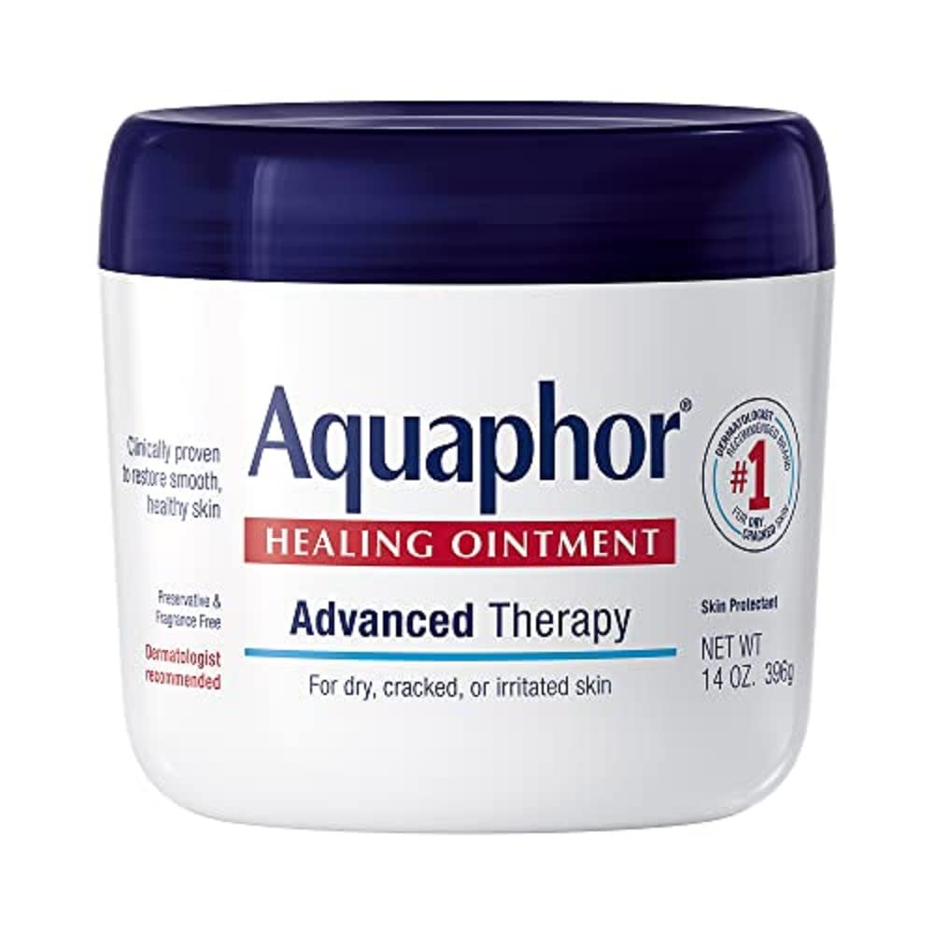
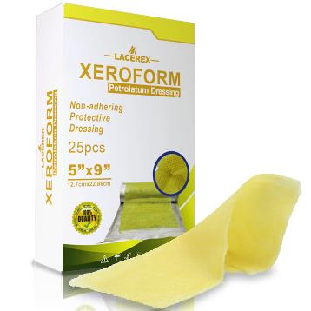
Skin Irritation
Redness, pealing, tanning
Prevention:
Conformal radiation therapy
Avoid chemical irritants
Avoid physical irritants
Limit direct sun exposure
Treatment:
Moisturizer (i.e. Aquaphor)
Topical corticosteroids,
Xeroform dressing or Silvadene in areas of pealing skin

Slide 22
Clinical Trials at UT Southwestern: HYPORT
Hypofractionated post-operative RT (HYPORT)
Eligibility: Patients with head and neck cancer who have undergone surgery with risk factors warranting post-operative radiation therapy
Trial design: Patients are randomized into two arms
Arm 1: Conventionally fractionated RT completed in 6 weeks (standard of care)
Arm 2: Hypofractionated RT completed in 3 weeks (experimental treatment)
Objective: To assess the novel RT technique delivering higher doses of RT each day to decrease the treatment time and ensure that it is as safe and effective as the standard RT
Why is the trial being done?
To see if we can half the treatment time from 6 weeks to 3 weeks to decrease the treatment burden associated with RT

Slide 23
Clinical Trials at UT Southwestern: DARTBOARD
Daily adaptive RT to better organ-at-risk doses (DARTBOARD)
Eligibility: Patients with oropharynx, larynx, and hypopharynx cancer
Trial design: Patients are randomized to two arms
Arm 1: involved nodal radiation therapy +/- chemotherapy as indicated
Arm 2: “margin-less” daily adaptive involved nodal radiation therapy +/- chemotherapy as indicated
Objectives:
To decrease the volume of RT targeting only involved and suspicious nodes
To further decrease volume of RT by eliminating margins using daily adaptive therapy
Why is the trial being done?
To decrease toxicity associated with RT by minimizing the volumes treated

Slide 24
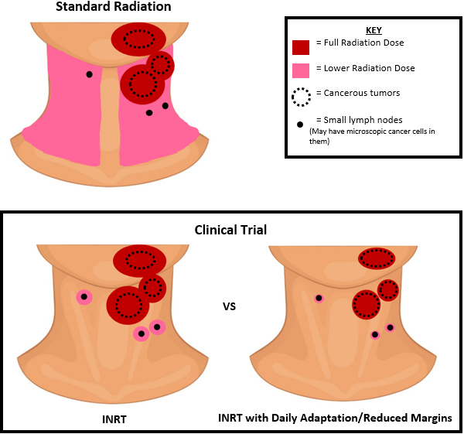
Clinical Trials at UT Southwestern: DARTBOARD

Slide 25
Summary
Radiation therapy takes advantage of the differential ability of cancer vs normal cells to repair damaged DNA to preferentially kill cancer cells
Radiation therapy is carefully designed and checked to optimize dose to the target and minimize dose to normal tissues
The treatment team works together using various strategies to prevent and treat side effects from radiation therapy
Clinical trials are ongoing to found ways to decrease the treatment burden and side effects of radiation therapy

