Slide 1
A Surgeon’s Perspective: Evaluation and Treatment of Laryngeal Cancer
Lenka Stankova MD
Assistant Professor, Otolaryngology-Head & Neck Surgery, UT Southwestern Medical Center
Section Chief, Otolaryngology-Head & Neck Surgery VA North Texas Medical Center
Texas Laryngectomee Association Conference March 9th, 2023
Dallas, TX

Slide 2
Nothing to Disclose

Slide 3
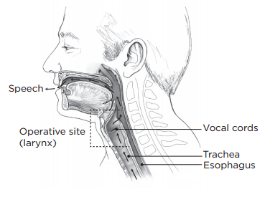
Function of the Larynx
Protection of the airway
Separation of the airway and the alimentary (digestive) tract
Breathing
Swallowing
Speaking
https://www.mskcc.org/cancer-care/patient-education/about-your-total-laryngectomy

Slide 4
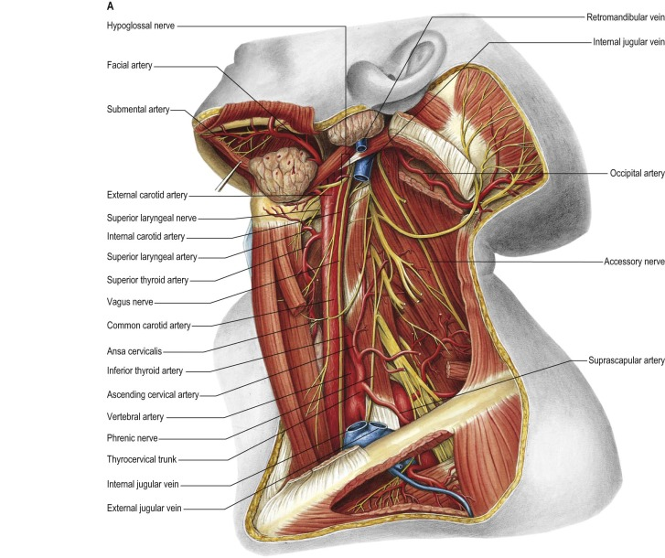
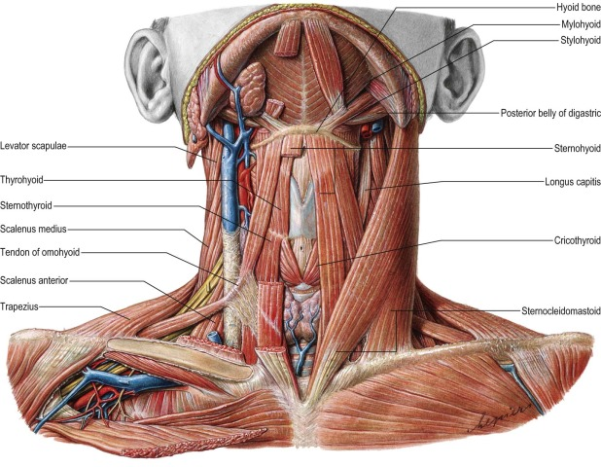
Anatomy of the Neck
Gray’s Anatomy, 2016

Slide 5
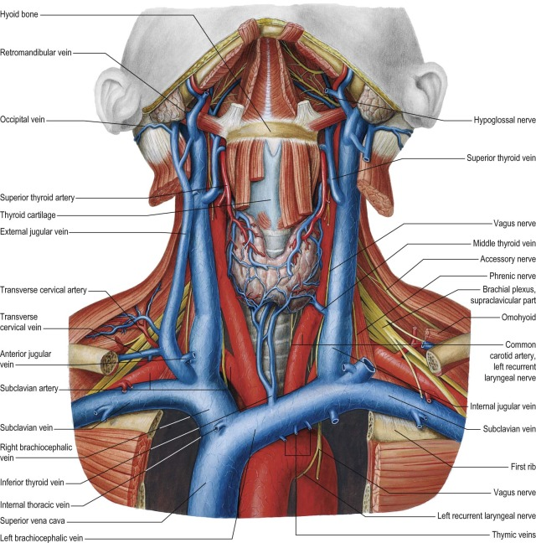
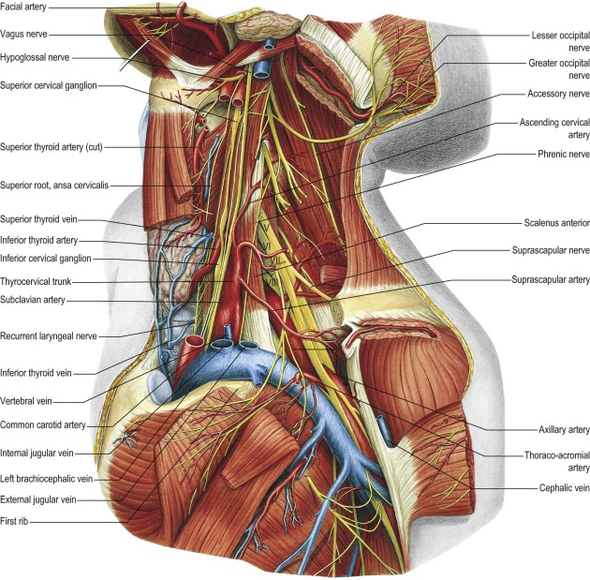
Anatomy of the Neck
Gray’s Anatomy, 2016

Slide 6
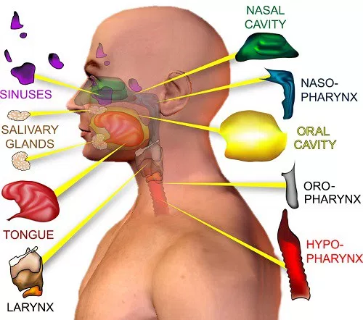
Divisions of the Upper Aerodigestive Tract
https://www.ahns.info/patient-information/understanding-head-neck-cancer/overview/

Slide 7
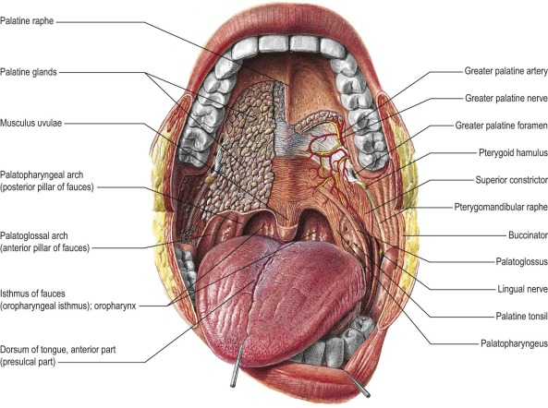
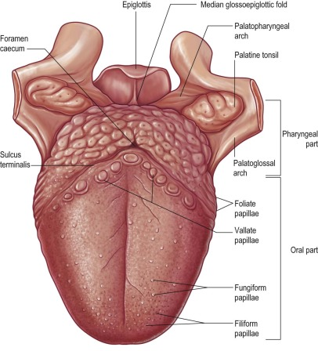
Anatomy of the Neck, Oral Cavity
Gray’s Anatomy, 2016

Slide 8
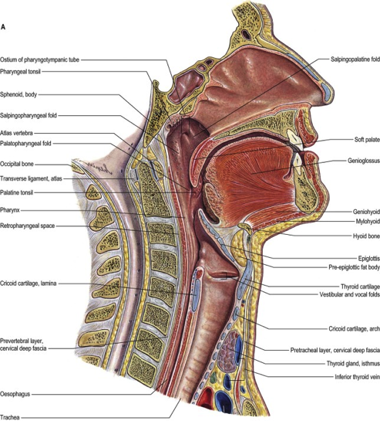
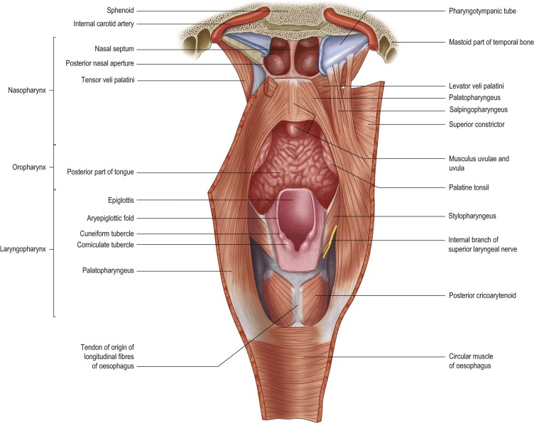
Pharynx
Begins at skull base and ends at the esophagus
Muscles and mucosa
Shaped as an inverted cone, 12-14 cm long
Further divided into nasopharynx, oropharynx and hypopharynx
Gray’s Anatomy, 2016

Slide 9
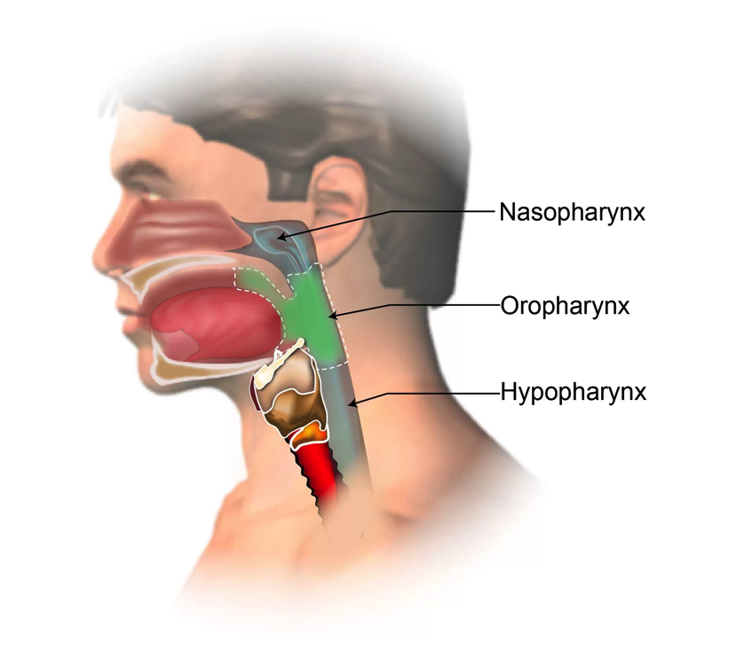
Pharynx
Larynx
https://www.ahns.info/patient-information/understanding-pharyngeal-cancer

Slide 10
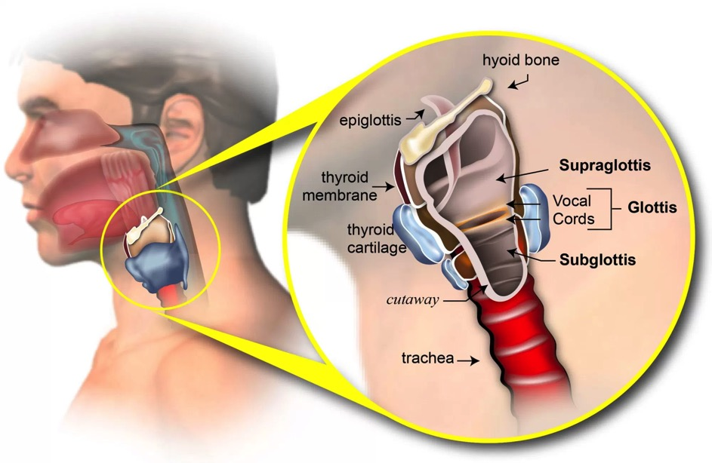
Larynx Anatomy
The larynx is divided into 3 areas
Supraglottis
Glottis
Subglottis
https://www.ahns.info/patient-information/laryngeal-cancer/

Slide 11
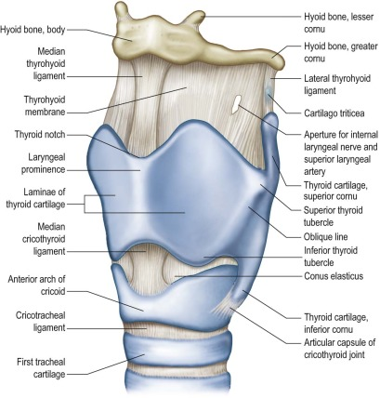
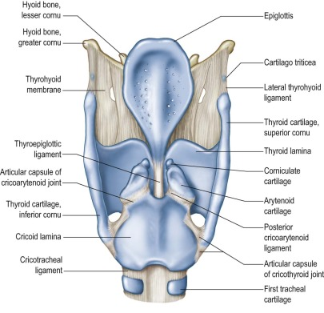
Larynx Anatomy; Cartilage “Skeleton”
Gray’s Anatomy, 2016

Slide 12
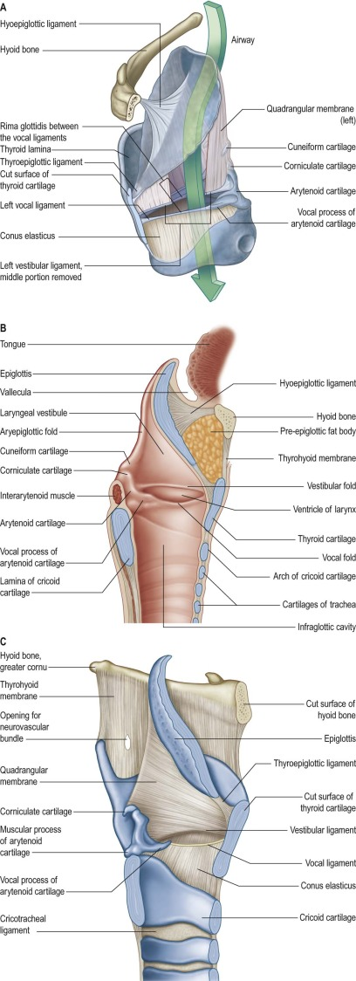
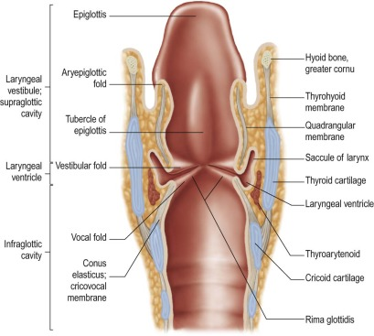
Larynx Anatomy
Gray’s Anatomy, 2016

Slide 13
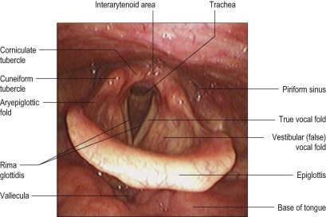
Endoscopic View of Larynx
Gray’s Anatomy, 2016

Slide 14
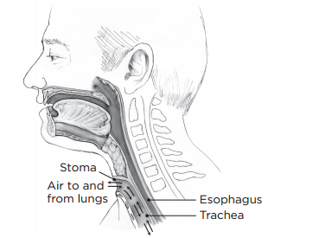
Post-laryngectomy Anatomy
Neopharynx
Tracheotomy
https://www.mskcc.org/cancer-care/patient-education/about-your-total-laryngectomy

Slide 15
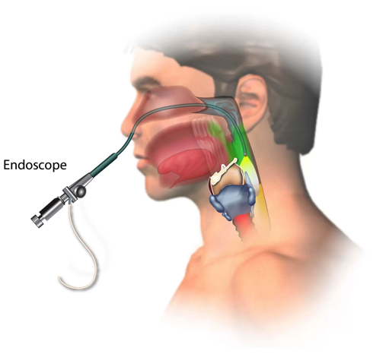
Evaluation of New Patient
History and Physical Examination
Larynx is examined with mirror examination or flexible laryngoscopy
Imaging
CT
PET/CT
US
MRI
Pathology
Fine needle aspiration
Biopsy (Clinic or OR)
Transoral or trans-nasal via channeled-endoscope
Open neck biopsy
Laryngoscopy, esophagoscopy, bronchoscopy to evaluate for synchronous tumors
https://www.ahns.info/patient-information/laryngeal-cancer/diagnosis/

Slide 16
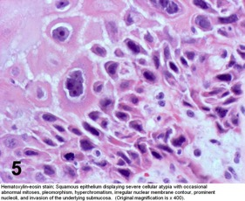
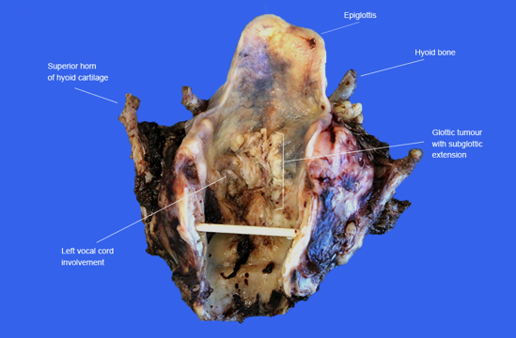
Laryngeal Cancer 2023
About 12,380 new cases of laryngeal cancer (9,900 in men and 2,480 in women)
Lifetime risk of developing laryngeal cancer is:
1 in 190 for men
1 in 830 for women
About 3,820 people (3,070 men and 750 women) will die from laryngeal cancer
Decreased smoking → decreased laryngeal cancer by 2.4% per year over the last decade
More than 85% are male and over 40yo
Vast majority (>85%) of laryngeal cancer are squamous cell carcinoma
60% of laryngeal cancers start in the glottis, 35% develop in the supraglottic area
Other types of carcinoma include minor salivary gland carcinoma, neuroendocrine carcinoma, and sarcoma
https://www.cancer.org/cancer/laryngeal-and-hypopharyngeal-cancer/about/key-statistics.html
http://www.pathologyoutlines.com/topic/larynxcarcinomageneral.html, Dr. Steven Catinchi-Jaime - malignant fibrous histiocytoma and squamous cell carcinoma arising in a vocal chord
http://www.rcpa.edu.au/Library/Practising-Pathology/Macroscopic-Cut-Up/Specimen/Head-and-neck/Larynx

Slide 17
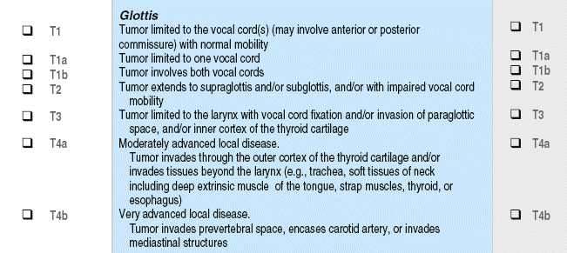
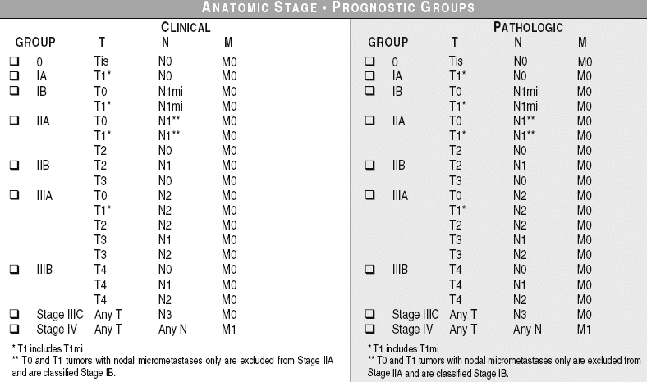
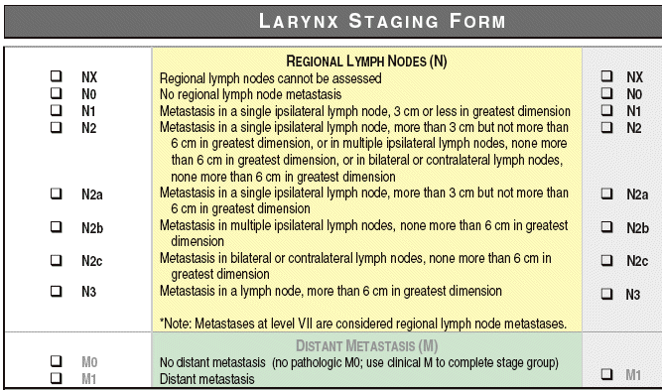
Laryngeal Cancer Staging (TNM)
AJCC 8th edition

Slide 18
Laryngeal Cancer Survival Rates
https://www.cancer.org/cancer/laryngeal-and-hypopharyngeal-cancer/detection-diagnosis-staging/survival-rates.html

Slide 19
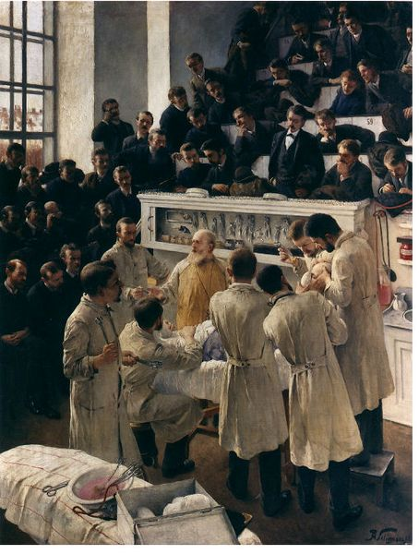
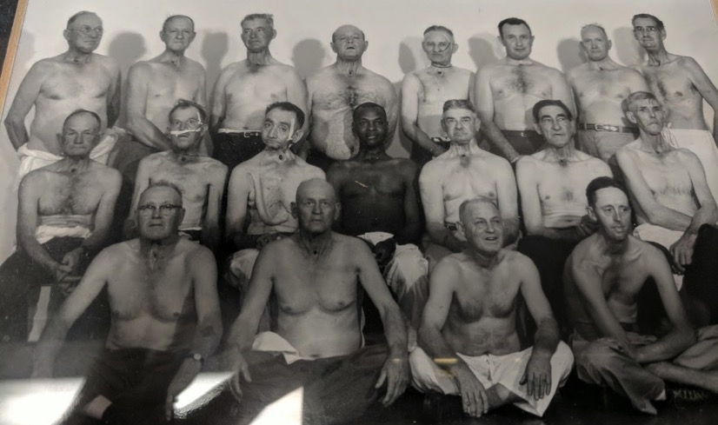
History of Laryngeal Cancer Treatment
1873 --First laryngectomy for carcinoma was by Dr. Billroth
1886 --Attempts at transoral resection
1906 --Dr Crile emphasizes importance of cervical lymph node dissection in laryngeal carcinoma
1920 --Radiation therapy for laryngeal cancer
Mid 1900s--Treatment of choice is total laryngectomy and radical neck dissection
1970s-- Use of laser in transoral resection
1990s-2000s– Decline in radical surgery. Combination treatment with RT+ chemotherapy and laryngeal preservation. IMRT.
Current: Focus on decreasing treatment toxicity
Novel systemic agents; Immunotherapy
New radiation technology
https://en.wikipedia.org/wiki/File:Seligmann_-_Billroth_operating.jpg
VA North Texas 1953. Archive.

Slide 20
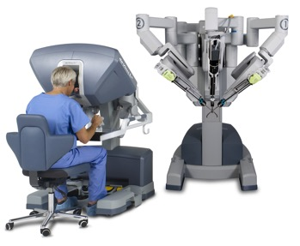
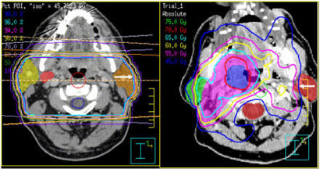
Treatment of Laryngeal Cancer
Early Stage Laryngeal Cancer
Single modality (Curative in 80-90% of patients)
Transoral surgery (Europe >> North America)
Transoral laser surgery
Transoral robotic surgery
Radiation therapy
Advanced Laryngeal Cancer
Multimodality treatment including surgery (<50% chance of cure)
Surgery + Radiation therapy
Surgery + Radiation therapy +Systemic therapy (Chemotherapy, immunothx)
Distal Metastatic Disease (No curative treatment)
Systemic therapy
Surgery and radiation therapy for palliation (symptom management)
https://www.intuitivesurgical.com/company/media/images/singlesite/SingleSite_PC_SC_Surgeon_head_in_console.jpg
Hong TS, et al. Intensity-modulated radiation therapy: emerging cancer treatment technology. Br. J. Cancer (2005)

Slide 21
Side Effects and Complications of Treatment
Radiation
Skin burns
Mucositis (mouth and throat pain)
Xerostomia (dry mouth)
Dysgeusia (altered taste)
Neck fibrosis (scarring)
Lethargy
Feeding tube dependence
Osteoradionecrosis (pain and loss of function)
Secondary malignancy
Lymphedema…
Chemotherapy
Organ dysfunction …
Hearing loss
Neutropenia
Surgery
Bleeding
Infection
Scarring, altered appearance
Fistula
Decreased shoulder and neck function
Pain
Graft loss
Injury to surrounding structures at harvest sites
Prolonged hospitalization/recovery, re-admission to hospital within 30 days after TL is ~25%
Peri-operative medical complications including permanent injury and death
Feeding tube dependence
Prolonged wound healing
Stomal stenosis, TEP failure, neopharynx stricture, lymphedema..

Slide 22
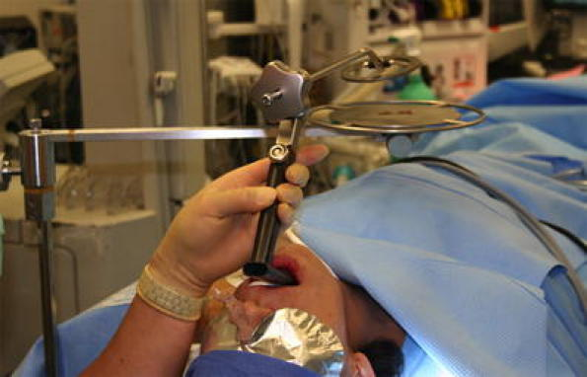
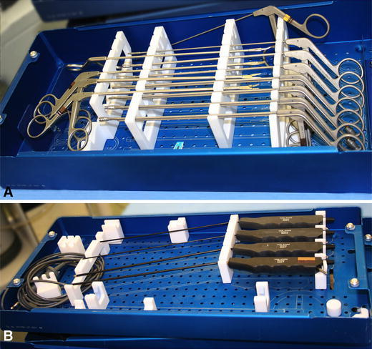
Transoral Surgery
Organ preservation surgery
Preserve function
Goal = negative margin=remove all cancer
Same oncologic outcome as RT as primary treatment in early staged cancers
May result in poorer voice quality compared to RT
Requires appropriate patient selection
Requires expertise in transoral surgery
Transoral laser microsurgery (TLM)
Transoral robotic surgery (TORS)
Anatomic limitations
Must be able to preserve cricoid, one arytenoid
?Can be used following RT
*Prolonged healing
*Requires increased rehabilitation
Ambrosch P. The role of laser microsurgery in the treatment of laryngeal cancer. Curr Opin Otolaryngol Head Neck Surg, 2007
Rubinstein M, Armstrong WB. Transoral laser microsurgery for laryngeal cancer: A primer and review of laser dosimetry. Lasers in Medical Science. 2011;26(1):113-124.

Slide 23
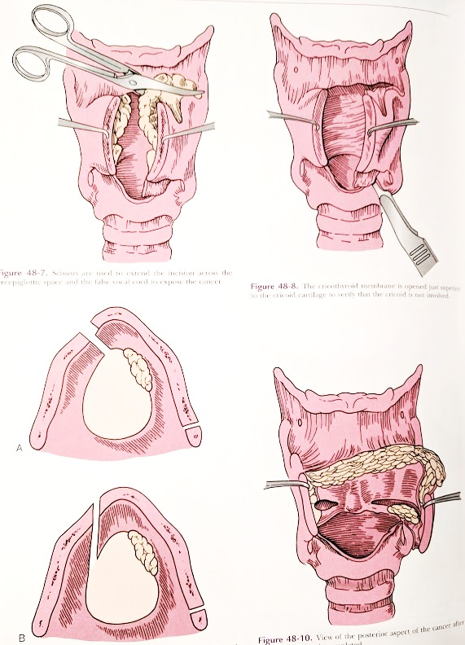
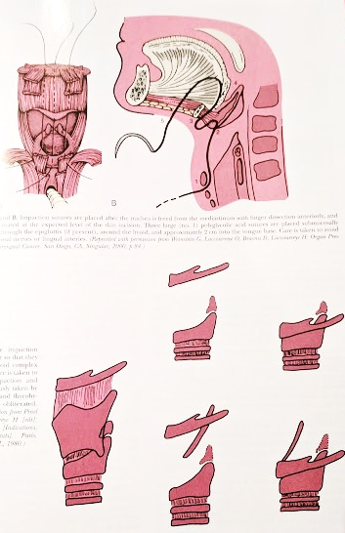
Open Partial Laryngectomy
Largely replaced by transoral surgery
Few Head and Neck Surgeons are trained in this technique
Horizontal partial laryngectomy
Vertical partial laryngectomy
?Longer procedure and recovery than transoral surgery
Function compromised in irradiated tissue
Myers, Eugene N, and Ricardo L. Carrau. Operative Otolaryngology: Head and Neck Surgery. Philadelphia: Saunders/Elsevier, 2008.

Slide 24
Indications for Total Laryngectomy
Primary treatment for advanced cancers of the larynx
Often with bilateral neck dissection for evaluate and treat regional spread (lymph nodes)
Often followed by radiation +/- systemic treatment within 6 weeks of surgery
Extent of resection is determined by disease
Radiation treatment is contraindicated
Patient preference
Salvage surgery
Prior treatment has failed and cannot be repeated
Prior radiation → poor wound healing and increased surgical site complications
Non-functional larynx
Tracheotomy and feeding tube dependence due to aspiration and airway obstruction
Osteoradionecrosis with severe pain

Slide 25
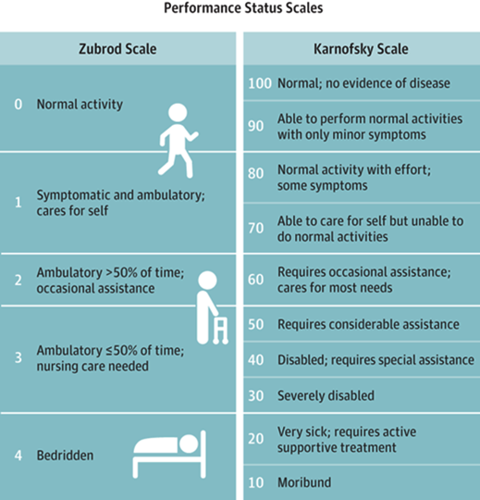
Pre-Operative Planning
Cancer staging
CT
PET/CT
MR
Multidisciplinary assessment
Assess and optimize nutrition
Poor nutrition increases risk of surgical complications
Address smoking cessation
Continued smoking → decreased survival
Substance abuse
Thyroid function
Psychosocial issues, social relationships
Functional status/Frailty assessment
Dental assessment
Any other systemic diseases (cardiac, pulmonary, hepatic…)
Pre-operative counseling and education with multidisciplinary team
West, H. Jin, J, Performance Status in Patients With Cancer. JAMA Oncol. 2015;1(7):998.

Slide 26
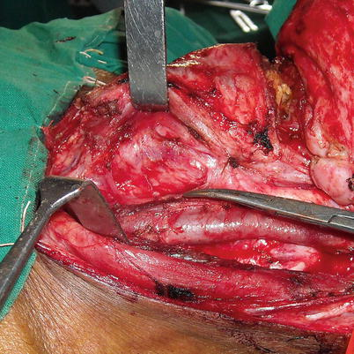
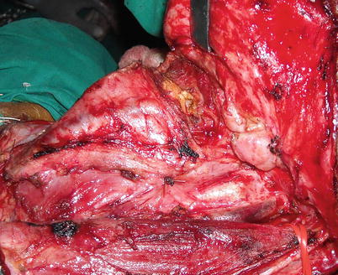
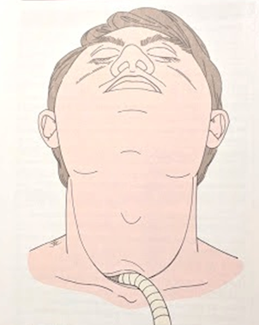
Total Laryngectomy
Trivedi N. Tumors of the Larynx and Hypopharynx. In: Atlas of Head and Neck Cancer Surgery. Springer, New Delhi 2015.

Slide 27
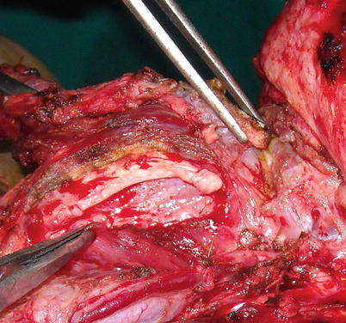
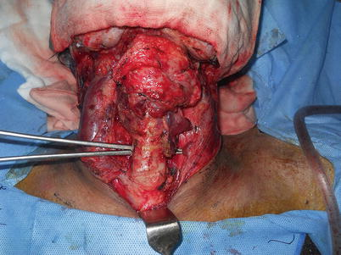
Total Laryngectomy
Trivedi N. Tumors of the Larynx and Hypopharynx. In: Atlas of Head and Neck Cancer Surgery. Springer, New Delhi 2015.

Slide 28
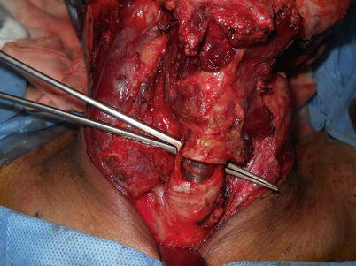
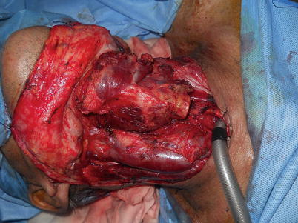
Total Laryngectomy
Trivedi N. Tumors of the Larynx and Hypopharynx. In: Atlas of Head and Neck Cancer Surgery. Springer, New Delhi 2015.

Slide 29
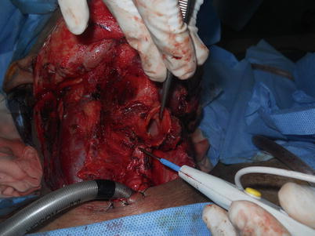
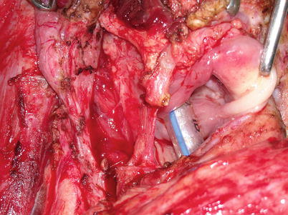
Total Laryngectomy
Trivedi N. Tumors of the Larynx and Hypopharynx. In: Atlas of Head and Neck Cancer Surgery. Springer, New Delhi 2015.

Slide 30
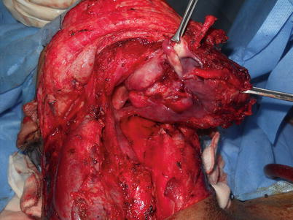
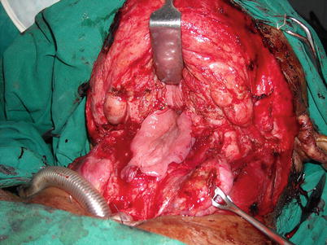
Total Laryngectomy
Trivedi N. Tumors of the Larynx and Hypopharynx. In: Atlas of Head and Neck Cancer Surgery. Springer, New Delhi 2015.
Myers, Eugene N, and Ricardo L. Carrau. Operative Otolaryngology: Head and Neck Surgery. Philadelphia: Saunders/Elsevier, 2008.

Slide 31
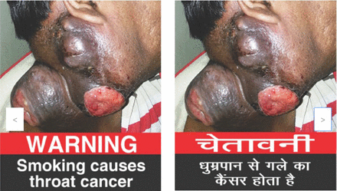
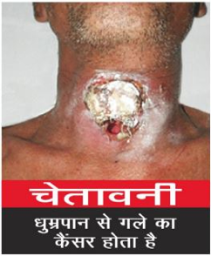
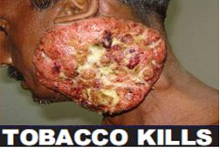
Resectability of Laryngeal Cancer
“Unresectable” (Stage T4b) Larynx Caner
Encasement (>270*) of the carotid artery
Invasion in the pre-vertebral space
Invasion of spine
Invasion of the skull base
Involvement of the brachial plexus (nerves to the upper extremity)
Mediastinal invasion
http://www.tobaccolabels.ca/countries/india/

Slide 32
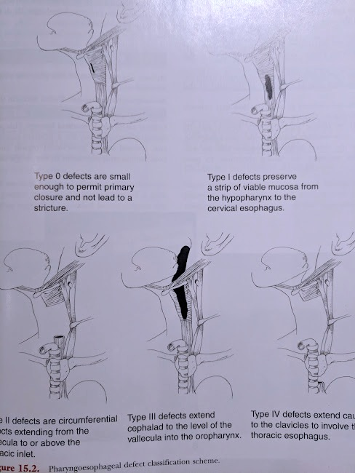
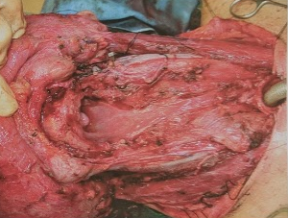
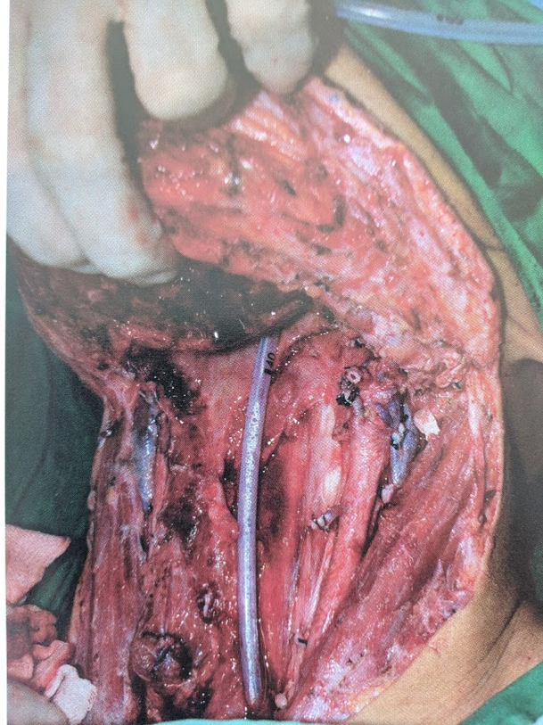
Classification of Defects
Partial laryngectomy
Total laryngectomy with endolaryngeal tumor
Total laryngectomy partial pharyngectomy
+/- External skin resection
Total pharyngolaryngectomy
Circumferential defect of pharynx
+/- External skin resection
Total pharyngolaryngectomy with glossectomy…
+/- External skin resection
Urken M, Multidisciplinary Head and Neck Reconstruction A DEFECT-ORIENTED APPROACH. LWW 2010.
Trivedi N. Tumors of the Larynx and Hypopharynx. In: Atlas of Head and Neck Cancer Surgery. Springer, New Delhi 2015.

Slide 33
Reconstruction
Primary closure of neopharynx
Endolaryngeal tumor
Patch flap
Hypopharynx involvement
Remnant strip of pharyngeal mucosa
Tubed flap
Pharyngolaryngectomy
External skin reconstruction
Tongue and oral cavity reconstruction
Salvage TL
On-lay or patch flap decrease fistula formation and promote healing if fistula occurs
https://clinicalgate.com/vocal-and-speech-rehabilitation-following-laryngectomy/
Urken M, Multidisciplinary Head and Neck Reconstruction A DEFECT-ORIENTED APPROACH. LWW 2010.
Bradley, P. Cancer of the Hypopharynx. Operative Techniques in Otolaryngology-Head and Neck Surgery Volume 16, Issue 1, March 2005,
Patel et. Al. Impact of Pharyngeal Closure Technique on Fistula After Salvage Laryngectomy JAMA Otolaryngol Head Neck Surg. 2013;139(11):1156-1162.
Myers, Eugene N, and Ricardo L. Carrau. Operative Otolaryngology: Head and Neck Surgery. Philadelphia: Saunders/Elsevier, 2008.

Slide 34
Reconstruction
Local (Pedicled) flap
Pectoralis flap
Supraclavicular island flap
Submental island flap
Microvascular reconstructive surgery with free tissue transfer
Anterior lateral thigh free flap
Radial forearm free flap
Rectus abdominis free flap
Jejunum free flap
Others
Visceral transposition
Gastric Pull-up
Colon Interposition
Kokot et al. The Supraclavicular Artery Island Flap in Head and Neck Reconstruction Applications and Limitations. JAMA Otolaryngol Head Neck Surg. 2013;139(11):1247-1255.
Chan, Richie & Chan, Jimmy. (2014). Deltopectoral Flap in the Era of Microsurgery. Surgery research and practice. 2014. 420892. 10.1155/2014/420892.
Bakshi A, Sugarbaker DJ, Burt BM. Alternative conduits for esophageal replacement. Annals of Cardiothoracic Surgery. 2017;6(2):137-143.
Urken M, Multidisciplinary Head and Neck Reconstruction A DEFECT-ORIENTED APPROACH. LWW 2010.
Bradley, P. Cancer of the hypopharynx. Operative Techniques in Otolaryngology-Head and Neck Surgery Volume 16, Issue 1, March 2005,

Slide 35
Cricopharyngeal Myotomy
Cricopharyngeal muscle spasm limits alaryngeal speech
Dilation and/or Botulinum toxin injections may decrease spasm
Cricopharyngeal myotomy
Cricopharyngeal muscle is cut after the larynx is removed
?Increased risk of anastomotic leak and fistula
https://clinicalgate.com/vocal-and-speech-rehabilitation-following-laryngectomy/

Slide 36
Primary TEP Placement
Relative Contraindications for Primary TEP
Separation of tracheal/esophageal party wall at site of TEP
Tubed flap reconstruction
Large patch reconstruction
Poor nutrition
Hypothyroidism
Poor quality of tissues
Poor prognosis
Inability to maintain or use TEP
https://www.atosmedical.com/product/provox-vega-puncture-set/

Slide 37
Post-Laryngectomy Eating
Timing and trial of eating by mouth after total laryngectomy is determined by the surgeon
Variable protocols; no conclusive evidence of the “best” protocol
Prior radiation
Type of defect and reconstruction
Nutrition
Tissue quality
Evaluation of leak or fistula
Clinical evaluation (physical examination, monitoring drain output, labs)
Blue dye test
Esophagogram
My “protocol”
Non-irradiated, primary closure; One week nothing by mouth then evaluate for leak
If no leak→ advance diet to liquid/puree
Others; patient and defect-driven; Minimum one week of nothing by mouth.
Irradiated with good nutrition and tissue quality; water and sugar-free and fat-free clear liquid POD 7 if no leak, advance POD 14

Slide 38
Pharyngocutaneous Fistulae
Connection or “hole” in neopharynx causing saliva leak
Occurs in 3-40% of total laryngectomy
Feeding tube dependence
Risk of life-threatening bleeding
Carotid blowout
Risk factors
Radiation
Chemotherapy
Advanced disease
Poor nutrition
Smoking
Hypothyroidism
Treatment
Local wound care
Irrigation
Packing
Wound vac
Surgery
Non-irradiated tissue transfer
Lack of vessels in the neck
Bohannon IA, Carroll WR, Magnuson JS, Rosenthal EL. Closure of post-laryngectomy pharyngocutaneous fistulae. Head & Neck Oncology. 2011;3:29.

Slide 39
Stricture of Neopharynx
Serial dilation
Boogie dilation
Balloon dilation
Often requires multiple procedures
Timing
Mature thick scar is not amenable to dilation
Rare, but life-threatening risk of perforation
Tubed flap microvascular reconstruction
Aforementioned surgical including fistula and poor wound healing
Tubed flap is adynamic (unlike the pharynx)
http://www.diversatekhealthcare.com/m-flex-blue-bougies/

Slide 40
Summary
Evaluation and treatment of laryngeal cancer is a multidisciplinary sport
Surgical and non-surgical treatment have varied side-effects and require rehabilitation
Patient factors and disease factors influence treatment recommendations
Research ongoing and our treatment paradigm will continue to change
Increased focus on function and survivorship
Questions?
Lenka.Stankova@UTsouthwestern.edu

Slide 41
References
Gray's anatomy : The anatomical basis of clinical practice. Forty-first edition./ editor-in-chief, Susan Standring; section editors, Neel Anand et al. Series: Gray's Anatomy: New York : Elsevier Limited, 2016.
Atlas of Head and Neck Cancer Surgery The Compartment Surgery for Resection in 3-D. Nirav Trivedi. Springer India 2015
Bakshi A, Sugarbaker DJ, Burt BM. Alternative conduits for esophageal replacement. Annals of Cardiothoracic Surgery. 2017;6(2):137-143. doi:10.21037/acs.2017.03.07.
Urjeet A. Patel, ; Brian A. Moore, ; Mark Wax; et al Eben Rosenthal,; Larissa Sweeny,; Oleg N. Militsakh,; Joseph A. Califano,; Alice C. Lin,; Christian P. Hasney,; R. Brent Butcher,; Jamie Flohr,; Demetri Arnaoutakis,; Matthew Huddle,; Jeremy D. Richmon, Impact of Pharyngeal Closure Technique on Fistula After Salvage Laryngectomy JAMA Otolaryngol Head Neck Surg. 2013;139(11):1156-1162.
https://clinicalgate.com/vocal-and-speech-rehabilitation-following-laryngectomy/
Kokot et al. The Supraclavicular Artery Island Flap in Head and Neck Reconstruction Applications and Limitations. JAMA Otolaryngol Head Neck Surg. 2013;139(11):1247-1255.
Urken M, Multidisciplinary Head and Neck Reconstruction A DEFECT-ORIENTED APPROACH. LWW 2010.
Bradley, P. Cancer of the Hypopharynx. Operative Techniques in Otolaryngology-Head and Neck Surgery Volume 16, Issue 1, March 2005,
Patel et. Al. Impact of Pharyngeal Closure Technique on Fistula After Salvage Laryngectomy JAMA Otolaryngol Head Neck Surg. 2013;139(11):1156-1162.
American Head and Neck Society www.ahns.info

