Slide 1
Oral Hygiene and Dental Care for the Laryngectomee Thomas Schlieve DDS, MD, FACS

Slide 2
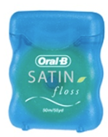
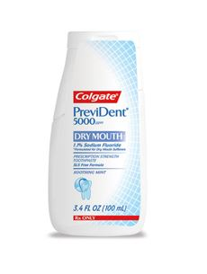
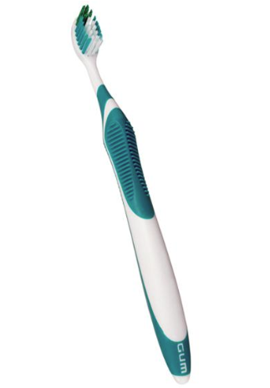
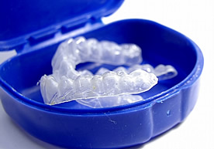
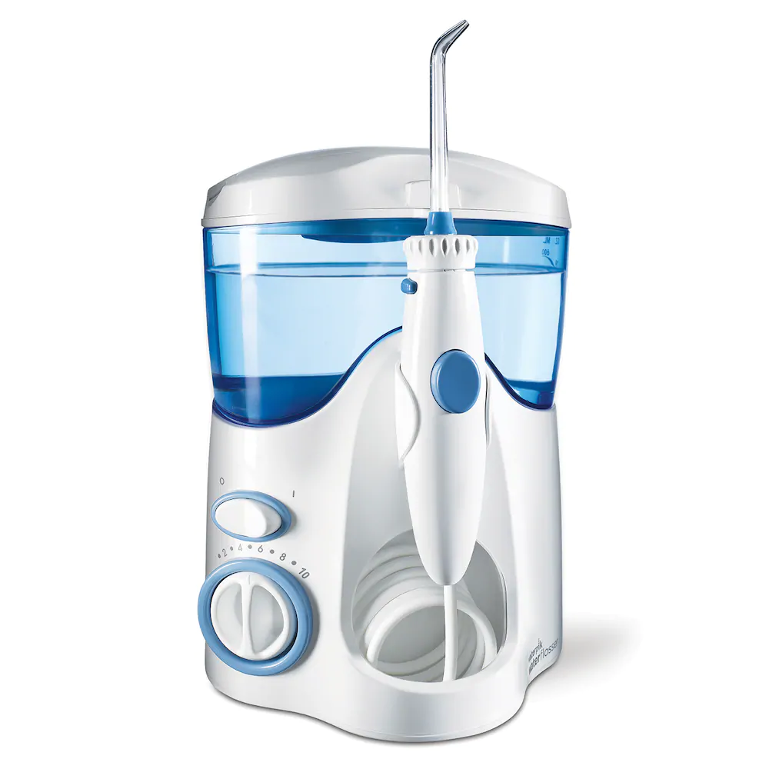
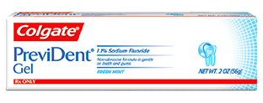
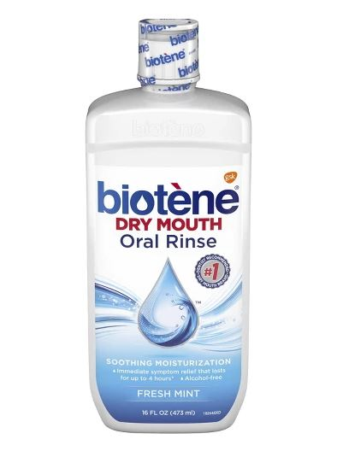
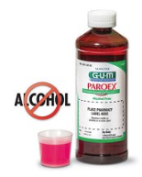
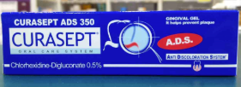
Outline
Why does it matter?
Osteoradionecrosis
Radiation
Limited Opening
Acid reflux
Saliva
Prevention & Treatment
Notes:
Prevident Booster Plus with tricalcium phosphate

Slide 3
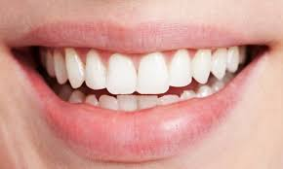
Why does it matter?
Evidence support
Teeth is better than no teeth
Function, self-esteem, comfort, cosmetics
Pain
Infection
Cost!
Prevention versus treatment
$104-$122 Cleaning
$50 supplies q3 months
$1,500-$5,000 Denture
Replacement, relining necessary (4-6 years)
48% dissatisfied, 5% completely satisfied
$1,362-$1,570 crown
$120 emergency exam
$200 extraction
$175-$450 filling
Osteoradionecrosis...
Notes:
Most expensive TP is $35, lasts 3 months.
Fluoride rinses, CHX- total of $50 q3 months.

Slide 4
Why does it matter?
Osteoradionecrosis
60% of H&N cancer patients receive radiation
Incidence of 5-15% for ORN
Incidence of 65,000 H&N cancers/ year
3,250 ORN cases/yr
Risk is lifelong
Mean 3 years after treatment
Can be severely debilitating
Notes:
Magnet for these difficult cases

Slide 5
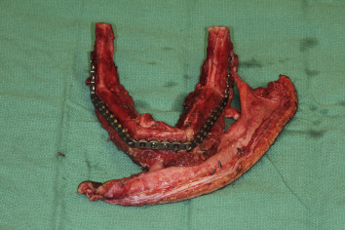
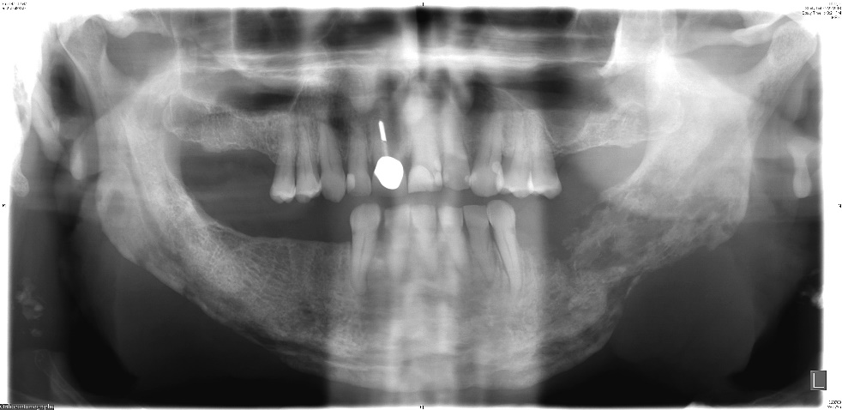
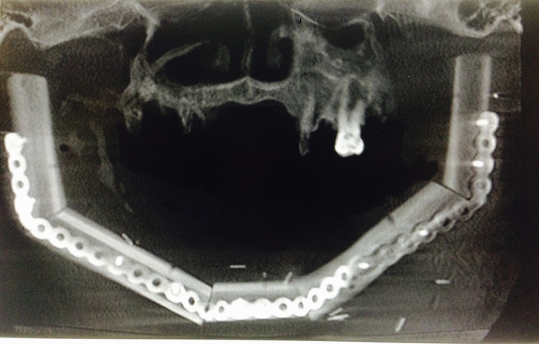
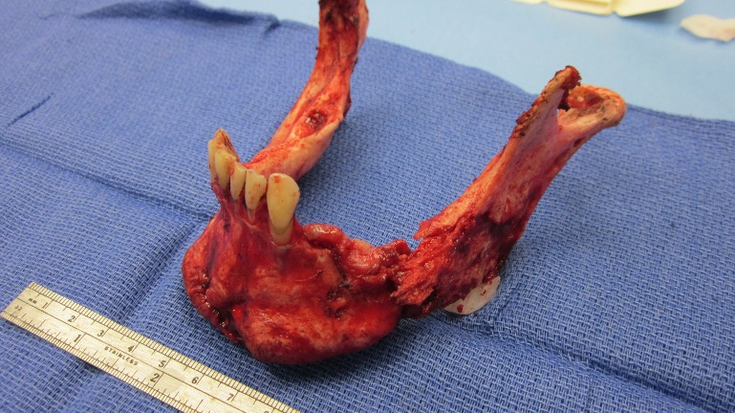
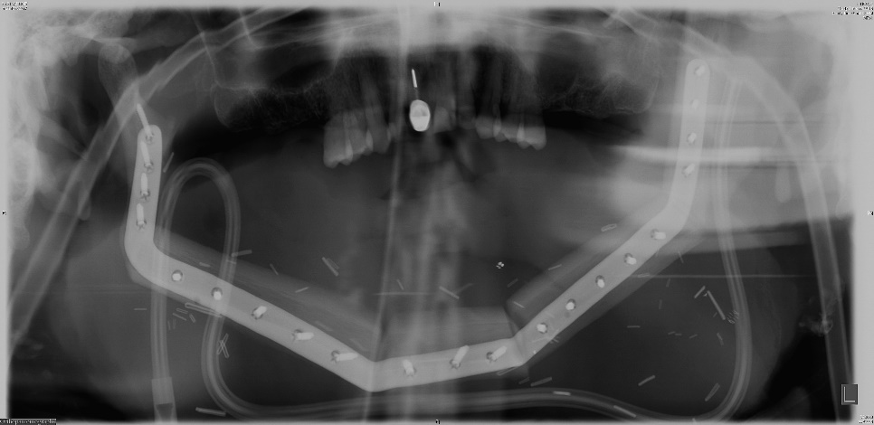
Morbidity

Slide 6
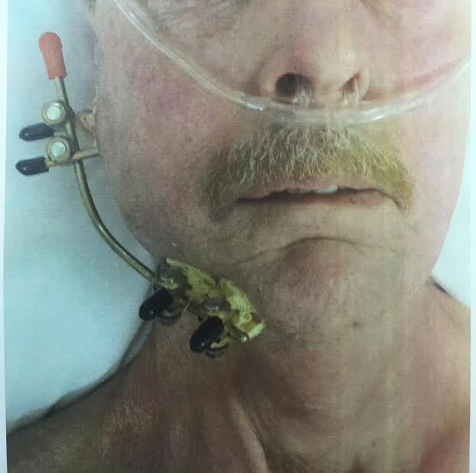
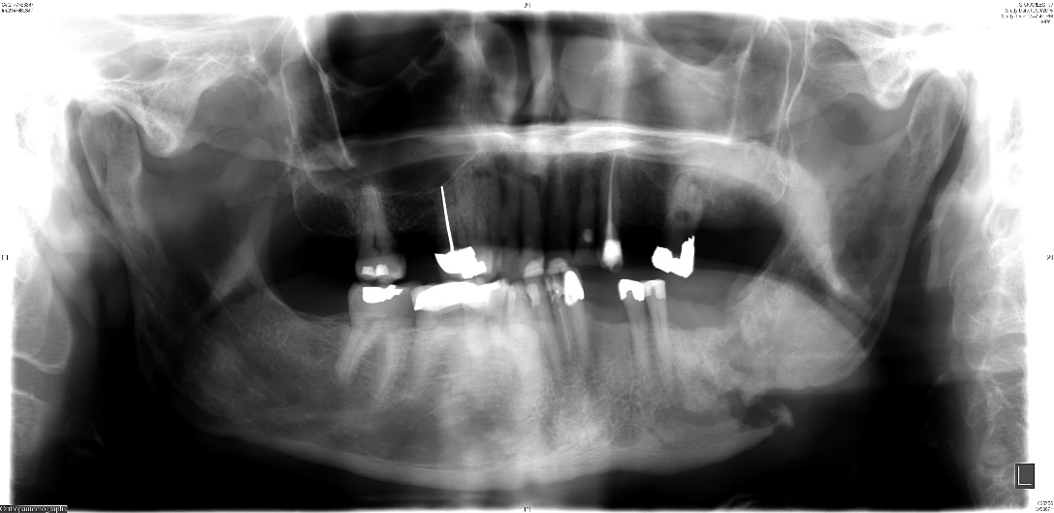
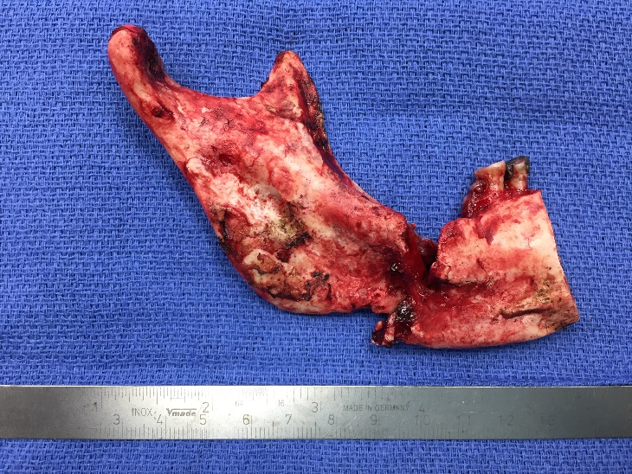
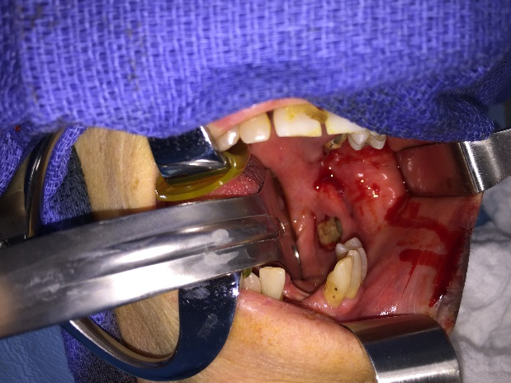
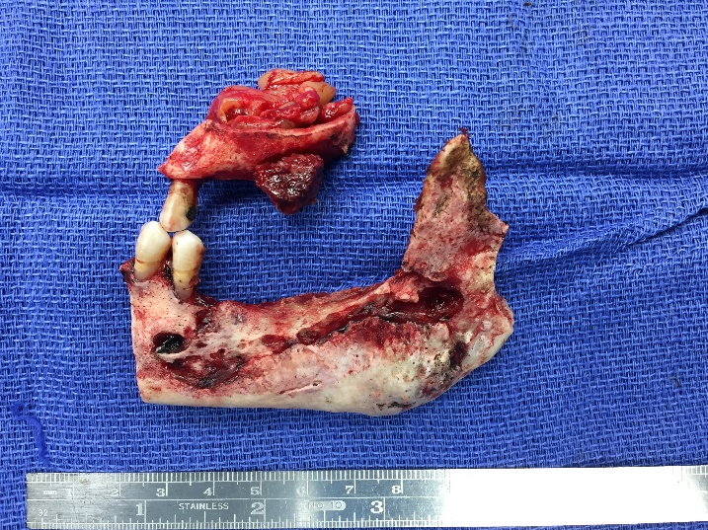
Morbidity

Slide 7
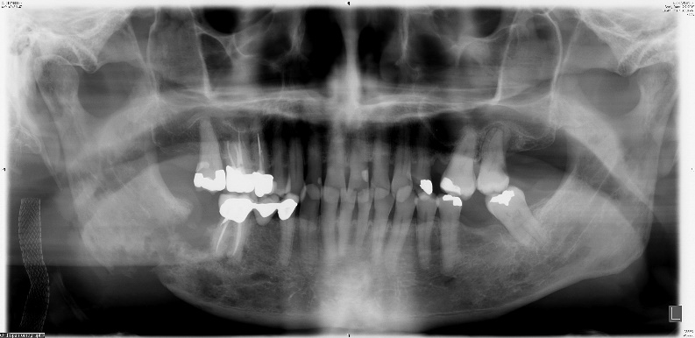
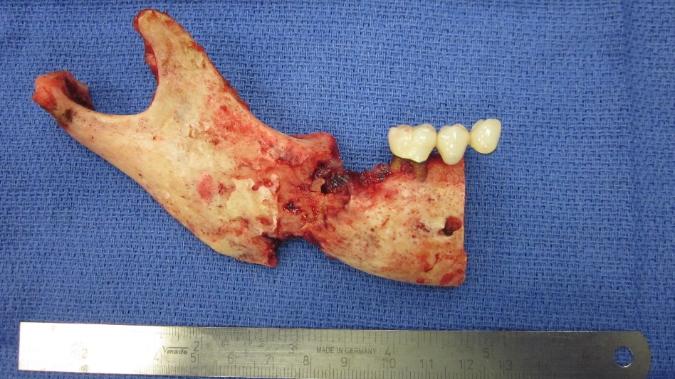
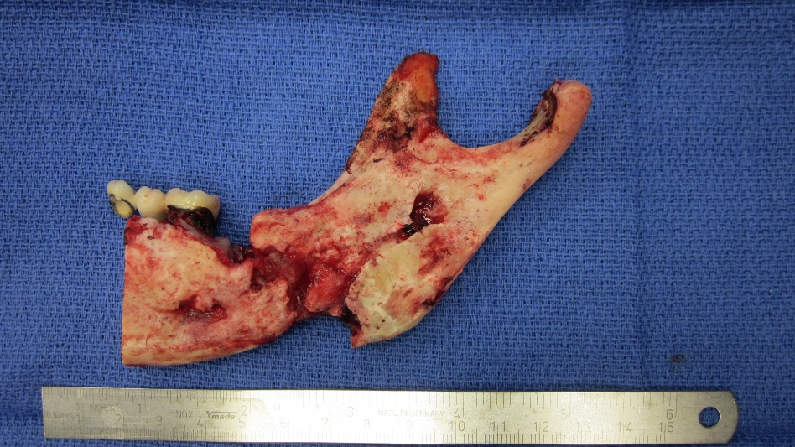
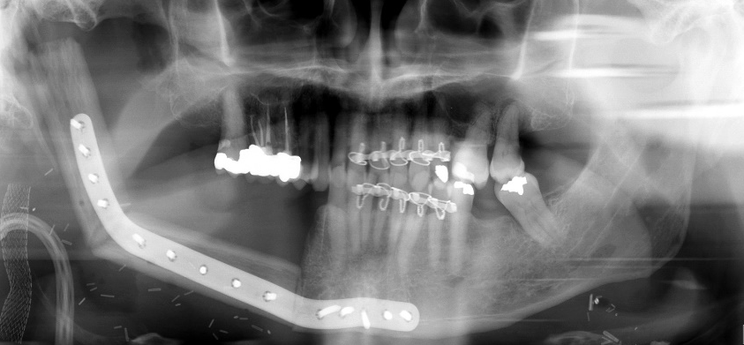
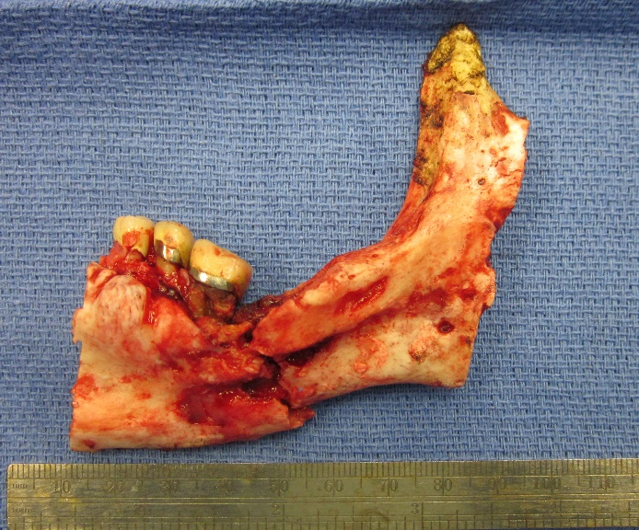
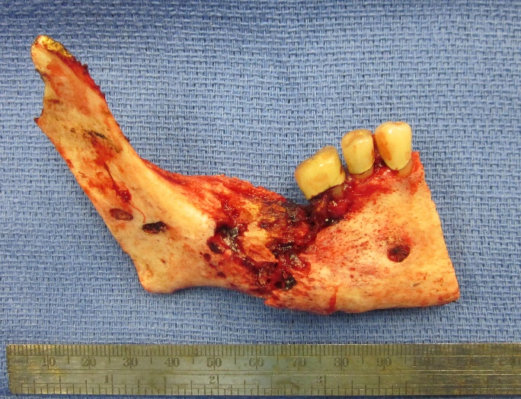
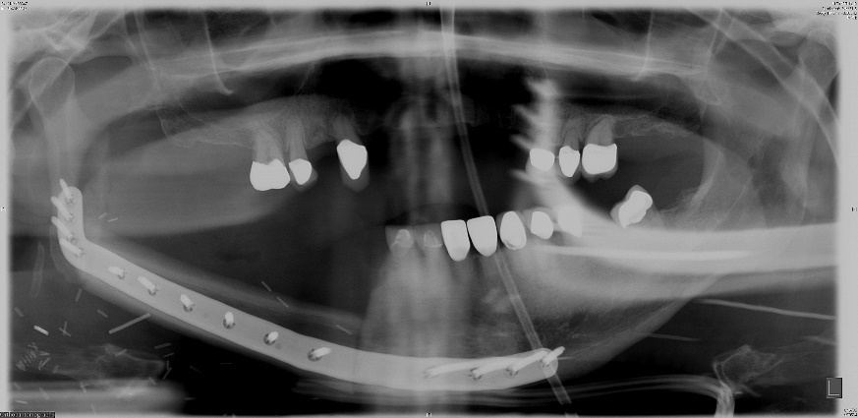
Morbidity

Slide 8
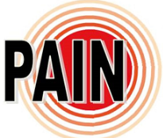
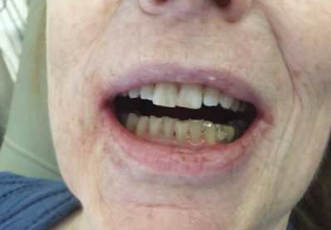
Osteoradionecrosis Signs/Symptoms
Symptoms
Pain
Paresthesia
Dysesthesia
Trismus
Signs
Ulceration of mucosa
Exposed bone
Malodor
Fracture
Fistula
Ulceration of skin

Slide 9
Osteoradionecrosis- Defined
Regaud 1922
Radiation Osteitis
Marx 1983
An area >1cm of exposed bone in field of XRT that fails to heal in 6 months
Epstein
Ulceration or necrosis of mucous membrane with exposure of bone >3 mo
Marx, Johnson 1987
Non-viable exposed bone which fails to heal without intervention
Definition
Exposed, devitalized bone
Radiation field
Failure to heal
3-6 months (chronicity)
No evidence of tumor!
Dx of exclusion
Can be superficial or deep
Active progression versus stable

Slide 10
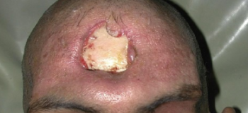
Osteoradionecrosis
Epidemiology
Incidence varies
Depends on definition
2-15%
Pre 1960 17-37%
Orthovoltage-Megavoltage
Mandible to maxilla 24:1
Total radiation dose
>50Gy, >60Gy, >70Gy
Increases with Chemo/XRT
Decreases with IMRT
Other sites
Skull
Chest wall
Breast Ca
Rib, sternum
Pelvis
Vertebra

Slide 11
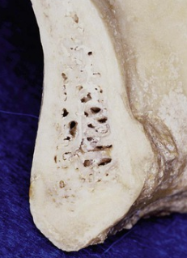
Osteoradionecrosis
Mandible
Poorly vascularized
Inferior alveolar- teeth
Endosteal to Subperiosteal plexus of vessels
High Density
More dense structures absorb higher dose XRT
Most tumors are peri-mandibular
Tongue, FOM, Tonsil, Larynx

Slide 12
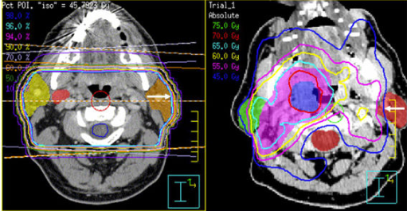
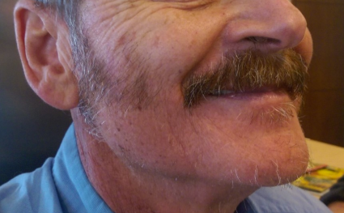
Osteoradionecrosis
Radiation
Higher total dose increases risk
>60Gy
Tumor close to bone
Brachytherapy
IMRT decreases risk
Reduced total volume to bone
60Gy- permanent hair loss

Slide 13
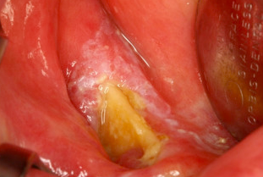
Osteoradionecrosis
Risk factors
Poor oral hygiene
Dental extractions
Tobacco/Alcohol
Denture pressure sores
Comorbidity

Slide 14
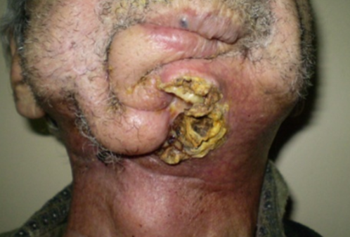
Management of ORN
HBO
Hyperbaric Oxygen
PENTOCLO
Pentoxifylline, Vitamin E
SURGERY
Cochrane Database Review 2016
Only included RCT’s
HBO vs No HBO
14 trials, N=753
Statistically significant improvement in mucosal coverage, decrease in wound breakdown, increased chance of cure/improvement following surgery (flaps, resection), and improved probability of healing irradiated tooth sockets following dental extractions.

Slide 15
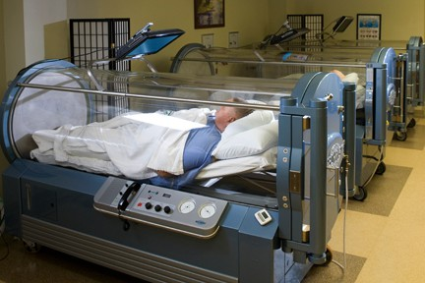
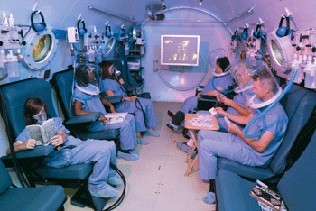
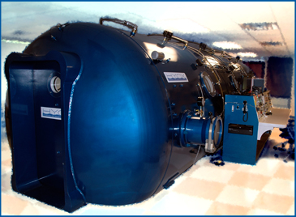
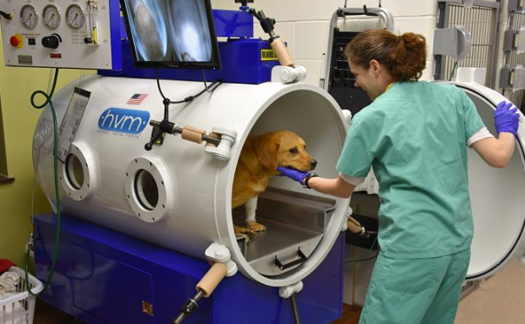
Hyperbaric Oxygen Therapy

Slide 16
Oral Effects of Radiation
Radiation
Dose dependent, site dependent
Reduces blood supply
Poor tissue healing, osteoradionecrosis
Does not affect teeth
Adult teeth are radiation resistant
Taste
Taste buds die
120 days
25tsp of sugar in 1 cup
Irreversible damage to salivary glands
Single dose of 1Gy can cause damage
24Gy Parotid
39Gy Submandibular
Glands exquisitely sensitive
Poor regenerative capacity
Xerostomia
“Dry Mouth”
Notes:
Some patients have almost zero saliva
patients can barely detect equivalent of 25 teaspoons of sugar in a cup of tea. Usually transitory with recovery at 120 days

Slide 17
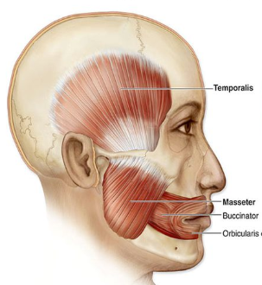
Effects of Radiation
Limited opening
Trismus
Radiation induced fibrosis
Muscles involved in oral function
Progressive
Prevention is key
“Sets up like Cement”

Slide 18
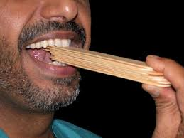
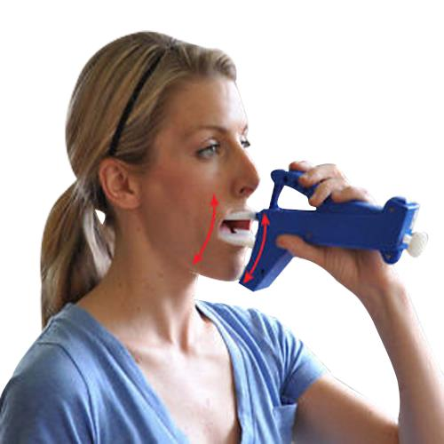
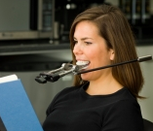
Effects of Radiation

Slide 19
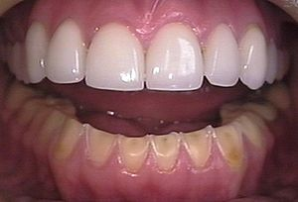
Acid Reflux
Laryngectomy
Removes UES
Cricopharyngeus muscle
Always open
Reflux of stomach contents
LES
¾ of people over 70
Acid erosion
Decreased saliva to buffer
Weakens enamel
Antacids
PPI
Avoid lying down flat
After eating
Upright 60 min
3 hours before laying down
Smaller meals
Avoid coffee, chocolate, alcohol, peppermint, large fatty meals
Weight loss
Smoking cessation
Relaxation
Elevate bed
6-8 inches
45 degree
Bend at the knees
Notes:
¾ of people over 70 have hiatal hernia and reflux

Slide 20
Acid Reflux

Slide 21
SALIVA

Slide 22
SALIVA
Radiation

Slide 23
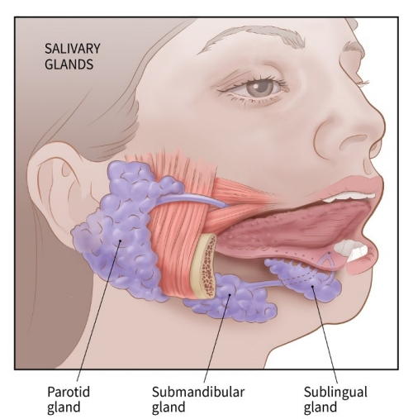
Saliva
Saliva
1000-1500mL per day
34oz, 3 cans of Coke
Parotid
25%
Submandibular
70%
Sublingual
4%
Minor
1%
Notes:
Some patients have almost zero saliva

Slide 24
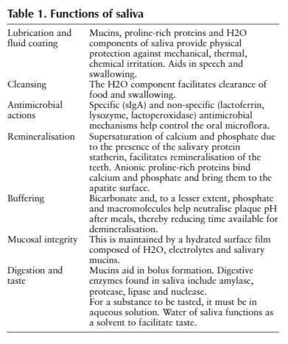
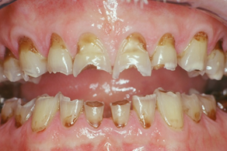
Saliva
Saliva
Serous
Stimulated, Sensitive
Watery
Mucous
Resting, Resistant
Thick, Viscous, Ropy, Sticky
Too much saliva sensation

Slide 25
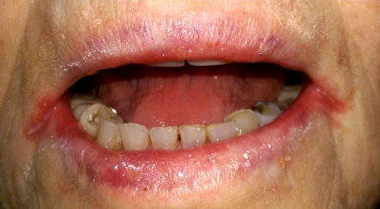
Saliva
Saliva
Water, electrolytes, protein, carbohydrates, immune function
Immune
IgA, Histatins, Immunoglobulins
Antibacterial, antifungal
37% of H/N XRT Candidiasis
Lubrication
Swallowing
Food
Protection
pH buffering
Bicarbonate
Promotes remineralization
Saliva
Taste
Need water, salivary enzymes
Also need smell for taste!
Cleaning effect
Washes away food debris
Notes:
Lubricates mucosa, food, eases swallowing, begins breakdown of food. Amylase, protease, lipase, nuclease.
Mechanical, chemical, thermal irritation
Calcium and Phosphate remineralization, proteins bind to Ca/Phos and bring to tooth surface to bind

Slide 26
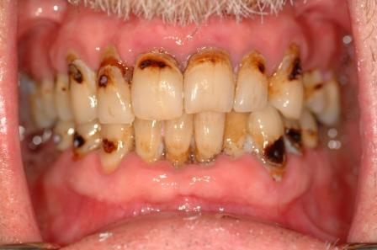
Saliva
Volume
Prone to injury
Infections- candida
Decreased buffering capacity >45%
Acid environment
Decreased “healing”
Remineralization
Composition
Decreased pH
More acidic
Less bicarbonate
Acidogenic bacteria
Strep Mutans
Lactobacilli
MD Anderson Study
Fewer “good” bacteria
#1 Reason for tooth decay
Notes:
Main Cause of Decay-
MD Anderson Study- compared fluoride gels, different interventions to a control group of cancer patients prior to treatment- ALL had increases in cariogenic bacteria after XRT. And at the expense of noncariogenic bacteria.
Normally when acid solutions contact enamel this is reversed by a continuous bathing of enamel in calcium rich saliva.
Less bicarbonate than normal. Decreased buffering capacity by 45%. PRIME REASONE FOR XRT DECAY. Decreased buffering leads to demineralization and lack of ability to repair this.

Slide 27
Prevention
What is a Cavity?
It is not caused by sugar
It IS caused by bacteria
That LOVE sugar
That LOVE acid
Caries
Demineralization
Acid
Erodes the enamel
Creates a “cavity”

Slide 28
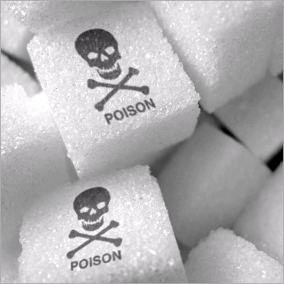
Prevention
Diet Modification
Sugar
Encourages cariogenic bacteria
ACID
Yeast colonization
20-30 minutes to recover
Sip all day, get Decay
Replace with xylitol
Or other sugar substitutes

Slide 29
Prevention
Beet sugar
Blackstrap molasses
Brown sugar
Buttered syrup
Cane juice
Cane sugar
Caramel
Carob syrup
Castor sugar
Coconut sugar
Confectioner’s sugar
Date sugar
Demerara sugar
Evaporated cane juice
Florida crystals
Fruit juice/concentrate
Golden sugar
Grape sugar
Honey
Icing sugar
Invert sugar
Maple syrup
Molasses
Muscovado sugar
Panela sugar
Raw sugar
Refiner’s sugar
Sorghum syrup
Sucanat
Treacke sugar
Turbinado sugar
Yellow sugar
Diet Modification
Sugar
Sucrose, fructose
High fructose corn syrup
Agave nectar/syrup
Galactose
Barley malt
Brown rice syrup
Dextrin
Dextrose
Diastatic malt
Ethyl maltol
Glucose
Lactose
Malt syrup
Maltodextrin
Maltose
Rice syrup

Slide 30
Prevention
Remineralization
Fluoride
Saliva
Chewing gum, lozenges
Sugar free, xylitol
Fibrous vegetables and fruits
Hard cheese
Calcium, Phosphate, pH
Substitutes
Tricalcium phosphate
Prevident 5000 Booster Plus
MI Paste
Recaldent
Milk allergy
Notes:
Stimulated saliva contains higher levels of bicarbonate buffers and is more supersaturated with hydroxyapatite than resting saliva.28Prolonged salivary stimulation by use of chewing gum increases the bicarbonate levels in saliva, preventing plaque pH from falling, and raises the potential for remineralisation
Chewing hard cheese, which is rich in nitrogenous substrates, also elicits a rapid rise in plaque pH following a sucrose rinse. It is believed the proteolysis of cheese proteins such as casein contributes to this pH-elevating effect. Cheese chewing also raises plaque calcium and phosphate levels and facilitates enamel rehardening
Stimulate saliva with sugar free, xylitol drops/candies. Frequent chewing of sugarless gum over a period of two weeks has been shown to increase parotid salivary output and increase the pH and buffer capacities of parotid and whole saliva

Slide 31
Prevention
Acid
We need a buffer
Salt/Soda rinse
Baking soda 1 tsp
Salt ½ tsp
12oz warm water
Baking Soda Paste
Chewing gum
Xylitol (candies, gum)
2 weeks
Increased saliva
Increased pH
Water bottle
Evidence benefit
Decontamination
Brushing
Twice daily minimum
After meals
2-3 min
Soft brush
Every surface and tongue
Flossing
Waterpik
Frequent dental visits
Pre, 3 weeks, 6 weeks, 3 months, 6 months then 3-6 months intervals lifelong
Notes:
Stimulate saliva with sugar free, xylitol drops/candies
Frequent chewing of sugarless gum over a period of two weeks has been shown to increase parotid salivary output and increase the pH and buffer capacities of parotid and whole saliva

Slide 32
Prevention
Pre Treatment
Might be the most important visit
Sets expectations
Treat existing disease
Mod-severe periodontal disease = extract
Assess dental IQ
Begin prevention
Evidence supports
Retain teeth
Make custom tray
Fluoride
1.1% neutral sodium fluoride gel or 0.4% stannous fluoride gel
Chlorhexidine gel

Slide 33
Prevention
Fluoride
Stannous fluoride 0.4%
Adv: Cariostatic, antimicrobial, works against root surface decay, arrest of incipient decay
DisAdv: Metallic taste, can cause staining and sensitivity, low pH
Apply in tray for 5 minutes
Do not rinse for 30-45 min
Meticulous hygiene alone was insufficient. Fluoride made the difference. Dreizen et al.
High fluoride RX toothpaste
Caution flavoring and SLS
Prevident dry mouth
Sodium fluoride 1% gel
Adv: Neutral pH, no sensitivity, pleasant taste
DisAdv: Not as effective as SnF for antimicrobial activity
Acidulated phosphate gel 1%
Adv: Taste, no sensitivity
DisAdv: Requires low pH to be effective, etches the tooth, can damage restorations in teeth
Notes:
sodium lauryl sulfate can be irritating in xerostomia

Slide 34
Prevention
Chlorhexidine (CHX)
Alcohol free version only
CHX and fluoride combination proven effective.
CHX kills bacteria, yeast, fungus
Don’t use with Nystatin, binds and makes both ineffective.
Rinses, gels.
Gel more effective
Lip Care
Prevent drying, cracking
Predispose to fungal infection

Slide 35
Prevention
Saliva substitutes
Water
Biotene
Lactoperoxidase, lysozyme and lactoferrin
Shown to relieve subjective oral symptoms in most xerostomic patient
No changes in microflora
SalivaMAX
Supersaturated calcium phosphate powder
Dissolve in water
RX only

Slide 36
Prevention
Saliva substitutes
Water
Palliative medical therapy
Pilocarpine (Salagen) 5mg, q4-q8
Cevimeline (Evoxac) 30mg, q8, newer, fewer side effects
Side effects
Miosis, flushing, bradycardia, bronchospasm, increased bronchial secretions, involuntary urination and/or defecation, sweating, lacrimation, salivation, hypotension and seizures.
Contraindicated:
Glaucoma, asthma, liver dysfunction
Caution:
Cardiovascular disease
Notes:
Pilocarpine (Salagen)
Cevimeline (Evoxac) newer

Slide 37
Treatment of Decay
At the Dentist:
Fillings are better than crowns
Amalgam (silver) is better than composite (tooth color)
Light activated glass ionomer good for non-chewing surfaces (release fluoride and uptake fluoride, tooth color)
Radiation
Wait 6 months to 1 year before new dentures or partials are made.
Dentures out during therapy most of the time.

Slide 38
Treatment of Decay
Different tooth surfaces than usually expected
Smooth surfaces.
Rapid progression.
Circumferential caries at CEJ.
More similar to acid related decay.
Makes repair more difficult.

Slide 39
Replacement of Teeth
Dental Implants
92% success @ 10 years
Still require maintenance/cleaning
Dental Bridge
10-15 year lifespan
Denture/Partial
Require reline every 5 years
Remake every 10-15

Slide 40
Replacement of Teeth
Dental Implants

Slide 41
Questions? Thomas Schlieve DDS, MD, FACS Thomas.Schlieve@utsouthwestern.edu

