Slide 1
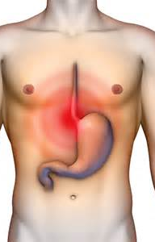
Acid Reflux and You: An Update
Katrina M. Jensen, M.A., CCC-SLP
Director, Rehabilitative Services
Advanced Head & Neck Rehabilitation Center of Texas;
Head & Neck Cancer Center of Texas
Dallas, Fort Worth &
Colleyville, TX

Slide 2
Disclosures
• Capital Interest and Salary, Advanced Head & Neck Rehabilitation Center of Texas
• Clinical Consultant, Atos Medical
• Clinical Consultant, Tactile Medical
• Clinical Consultant, Medtronic, GI Division
• Protocol 8030 Collaborative, Vanderbuilt University

Slide 3
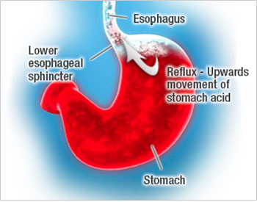
What is Reflux?
Reflux: Gastric (stomach) contents that pass retrograde from the stomach into the esophagus and possibly to the level of the pharynx.²
Acid Reflux: Refluxate with a pH <4.0
Weakly-Acidic Reflux: Refluxate pH 4.1-7.9

Slide 4
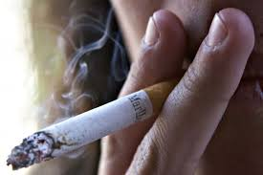
What Causes Reflux?
Genetics
Hereditary component
Hiatal Hernia
Causes displacement of LES
Smoking/Tobacco History
Long-term nicotine use
COPD

Slide 5
Hiatal Hernia
A portion of the stomach is pushed above the diaphragm, resulting in altered position and posture of the LES.
Increases pressures within the stomach

Slide 6
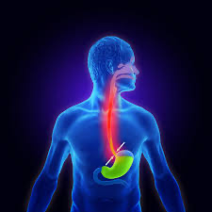
Reflux Associated Morbidities^{1,2,3}
Esophagitis
Stricture
Achalasia
Esophageal Webbing
Cancer
TEP complications in laryngectomees

Slide 7
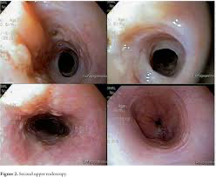
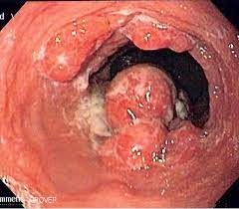

Slide 8
Laryngectomy Changes that Implicate Reflux
Post-operative changes in deglutition process can contribute to increased reflux incidence in this population.^{7,8,9}
Altered esophageal posture
Increased air volumes are swallowed
Both esophageal speakers and those with TEPs have increased intrathoracic pressures while speaking.

Slide 9
Laryngectomy Post-Operative Deglutitive Changes
Reduced pharyngeal pressures driving bolus into esophagus.
Loss of subglottic pressurization translates into diminished negative esophageal pressures.
These factors combine to reduce the distal contractile integral (force of the bolus as it enters the stomach).

Slide 10
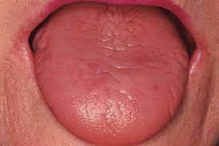
Post-Radiation Implication on Reflux
Evidence suggests the xerostomia many patients experience secondary to radiotherapy effects, may contribute to the increased clinical manifestations of reflux in this population due to the diminished neutralizing effects of saliva as a protective element against reflux damage to affected structures. ⁹

Slide 11
Xerostomia and the Bicarbonate Effect
Majority of laryngectomees have a history of external beam radiation with a very common side-effect of xerostomia (dry-mouth).
Saliva has a high pH which serves to dilute the low pH of gastric refluxate.
This could mean tissues are exposed to higher levels of acidity than the general population, increasing risk for reflux-associated morbidity.⁹

Slide 12
TL Not Well Studied
Limited research has been conducted specific to reflux in the laryngectomized population.
Available research has been specific to complications, although the incidence and severity in this population is not well documented.

Slide 13
AHNRCT & HNCCT Ongoing Research
Conducting esophageal manometry and 24 hr dual-channel pH-Z monitoring since November 2014.
HNCCT has one of the largest local laryngectomy populations in the country.
Now able to directly compare populations with uniform treatment protocols.

Slide 14
AHNRCT Patient Data
672 Total Patients:
530 Non-laryngectomy
165: history of H&N cancer + radiation
29: history of H&N cancer, no radiation
336: no history of H&N cancer
142 total laryngectomy
123 had history of radiation

Slide 15
Test Parameters
All patients had been diagnosed with reflux prior to testing.
All patients are required to discontinue acid suppressant medication. This is verbally verified before testing.
All patients are asked to continue normal activity with probe in place.

Slide 16
DeMeester Score
Number of reflux events in 24 hrs
Number of long refluxes
Longest reflux event
Time below acid threshold (%)
Upright time below acid threshold (%)
Supine time below acid threshold (%)
Normal Score: <14.7

Slide 17
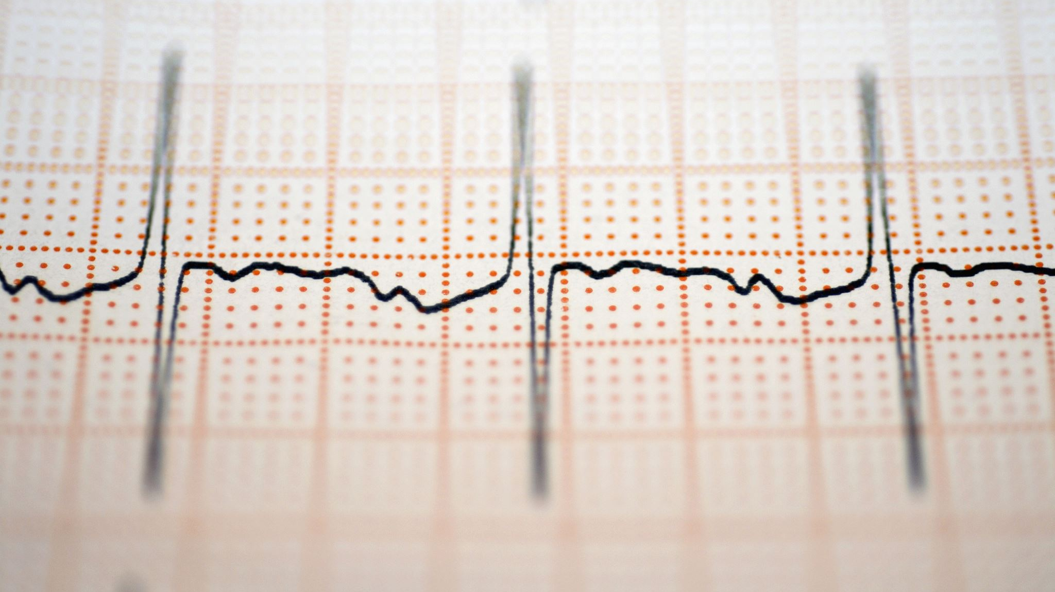
Impedance Testing
Detects electrical impedance within the esophagus. A significant drop in impedance translates into fluid/refluxate within the column. pH levels are then cross-referenced.
Runs simultaneous to the pH monitor.

Slide 18
Current Data
Non-H&N Cancer Population (GERD)
Mean DeMeester: 34.6
Mean weakly-acidic events (occurrence): 47
Head & Neck Cancer Population (non-TL)
Mean DeMeester: 74.7
Mean weakly-acidic events (occurrence): 88

Slide 19
Laryngectomy Data
Mean DeMeester: 107.1
01
Mean weakly-acidic events (occurrence): 187
02
Mean XBRT DeMeester: 134.2
03
Mean DeMeester no XBRT: 89.2
04

Slide 20
So What’s the Big Deal?
In the post-laryngectomy population, reflux has been shown to contribute significantly to tracheoesophageal prosthesis (TEP) complications, including shortened device life, granulation tissue formation, voicing difficulties and peri-prosthetic leakage (leakage around the TEP).^{10,11}
In these cases, use of a proton pump inhibitor (PPI) has been shown to have a positive impact on such complications, reducing both the incidence as well as severity of such manifestations. ^{10,11,12}

Slide 21
Implications
In 2012, Jensen et. al., suggested fundoplication surgery as an effective means of controlling reflux associated morbidities in the TEP population.¹⁶
Pre-dated current data and Linx procedure.
More data is needed regarding reflux associated morbidity in the head & neck cancer population.
Alternate control protocols may be warranted.

Slide 22
Hiatal Hernia Repair & Fundoplication
87% of patients with pathologic reflux have a hiatal hernia.
Hiatal hernia repair alone is effective in eliminating reflux in 27-36% of patients.
Hiatal hernia repair with fundoplication is effective in eliminating 87-93% of GERD 12 mo post-surgery.
25-40% recurrence of hiatal hernia after 3 years with fundoplication

Slide 23
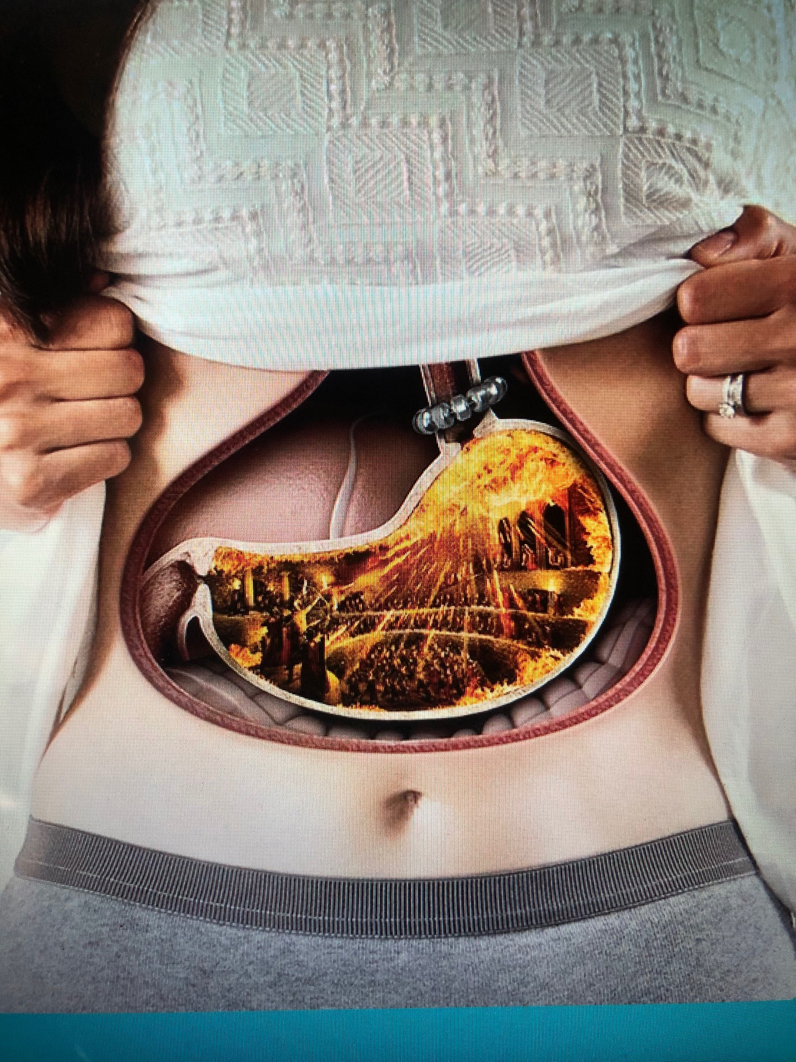
The LINX Procedure
The LINX procedure is an alternative to fundoplication, utilizing magnetic sphincter augmentation, that entails a minimally invasive laparoscopic implantation of a small device made of interlinked titanium beads with magnetic cores, which prevents reflux by augmenting the esophageal sphincter’s barrier function. ¹⁹

Slide 24
How LINX Works…
Opens in response to 28mmHg pressure
Encapsulates within the extrinsic esophageal lining 10-14 dys post-operatively.
Allows for gastric venting (belching) as well as vomitting.

Slide 25
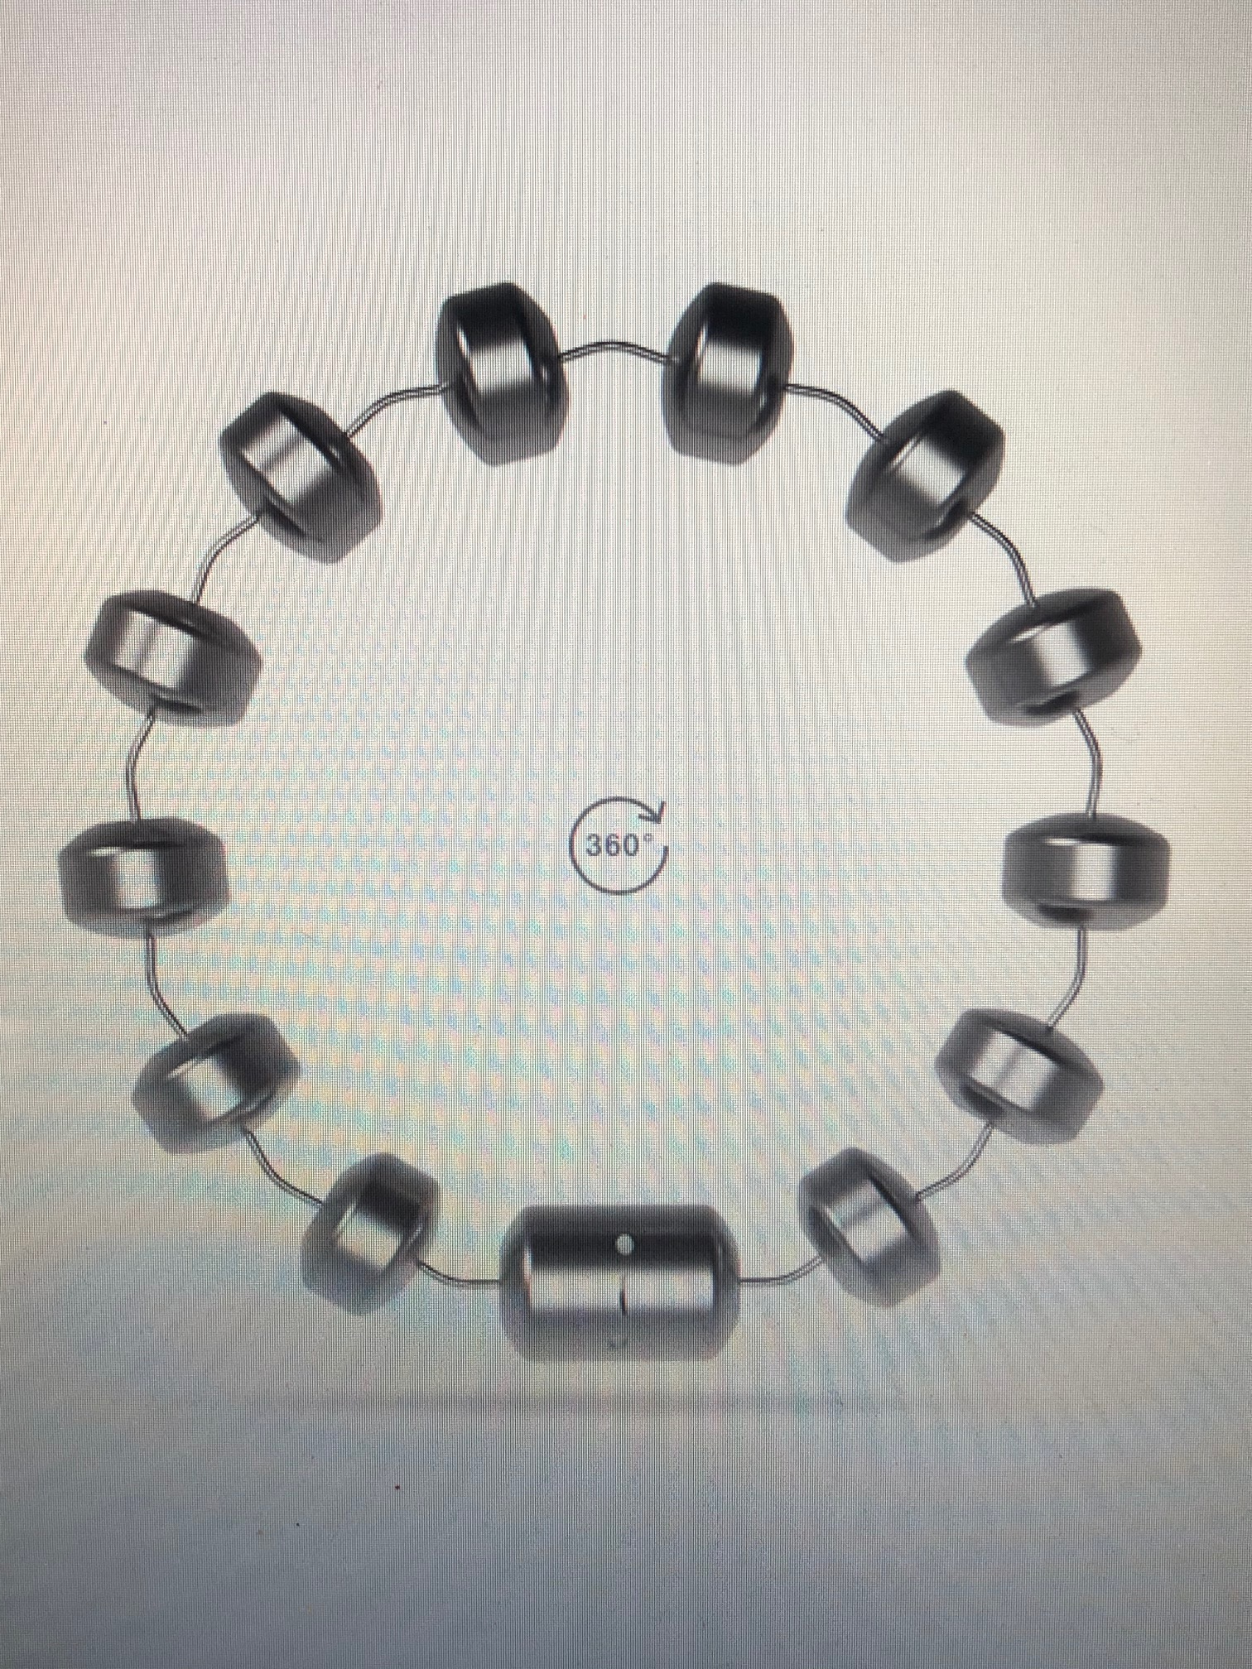
How LINX Works…

Slide 26
Linx Candidacy
Must have good esophageal function (Need DCI within normal limits).
Must have BMI<35
No metal allergy

Slide 27
Encouraging Horizons
7 years AHNRCTdata:
387 patients
2 hiatal hernia recurrence
94% no longer using PPIs
Average 37% increase TEP lifetime
<10% incidence of periprosthetic leakage

Slide 29
Happy Campers…

Slide 30
References
Koufman JA. The otolaryngologic manifestations of gastroesophageal reflux disease (GERD): a clinical investigation of 225 patients using ambulatory 24-hr pH monitoring and an experimental investigation of the role of acid and pepsin in the development of laryngeal injury. Laryngoscope 1991; 101 (4 pt 2 Suppl 53): 1-78.
Koufman JA, Aviv JE, Casiano RR, Shaw GY. Laryngopharyngeal reflux: position statement of the committee on speech, voice and swallowing disorders of the American academy of otolaryngology-head and neck surgery. Otolaryngol Head Neck Surg 2002; 127:32-34
Belafsky PC, Postma GN, Amin MR, Koufman JA. Symptoms and findings of laryngopharyngeal reflux. Ear Nose Throat J 2002;81(9 Suppl 2): 10-13.
Dennish GW, Castell DO. Inhibitory effect of smoking on the lower esophageal sphincter. N Engl J Med 1971;284: 1136-1137.
Vitale GC, Cheadle WG, Patel B, Sadek A, Michel ME, Cuschieri A. The effect of alcohol on nocturnal gastro-esophageal reflux. JAMA 1987; 258:2077-2079.
Smit CF, Tan J, Lisbeth MH, et al. High incidence of gastropharyngeal and gastroesophageal reflux after total laryngectomy. Head Neck 1998;20:619-622.
Choi EC, Hong WP, Kim CB, et al. Changes of esophageal motility after total laryngectomy. Otolaryngol Head Neck Surg 2003;128:691-699.
Welch RW, Luckmann K, Ricks PM, Drake ST, Gates GA. Manometry of the upper esophageal sphincter and its alteration in laryngectomy. J Clin Invest 1979;63:1036-1041.
Korsten MA, Rosman AS, Fishbein S, Shlein RD, Goldberg HE, Biener A. Chronic xerostomia increases esophageal acid exposure and is associated with esophageal injury. Am J Med 1991;90:701-706.
Pattani KM, Morgan M, Nathan CO. Reflux as a cause of tracheoesophageal puncture failure. Laryngoscope 2009;119: 121-125.
Lorenz KJ, Grieser L, Ehrhart T, Maier H. The management of periprosthetic leakage in the presence of supra-oesophageal reflux after prosthetic voice rehabilitation. Eur.Arch.Otorhinolaryngol., 268[5], 695-702. 2011.
Lorenz KJ, Grieser L, Ehrhart T, Maier H. Role of reflux in tracheoesophageal fistula problems after laryngectomy. Ann Otology, Rhinology & Laryngology 2010;119 (11):719-718
Minjarez, RC; Jobe BA. Surgical therapy for gastroesophageal reflux. GI Motility online. Doi:10.1038/gimo56 (i2008-06-21).

Slide 31
References
Eerenstein, S. E., Grolman, W., and Schouwenburg, P. F. Microbial colonization of silicone voice prostheses used in laryngectomized patients Clin.Otolaryngol.Allied Sci., 1999; 24[5], 398-403.
Jobe BA, Rosenthal E, Wiesberg TT, Cohen JI, Domreis JS, Deveney CW, Sheppard B. Surgical management of gastroesophageal reflux and outcome after laryngectomy in patients using tracheoesophageal speech. Amer J of Surg 2002;183:539-543.
16. Kieboom BC, Kiefte-de Jong JC, Eijgelsheim M, Franco OH, Kulpers EJ, Hofman A, Zieste R, Stricker BH, Hoom, EJ, Proton pump inhibitors and hypomagnesemia in the general population: a population-based cohort study. Am J Kidney Dis 2015 Nov;66(5):775-82
17. Gomm W, von Holt K, Thome F, Maier W, Fink A, Doblhammer G, Haenisch B. Association of proton pump inhibitors with risk of dementia: a pharmacoepidemiological claims data analysis. JAMA Neurol. 2016;73(4):410-416.
18. Jensen, K.M., Ducic, Y., Thompson, A.M., Garcia, F., Reflux surgery and it’s impact of voice restoration following total laryngectomy, Poster presentation American Sp Lang Hear Assoc 2012 Ann Conv.

Slide 32
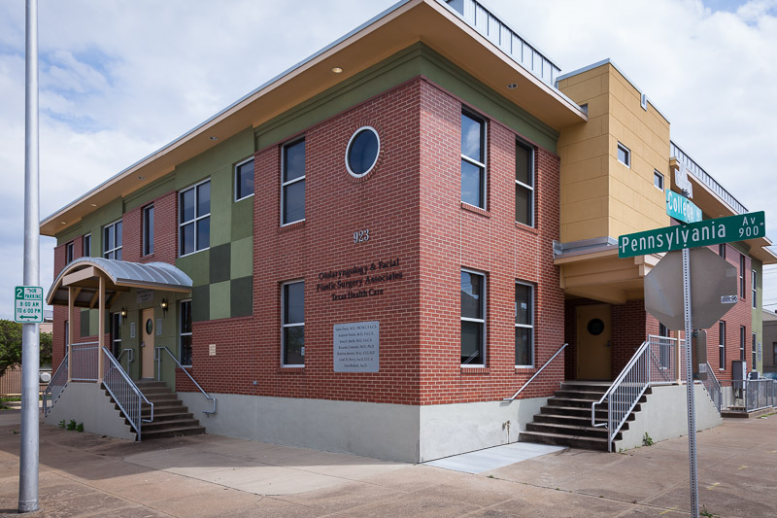
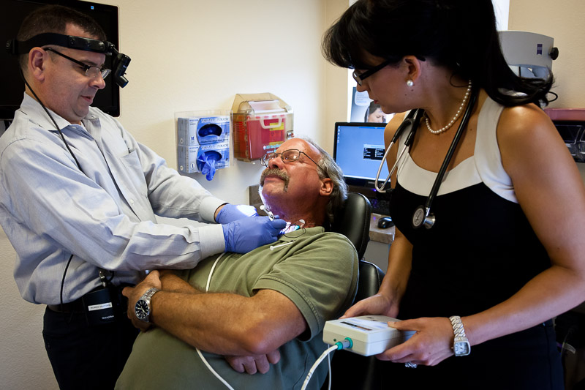
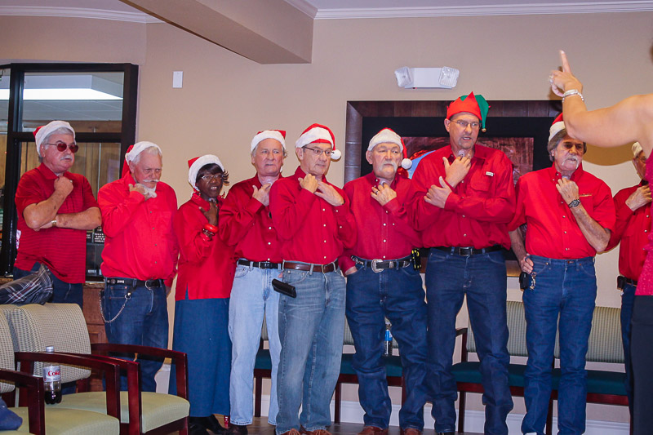
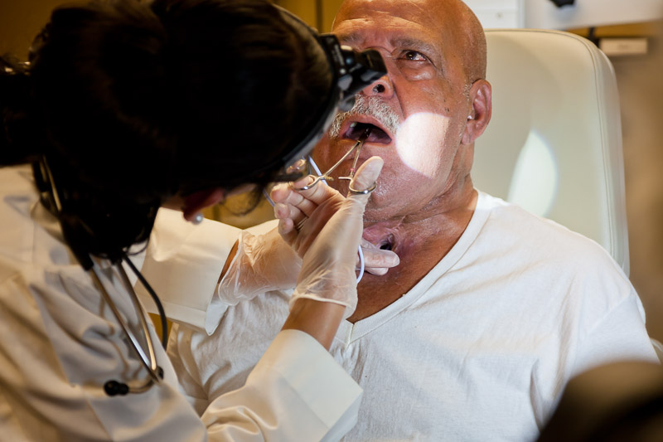
Thank you for your time!
Questions?
Info@practicalSLPinfo.com
www.practicalSLPinfo.com

