Slide 1
Introduction to Tracheo-esophageal Speech
Janis H. Deane, M.Ed.,CCC-SLP
Director, Speech-Language Pathology
Clinical Center for Voice and Swallowing
UT Southwestern Medical Center

Slide 2
Total Laryngectomy
Three primary means of communication:
Electrolarynx
Esophageal speech
Tracheo-esophageal speech

Slide 3
Tracheo-esophageal Speech
Possible via a surgically created fistula in the wall separating the trachea and esophagus.
A one-way valve is placed in the TE tract allowing air to be shunted from the lungs into the esophagus, thus causing vibration of the PE segment.

Slide 4
Tracheo-esophageal Speech
Advantage – a more natural sounding speech option, typically easy for patients to learn.
Disadvantage – expense and upkeep of prosthesis; initially, one-handed communicator.

Slide 5
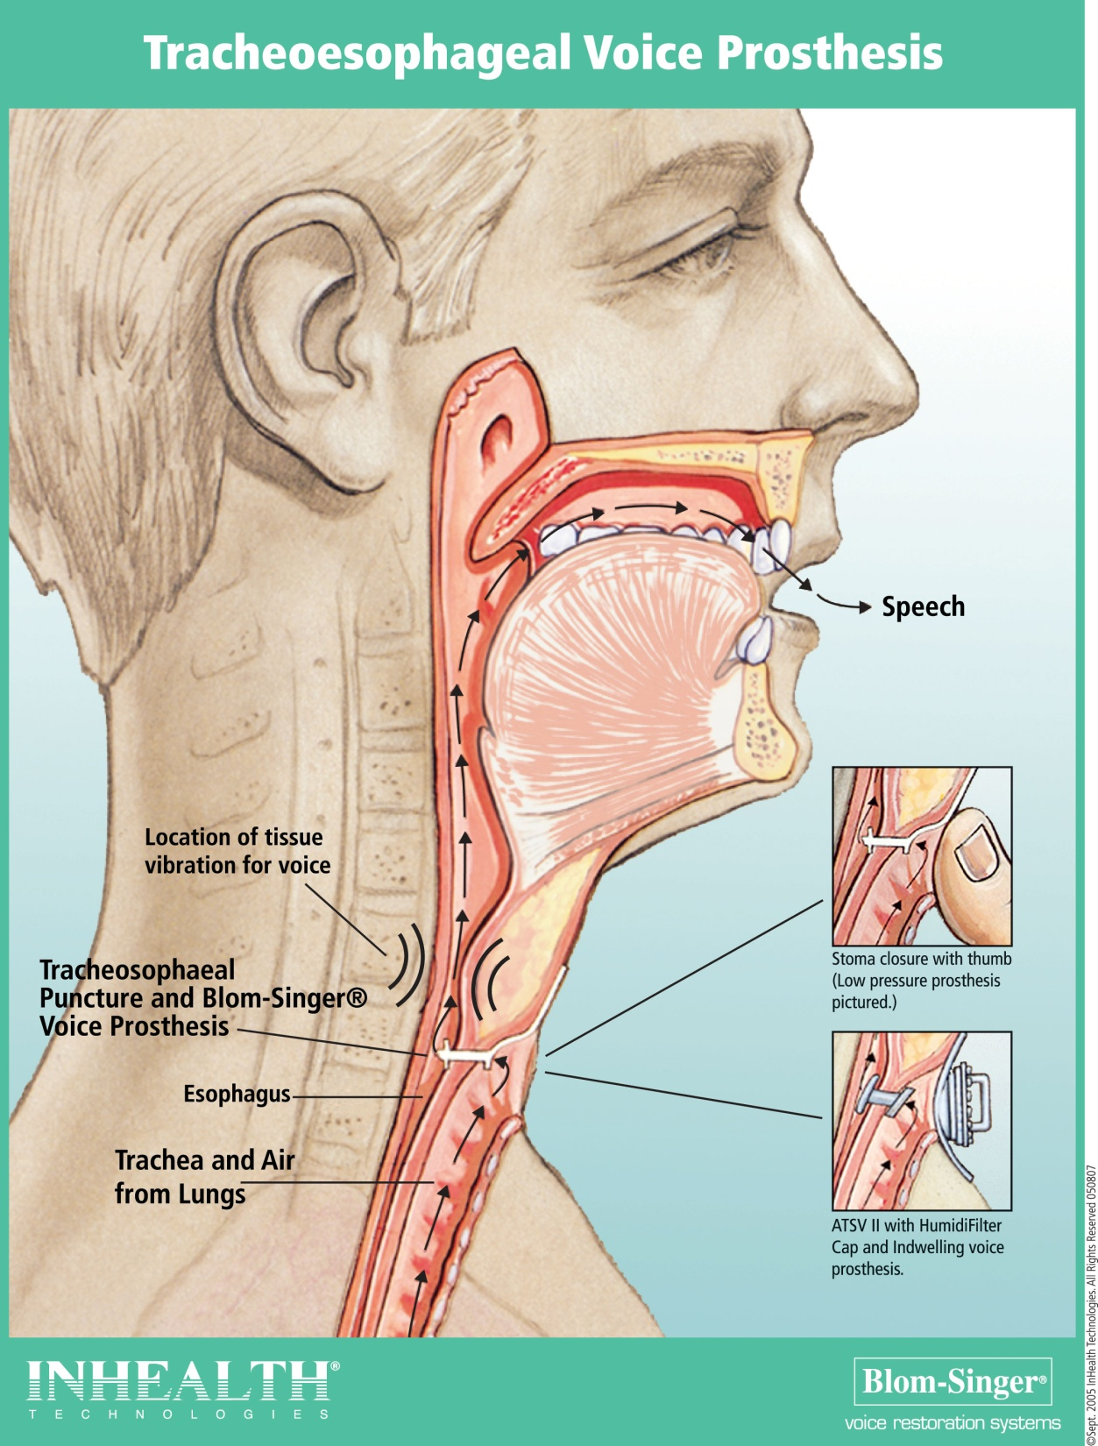

Slide 6
Timing of TE Puncture
Primary TEP – performed at the time of total laryngectomy with or without placement of a prosthesis
Secondary TEP – puncture created any time after the initial surgery

Slide 7
Primary TE Puncture
In some hospitals, patients will have a feeding tube, a white catheter, or a red rubber catheter in the TE tract.
In some facilities, TE prosthesis is placed at time of surgery; patient then fed through NG tube or PEG if present.

Slide 8
Secondary TE Puncture
In many facilities, a prosthesis is placed during the secondary puncture procedure by the surgeon.
In some facilities, patients have a place holder in the TE tract and the prosthesis is placed by the SLP.

Slide 9
Secondary TE Puncture: Clinical Considerations
Esophageal integrity – Air insufflation test - Does the PE segment vibrate, can the patient attain TE speech

Slide 10
Secondary TE Puncture: Clinical Considerations
Swallowing function – MBS study to ensure passage of foods and liquids past the TE puncture site.

Slide 11
Secondary TE Puncture: Clinical Considerations
Tissue integrity – is patient prone to development of fistulas? Have they proven that they can heal?

Slide 12
Initial Placement of Prosthesis
Feeding tube/catheter is removed from the TE tract
TE tract is dilated to 18-french
TE tract is measured
Prosthesis is inserted

Slide 13
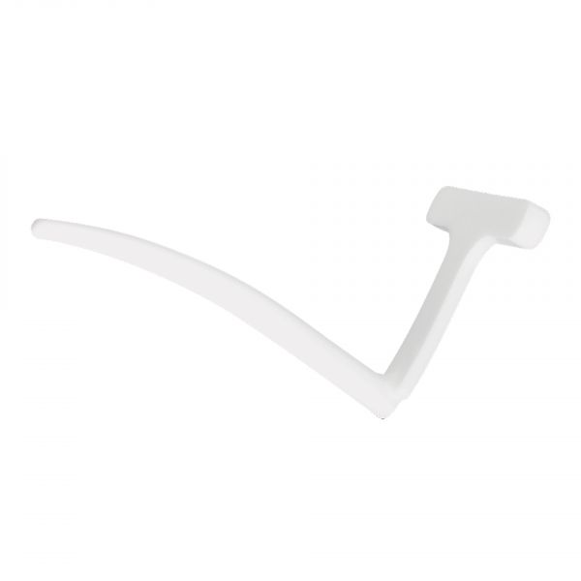
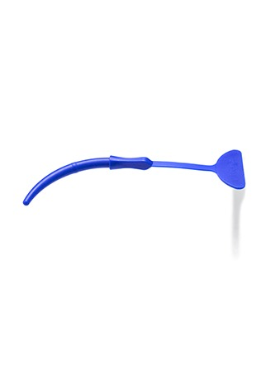
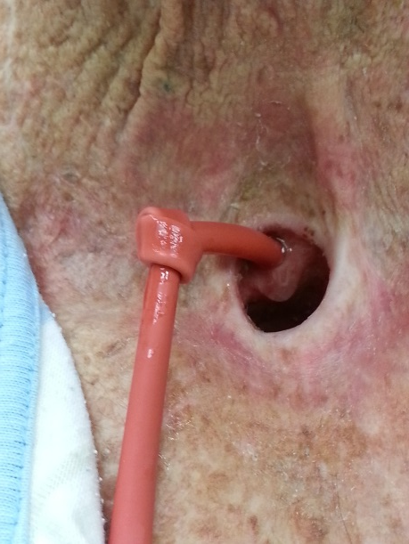
TE Tract Placeholders/Dilators

Slide 14
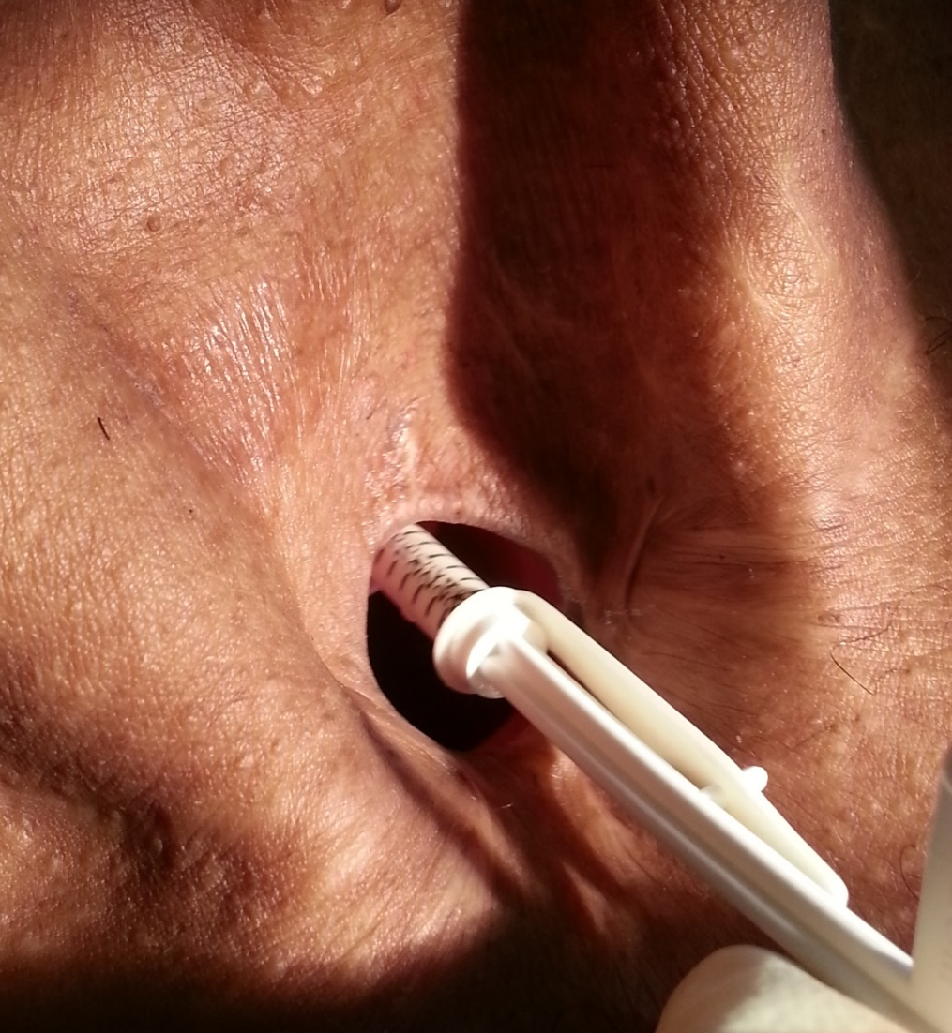
InHealth Measuring Device

Slide 15
ATOS Measuring Device

Slide 16
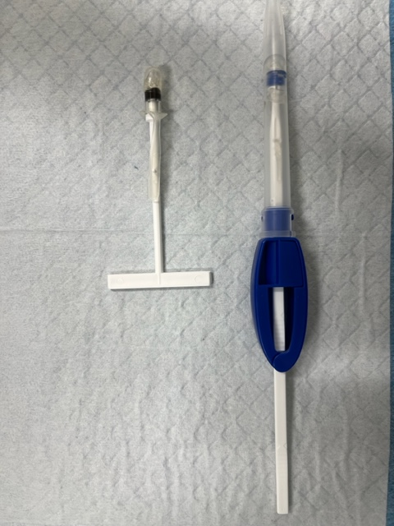
Insertion Methods

Slide 17
Insertion of ATOS Provox NID

Slide 18
Testing for Leaks

Slide 19
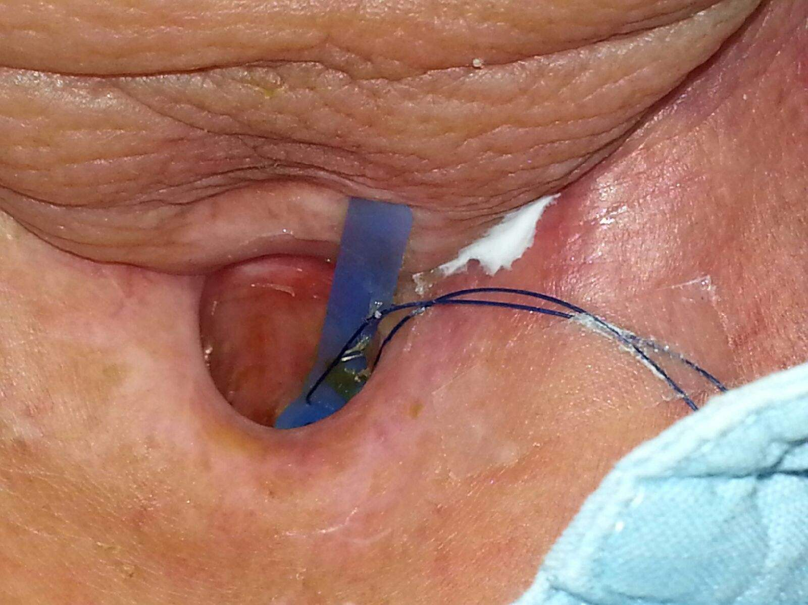
Testing for fistulas

Slide 20
Removal of an Indwelling TEP

Slide 21
Initial Patient/Family Training
Insertion of a catheter into the TE tract if the prosthesis should become dislodged.
Cleaning the TE prosthesis (flushing and or brushing)
Monitoring the prosthesis for leaks, either through the valve or around the perimeter
Cleaning a laryngectomy tube if present

Slide 22
Tracheo-esophageal Voice Prostheses

Slide 23
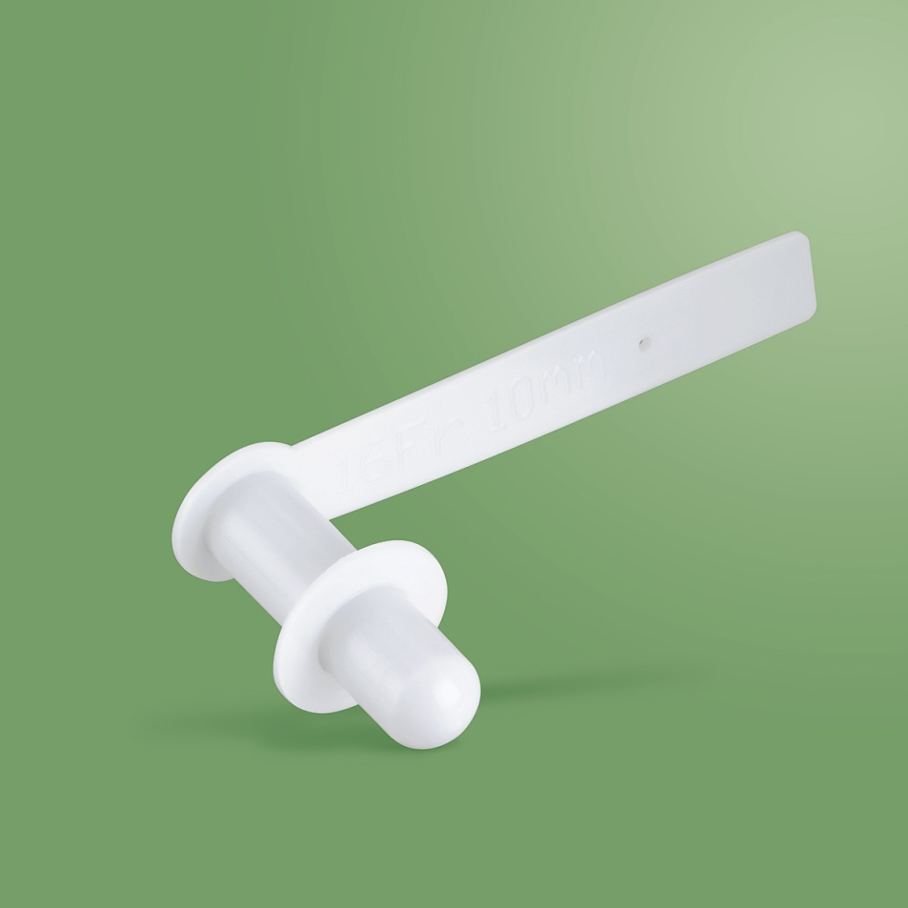
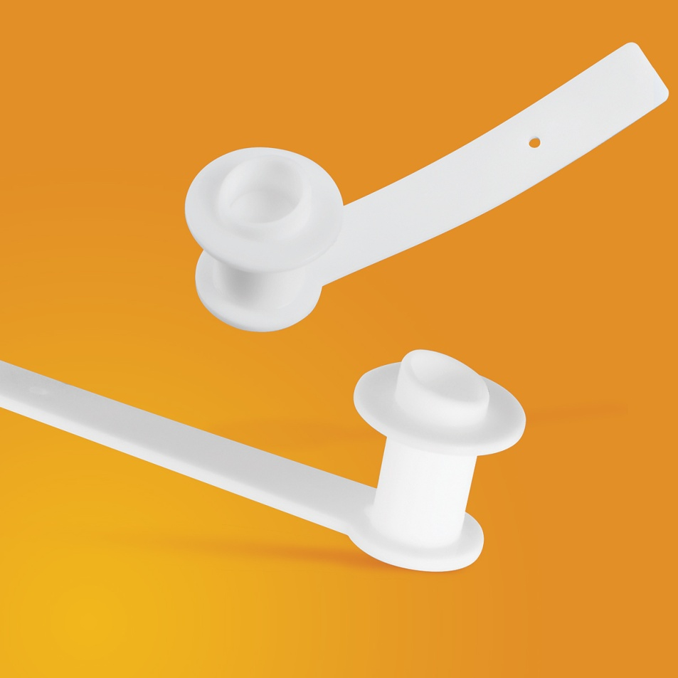
Non-Indwelling Prostheses
Patients can change these at home.

Slide 24
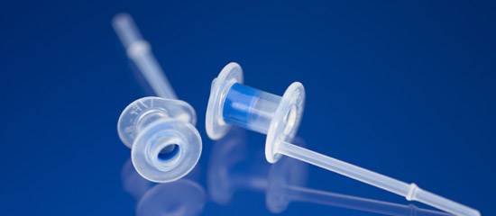
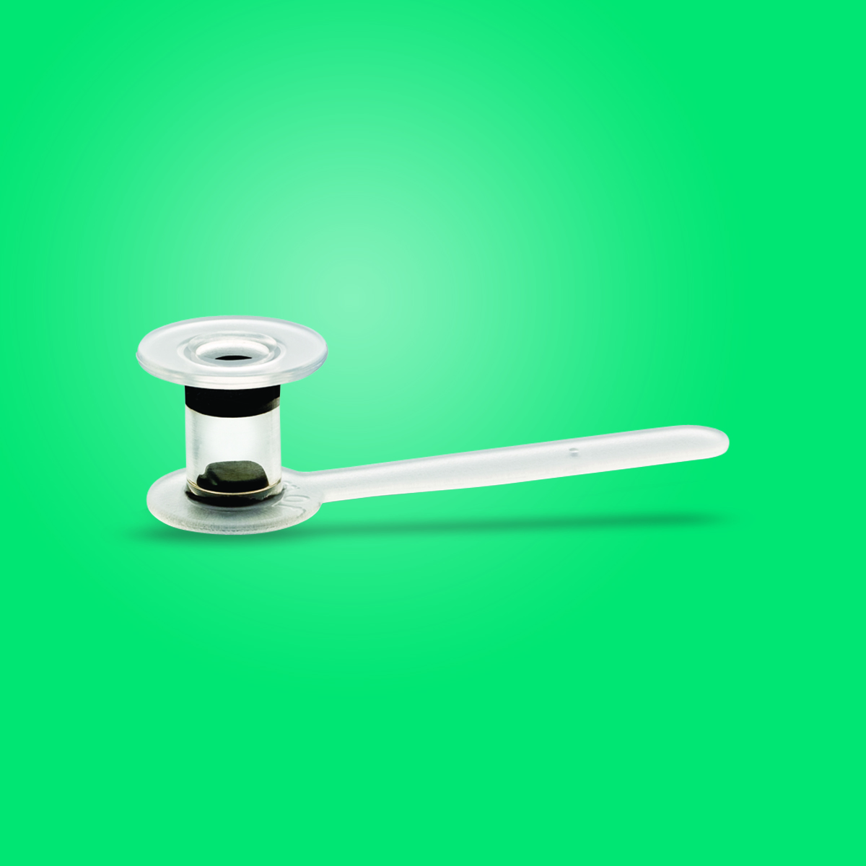
Indwelling Prostheses
Clinician placed

Slide 25
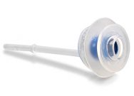
Indwelling Large Flange TEPs
These prostheses are the ones we use for patients who have leakage around the prosthesis.

Slide 26
Provox Xtraflange
Placed around the tracheal side of the prosthesis to prevent leakage around the perimeter

Slide 27
Xtraflange in place

Slide 28
Provox ActiValve
Designed for patients with short device life due to candida growth.
Also good for patients with inadvertent valve opening due to back pressure.

Slide 29
Patient Supplies
Prosthesis Management

Slide 30
Cleaning in Situ
It is recommended that the indwelling prosthesis be flushed/brushed at least twice a day.

Slide 31
Blomsinger Accessories
Flushing device can be used with all Blomsinger prostheses.
Cleaning brush is used with the Advantage prosthesis.
Plug and Valved inserts are available.

Slide 32
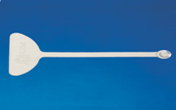
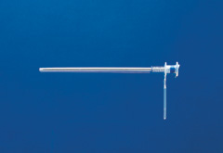
ATOS Accessories
The prosthesis can be flushed in situ by the patient or a caregiver.

Slide 33
Stomal Occlusion for TE Speech
Finger occlusion is taught as one method for occluding the stoma for TE speech.
Use of laryngectomy tubes, laryButtons, or adhesive baseplates paired with an HME filter or freehands device.

Slide 35
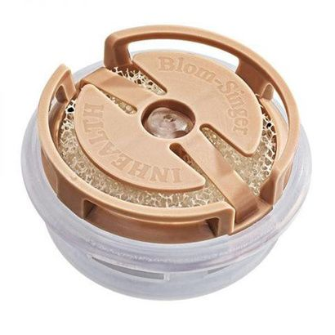
HME Filters

Slide 36
Handsfree Options

Slide 37
Laryngectomy Tubes

Slide 38
HME Base Plates

Slide 39
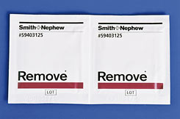
Peristomal Supplies
Skin-Prep and silcone glue are used to facilitate adhesion of base plates.
Remove assists with removal.

Slide 40
Laryngectomy Tube + Base Plate

Slide 41
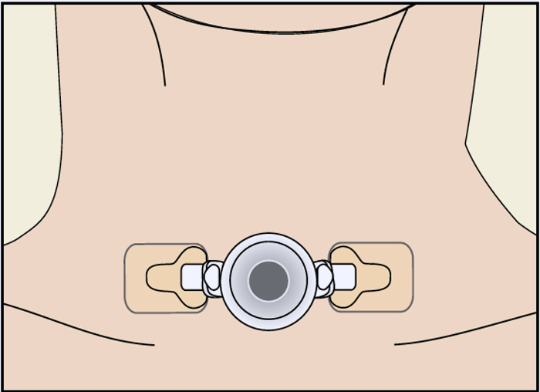
ATOS LaryButton with Laryclips

Slide 42
Clinical Considerations

Slide 43
Device Life
The TEPs are prone to damage from yeast, biofilm, reflux. This can result in peripheral leakage or central leakage.

Slide 44
Leakage
Central leakage – through the valve
Peripheral leakage – around the prosthesis

Slide 45
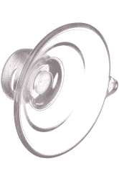
Stoma Size
Stoma too large/too small
If stoma is too large, patient can not finger occlude and there is often too much air pressure for stoma housings to adhere.
If stoma is too small, difficult to place and care for a prosthesis.

Slide 46
TE Tract
Separated “party” wall – can occur due to excessive coughing, brushing the prosthesis too aggressively (patient) swelling in the TEP area, placement of a prosthesis that is too short. It can lead to the closure of the esophageal side of the puncture.
Can be caused by the patient, a caregiver or an inexperienced clinician.
Sometimes the puncture can be restored through serial dilation of the tract.

Slide 47
Separated Party Wall

Slide 48
TE Tract
TE tract is too large, decreased tone.
It is difficult to get a prosthesis to stay in place in both of these situations.
At times, the tract will continue to enlarge due to the irritation of the prosthesis – this is a complication that has increased with re-irradiation.

Slide 50
Tissue Issues
Granulation tissue growth around the prosthesis.

Slide 51
TE Tract Continued
TE tract too high/too low
It is difficult to visualize the prosthesis for removal and replacement.
It is also difficult for the patient to flush/clean the prosthesis.
Optimal placement – 7mm below the tracheocutaneous juncture.

Slide 52
Untrained SLP Role
Patient safety, education of physicians, nurses, respiratory therapists, peers.
Understanding patient’s unique respiratory needs.
Understanding patient’s communication limitations and options.
Understanding patient’s swallowing abilities.
Contact primary SLP for direction.

Slide 53
Patient/Family Involvement
If patient has a TE prosthesis, chances are good that the patient and his/her family know how to care for it.
Patient/family should be consulted prior to any intervention that can disrupt prosthesis to minimize risk of losing the puncture.

Slide 54
Good Websites
ATOS America
InHealth Technologies
American Cancer Society
Web Whispers
International Laryngectomy Association

Slide 55
Janis Deane, M.Ed., CCC-SLP
Amy Hamilton, M.A., CCC-SLP
Cory Atkinson, M.A., CCC-SLP
Melanie Turner,
M.A., CCC-SLP
Jacob Lofland,
M.S., CCC-SLP

