Slide 1
Thriving not just surviving:
The Importance of Exercise throughout Survivorship
Karthik Jayaraman PT, DPT
Board Certified Clinical Specialist in Oncologic Physical Therapy | Center Manager Baylor Scott and White Rehabilitation Dallas Sammons Cancer Center
Notes:
My name is patty horning. I am a cancer rehabilitation specialist. I am proud to be part of the ReVital Cancer rehabilitation program ReVital was founded 4 years ago, with the vision of establishing cancer rehab as the standard of care so no person who needed it would have to say, “I wish I’d have known sooner.”

Slide 2
WHY CANCER REHABILITATION?
60-90% of individuals impacted by
cancer have at least one need for specialized rehabilitation
Less than 2% of rehabilitation needs are addressed
Cheville, A. L., Troxel, A. B., Basford, J. R., & Kornblith, A. B. (2008). Prevalence and treatment patterns of physical impairments in patients with metastatic breast cancer. Journal of clinical oncology: official journal of the American Society of Clinical Oncology, 26(16), 2621.; Pergolotti, M., Deal, A.M., Lavery, J., Reeve, B., & Muss, H.B. (2015). The Prevalence of Potentially Modifiable Functional Deficits and the Subsequent Use of Occupational and Physical Therapy by Older Adults with Cancer. Journal of Geriatric Oncology, 6 (3), 194-201. doi: 10.1016/j.jgo.2015.01.00
Notes:
17 million cancer survivors. There’s unfortunately a catch here. While the evidence suggests that 60-90% of people affected by cancer could benefit from the skills of a trained therapist, less than 2% of these patients have their rehabilitation needs addressed.
In addition, 25 to 60 percent of experience lasting pain,³ while 60 to 90 percent deal with fatigue related to their cancer.⁴
Why? Today, access to therapy providers with specialized training is often limited; cancer care teams haven’t been educated on the full scope of services therapists can offer, and most practice workflows haven’t been built to include functional assessments or referral triggers.

Slide 3
CANCER REHABILITATION
The Big Picture
Pain
Cancer-related fatigue
Weakness
Deconditioning
Restricted recreation & participation
Numbness/pain in hands or feet
Walking & balance deficits
Falls or near falls
Cognitive impairment
Joint Pain
Soft tissue changes
Lymphedema
Pelvic Health
60-90% of individuals impacted by
cancer have at least one need for specialized rehabilitation
Cheville, A. L., Troxel, A. B., Basford, J. R., & Kornblith, A. B. (2008). Prevalence and treatment patterns of physical impairments in patients with metastatic breast cancer. Journal of clinical oncology: official journal of the American Society of Clinical Oncology, 26(16), 2621.; Pergolotti, M., Deal, A.M., Lavery, J., Reeve, B., & Muss, H.B. (2015). The Prevalence of Potentially Modifiable Functional Deficits and the Subsequent Use of Occupational and Physical Therapy by Older Adults with Cancer. Journal of Geriatric Oncology, 6 (3), 194-201. doi: 10.1016/j.jgo.2015.01.00
Notes:
Research shows 60-90% have at least one need for specialized rehab.
Cancer and its treatment have known side effects, many that you’ve treated such as pain, fatigue, weakness and arthralgia. However, cancer rehab is not just treating a person with a history of cancer, but also recognizing the impact of cancer and its treatment, how they directly relate to individual needs, and how you should best approach care to optimize outcomes.
Let’s see what this looks like in a patient referred to one of our clinics.

Slide 4
Notes:
Dr Wallace and prehab

Slide 5
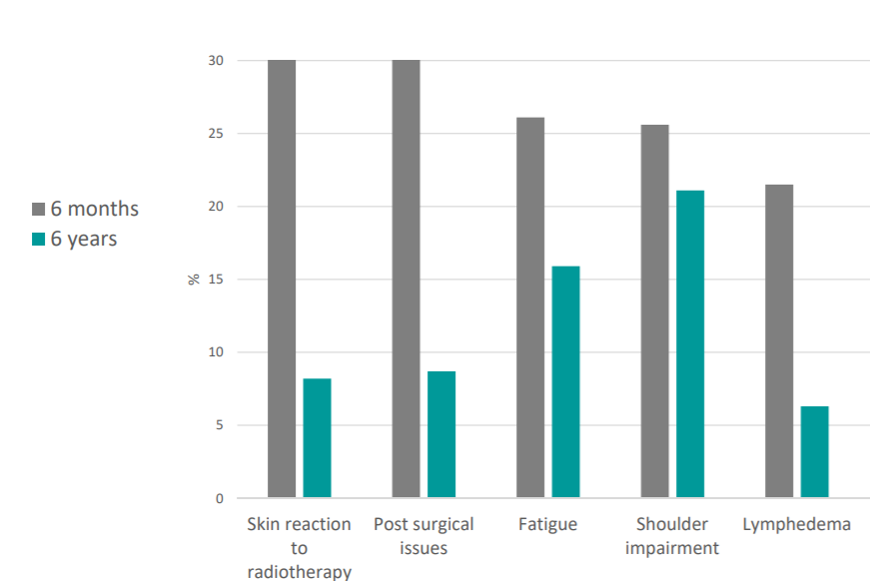

COMMON SIDE EFFECTS RELATED TO H&N CANCER/POST LARYNGECTOMY

Slide 6
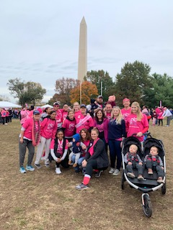
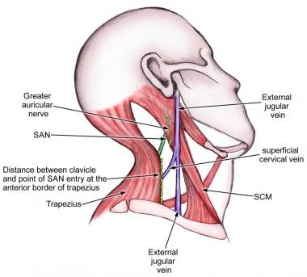
COMMON SIDE EFFECTS RELATED TO H&N CANCER/POST LARYNGECTOMY
Spinal accessory nerve involvement
  Major cause of shoulder dysfunction and pain
  Upper trap and middle trap EMG activity = significantly decreased compared to unaffected side
Post-radiation fibrosis
  Can potentially lead to severe neck contracture and cervical muscle involvement
Generalized weakness/deconditioning
  Restricted recreation & participation
Chemotherapy induced peripheral neuropathy (CIPN)
  Walking & balance deficits
  Falls or near falls
Lymphedema

Slide 7
CHEMOTHERAPY INDUCED PERIPHERAL NEUROPATHY (CIPN)
“Is a nerve damaging side effect of anti cancer drugs most typically known as chemotherapy. It can afflict between 30 to 40% of individuals who have undergone chemotherapy.”

Slide 8
CIPN AND FALLS
2018 Journal of Clinical Oncology
  Survivors with CIPN have almost three times the fall rate of those without CIPN
  Almost 50% of people with CIPN still experienced symptoms up to six years after treatment
  Survivors with CIPN were almost twice as likely to fall
2017 Journal of Clinical Oncology
Kolb NA, Smith G, Singleton JR, Beck SL, et. al. The association of chemotherapy-induced peripheral neuropathy symptoms and the risk of falling. JAMA Neurol. 2016;73(7):860-866.
Winters-Stone KM, Horak F, Jacobs PG, Trubowitz P, et al. Falls, functioning and disability among women with persistent symptoms of chemotherapy-induced peripheral neuropathy. J Clin Oncol. 2017; 35. DOI: https://doi.org/10.1200/JCO.2016. 71.3552.
Notes:
The presence of CIPN increases fall risk. These JCO studies demonstrated that CIPN persists 6 years post-treatment in almost 50% of survivors and those individuals were 2-3 times as likely to fall.

Slide 9
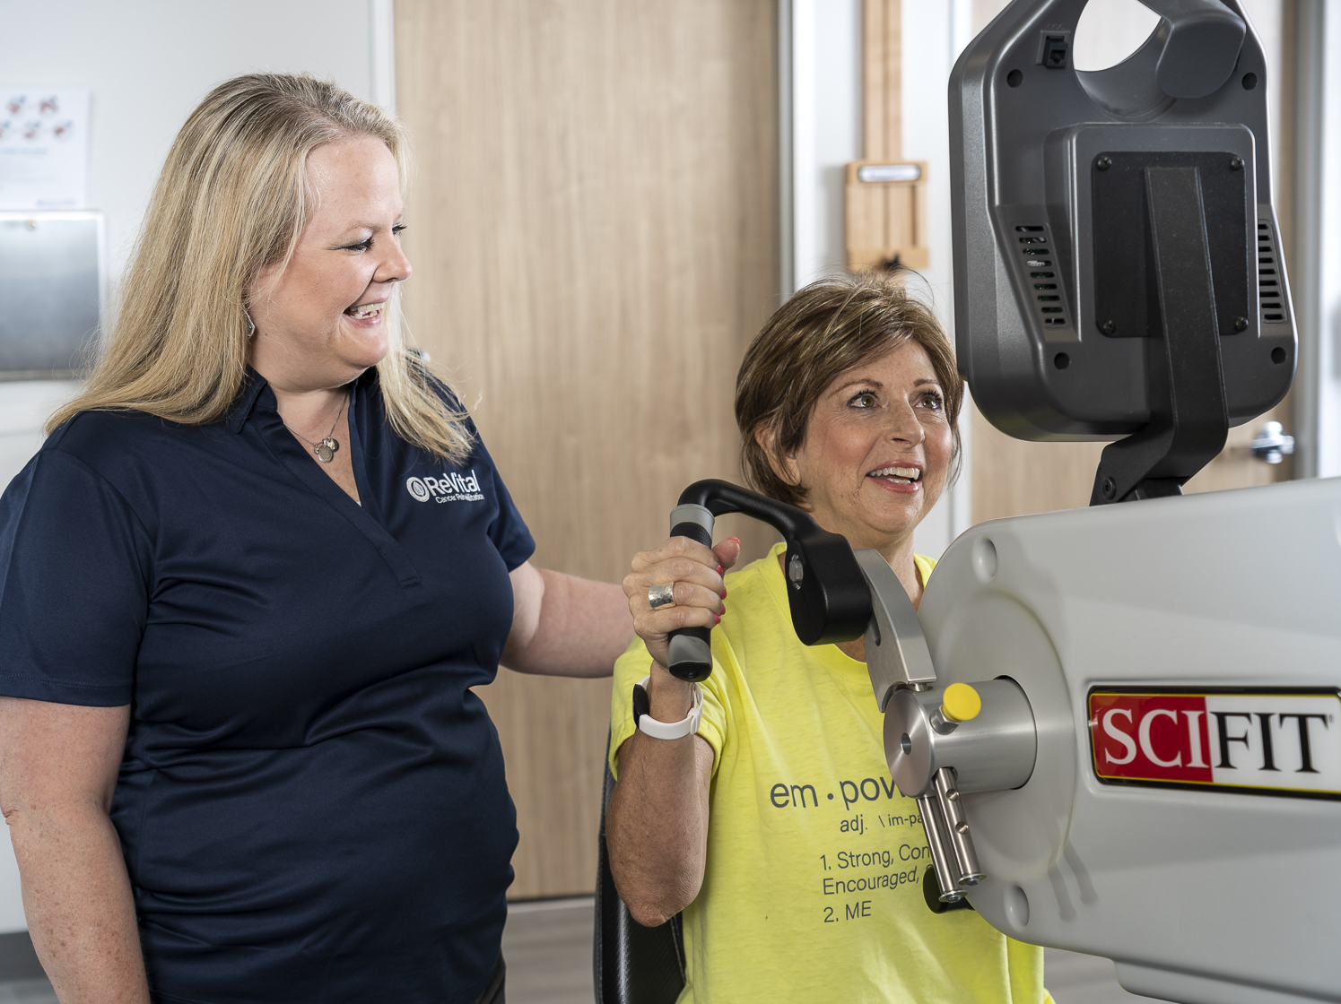
CHEMOTHERAPY INDUCED PERIPHERAL NEUROPATHY (CIPN)
2018 Journal of Clinical Oncology
  “Is a nerve damaging side effect of anti cancer drugs most typically known as chemotherapy. It can afflict between 30 to 40% of individuals who have undergone chemotherapy.”
  Survivors with CIPN have almost three times the fall rate of those without CIPN
  Almost 50% of people with CIPN still experienced symptoms up to six years after treatment
  Survivors with CIPN were almost twice as likely to fall
Exercise for CIPN
Aerobic exercise
Weight bearing exercises
Balance training
Manual therapy
Taping techniques
Fine motor training
Modalities
Kolb NA, Smith G, Singleton JR, Beck SL, et. al. The association of chemotherapy-induced peripheral neuropathy symptoms and the risk of falling. JAMA Neurol. 2016;73(7):860-866.
Winters-Stone KM, Horak F, Jacobs PG, Trubowitz P, et al. Falls, functioning and disability among women with persistent symptoms of chemotherapy-induced peripheral neuropathy. J Clin Oncol. 2017; 35. DOI: https://doi.org/10.1200/JCO.2016. 71.3552.
Notes:
“Is a nerve damaging side effect of anti cancer drugs most typically known as chemotherapy. It can afflict between 30 to 40% of individuals who have undergone chemotherapy.”
The presence of CIPN increases fall risk. These JCO studies demonstrated that CIPN persists 6 years post-treatment in almost 50% of survivors and those individuals were 2-3 times as likely to fall.

Slide 10
What is cancer-related fatigue?
Notes:
Let’s briefly examine what is cancer related fatigue.

Slide 11
What is Cancer-Related Fatigue (CRF)?
“
Distressing, persistent, subjective sense of physical, emotional and/or cognitive tiredness or exhaustion related to cancer or cancer treatments that is not proportional to recent activity and interferes with usual functioning
“
What is the Problem?
60% of
cancer
population
Persists 6+ months in 33%
Rarely treated
Referenced with permission from the NCCN Clinical Practice Guidelines in Oncology (NCCN Guidelines®) for Cancer-Related Fatigue V.1.2019. © National Comprehensive Cancer Network, Inc. 2019. All rights reserved. Accessed June 11th, 2019. To view the most recent and complete version of the guideline, go online to NCCN.org.
Stubblefield MD, O’Dell MW. Cancer Rehabilitation Principles and Practice. 1st ed. New York, New York: Demos Medical Publishing; 2009.
Jones JM, Olson K, Catton P, Catton CN, et al. Cancer-related fatigue and associated disability in post-treatment cancer survivors. Journal of Cancer Survivorship. 2016; 10 (1): 51-61.
Notes:
So what is Cancer-Related Fatigue? The official definition of Cancer Related Fatigue according to the National Comprehensive Cancer Network is a distressing, persistent, subjective sense of physical, emotional and/or cognitive tiredness or exhaustion related to cancer or cancer treatment that is not proportional to recent activity and interferes with usual functioning. The key words in that sentence are persistent, not proportional to recent activity and interferes with usual functioning.

Slide 12
Cancer-Related Fatigue
Normal Fatigue vs. CRF
Predictable
Temporary
Treated by rest
Short duration
Not related to event
Not treated by rest
Can last years after treatment
May be more distressing and severe
Normal Fatigue
Cancer-Related Fatigue
Referenced with permission from the NCCN Clinical Practice Guidelines in Oncology (NCCN Guidelines®) for Cancer-Related Fatigue V.1.2019. © National Comprehensive Cancer Network, Inc. 2019. All rights reserved. Accessed June 11th, 2019. To view the most recent and complete version of the guideline, go online to NCCN.org.
Notes:
Looking at that definition, It’s important to understand the differences between acute fatigue and CRF.
Normal fatigue is predictable, temporary and you can typically recover with rest. Cancer related fatigue is not necessarily related to any one event. You can feel tired or exhausted even after a good night’s sleep, you can have a lack of energy or prolonged tiredness after activity. Weakness, heaviness in arms/legs, listlessness or irritability are common. Patients have told me they have difficulty starting or finishing tasks due to tiredness, they can’t do usual activities, they are too tired to eat. They may have difficulty with concentration and memory. As you can see symptoms of cancer related fatigue may be more distressing and severe and may persist-even years after treatment.

Slide 13
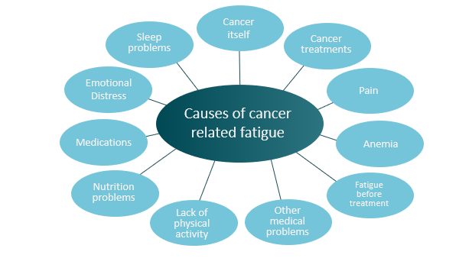
Referenced with permission from the NCCN Clinical Practice Guidelines in Oncology (NCCN Guidelines®) for Cancer-Related Fatigue V.1.2019. © National Comprehensive Cancer Network, Inc. 2019. All rights reserved. Accessed June 11th, 2019. To view the most recent and complete version of the guideline, go online to NCCN.org.
Notes:
As you can see on this slide, there are many causes of CRF. These may include many common cancer treatments such as chemotherapy, radiation, surgery and stem cell transplant. In some cases, it may also be due to the cancer process itself. Some other examples are medications patients are taking, fatigue level prior to treatment, emotional distress, sleep problems and pain, just to name a few.

Slide 14
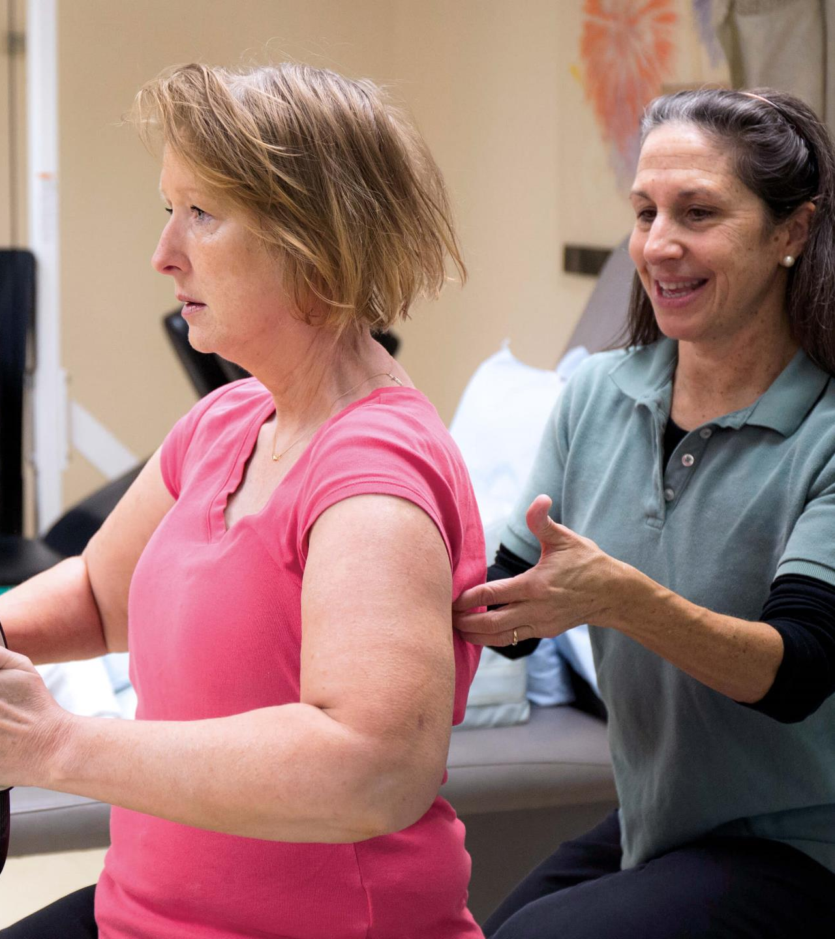
Physical Therapy Treatment
for Cancer Related Fatigue
Aerobic exercise
Strengthening exercises
Posture Education
Body mechanics education
Stretching
Relaxation techniques
Mindfulness training
Tips on sleeping habits
Energy conservation education
Notes:
Physical Therapy isn’t only about exercise though. It is more holistic than that. We do a lot of aerobic and strengthening activities, yes-but we also focus on posture and body mechanics education. If you have a hunched over posture, then you aren’t getting good oxygen in your body, which can cause you to be more fatigued. We also teach techniques for relaxation and mindfulness. We know cancer-related fatigue is very multi-factorial and can affect multiple structures. There is a mental fatigue that goes along with this as well and if we can help with some of these relaxation and mindfulness activities, it can help with the mental fatigue and any underlying anxiety that comes along with this. Finally, we can help educate on good sleep hygiene (essentially tips for how to get a good night’s sleep) and on energy conservation activities, such as pacing. We do a lot of journaling, which can be very eye-opening and insightful when learning how to adapt to your energy levels while going through treatment.

Slide 15
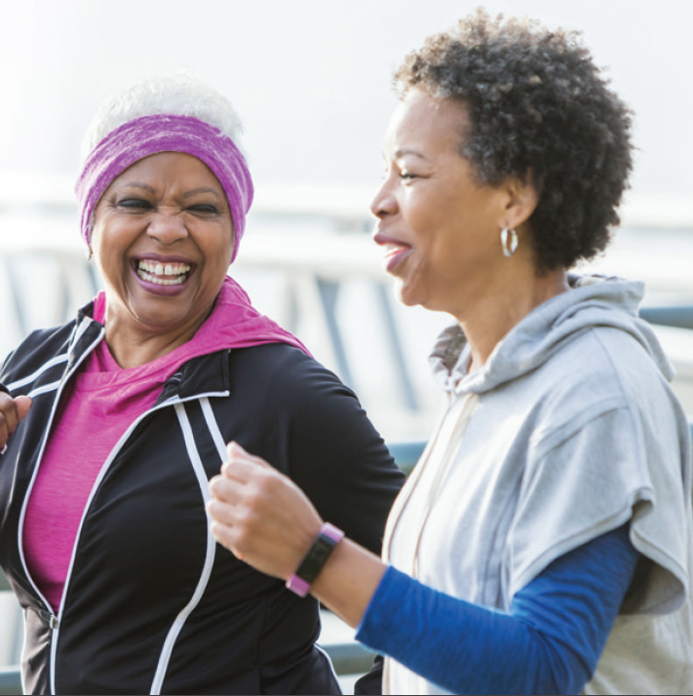
Exercise—You
must be KIDDING
me?!?!
Notes:
I know what you are thinking-”EXERCISE?! SERIOUSLY?! You MUST be joking! I’m too tired to exercise!”
But--Aerobic endurance training and Moderate resistance strength training have been shown to be THE most effective way to combat cancer-related fatigue in the research.
A PT that specializes in cancer rehabilitation can help you work up to exercise safely and take into consideration your specific needs and restrictions, including any modifications that may need to be made. A PT can also monitor your signs and symptoms during your exercise program and educate you on how to make sure you are doing your activities safely.

Slide 16
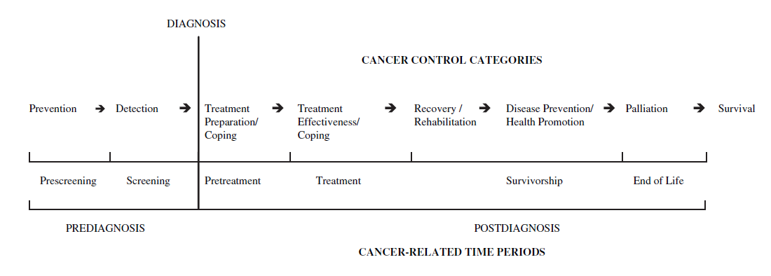
Benefits of Physical Activity and Exercise
PRE-diagnosis
POST-diagnosis
(Courneya, K. S., & Friedenreich, C. M., 2007)
Meeting exercise guidelines associated with:
Meeting exercise guidelines associated with:*
Lower risk of cancer occurrence
Preventative for many specific cancer types
Lower risk of cancer-related mortality
Decreased fatigue, distress, anxiety and depression.
Improved physical and cognitive functioning, strength, balance and endurance.
Benefits for length and quality of survival.
Improved sleep, bone health, neuropathy symptoms, lymphedema, and other symptoms.
(Patel et al 2019; Campbell et al 2019)
*Independent of pre-cancer diagnosis activity level
Notes:
In March 2018 the American College of Sports Medicine convened an International Multidisciplinary Roundtable on Exercise and Cancer in to evaluate and translate the evidence linking physical activity and cancer prevention, treatment, and control. Their findings were published in late 2019 and provide the highest level of evidence supporting the benefits of physical activity and exercise for individuals living with and beyond cancer.
PREdiagnosis
The evidence supports that there are a number of ways physical activity can influence cancer risk, and that physical activity is beneficial for the prevention of several types of cancer including breast, colon, endometrial, kidney, bladder, esophageal, and stomach.
Minimizing time spent in sedentary behavior may also lower risk of endometrial, colon and lung cancers.
POST diagnosis
physical activity before and after a cancer diagnosis is also likely to improve survival for those diagnosed with breast and colon cancer; with research suggesting that post-diagnosis physical activity provides greater benefits to reduce mortality than pre-diagnosis physical activity.

Slide 17
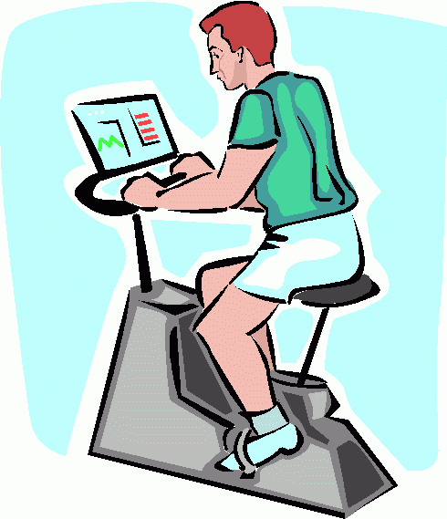
Benefits of Physical Activity and Exercise
During Cancer Treatment
Increased energy and reduced fatigue
Decreased depression and anxiety
Improved health-related quality of life
Improved sleep
Improved chemo tolerance and blood counts
Stout et al 2017
Notes:
I’m going to break down these benefits further for you. Let’s first start with the benefits of exercise during cancer treatment. Research has found that exercising during cancer treatments is safe and in fact, actually has many benefits. Studies have showed that those who exercised regularly had 40% to 50% less fatigue than those who were less active. Exercise also helps mood, which can benefit those feelings of depression and anxiety that often go hand in hand with a cancer diagnosis. Those that stayed physically active during treatment slept better and what I find really interesting and important is that these folks had less side effects with their treatments and improved blood counts-leading them to have better chemo completion rates than those that were sedentary during their treatments.
When exercising during cancer treatments, you don’t have to try to run a marathon or compete in the World’s Strongest Man Competition-even just some moderate aerobic activity paired with some light strength training can do wonders. We’ll talk more about this in a minute.

Slide 18
How to Safely and Effectively Prescribe Exercise in Cancer Survivors
Include aerobic exercise, weight training and flexibility activities
  Aerobic 150 min moderate intensity per week
  Weights - moderate intensity 2x/week
  Flexibility - on days exercise performed
Prescribe specific exercise metrics with ranges and patient instruction for modification as needed
Notes:
It is important that exercise involve multiple formats to improve cardiovascular fitness, general strength and overall mobility/flexibility. Moderate intensity aerobic activity should take place 150 min per week (30 min 5x/wk), SLOWLY-PROGRESSED strength training 2x/wk and stretching on any day exercise is performed.
Cancer rehabilitation clinicians are instructed in specific metrics to determine a safe and effective target heart rate range for patients during exercise. Prescribing target heart rate metrics ensures patients work hard enough to realize the full benefits of exercise. Providing a range allows patients the ability to modify as needed based on how they feel each day.

Slide 19

Benefits of Physical Activity and Exercise
After Cancer Treatment
Improved physical function, endurance and strength
Improved quality of life
Improved bone health
Improved body composition/weight control
Research shows that you can decrease your risk of cancer recurrence with exercise in certain types of cancer
Stout et al 2017, Holmes et al 2005, Arem et al 2015, Kenfield et al 2011
Notes:
In studies done on patients that exercised after they had completed their cancer treatments, they also noted improvements in many areas. These folks showed improved physical function, endurance and strength, improved quality of life, improved bone health, and decreased depression and anxiety.
Finally, exercise helps control weight -- a crucial factor, as studies have shown that gaining weight during and after treatment raises the risk of a cancer recurrence, particularly for breast, colon and prostate cancers.
I want to highlight just a few studies that illustrate this point. One study of over 3,000 women found that women with a diagnosis of breast cancer who exercised moderately (they walked 3 to 5 hours per week at an average pace) had approximately 40% to 50% lower risk of breast cancer recurrence, death from breast cancer, and death from any cause compared with more sedentary women. That is HUGE! That is the same kind of risk reduction women with hormone positive cancers get from taking hormone blockers.
For patients after a colorectal cancer diagnosis, those who participated in physical activity had a 31% lower risk of death than those who did not.
And, finally, in one study of men with non-metastatic prostate cancer who engaged in vigorous activity for at least 3 hours per week had a 61% lower risk of death from prostate cancer compared with men who engaged in vigorous activity for less than 1 hour per week.
So this goes to show that it’s never too late to get started with a physical activity program after a cancer diagnosis.

Slide 20
Monitor your exercise intensity
0
1
2
3
4
5
6
7
8
9
10
0 - Rest.
The equivalent of lying or sitting. Normal breathing, no breathlessness
1-2 Very light.
The equivalent of watching TV, riding in a car, etc.
3-4 Moderate.
Feels like you can maintain for a while. No challenges to breathe or carry a conversation.
5-6 Somewhat hard.
Breathing increases, becomes heavy. Can hold short conversation. Still fairly comfortable, but becoming noticeably more challenging.
7-8 Hard.
Breathing heavily, but can speak short sentence. Likely sweating. Borderline uncomfortable.
9 – Extremely hard
Very difficult to maintain exercise intensity. Can barely breathe or speak a few words.
10 – Almost impossible to sustain.
Completely out of breath and unable to talk.
Notes:
*Tie to cancer rehab:
A cancer rehab specialist can help you understand how to easily monitor your intensity using HR and RPE. They can help you to safely progress your exercise over time to get the maximum benefits of exercise

Slide 21
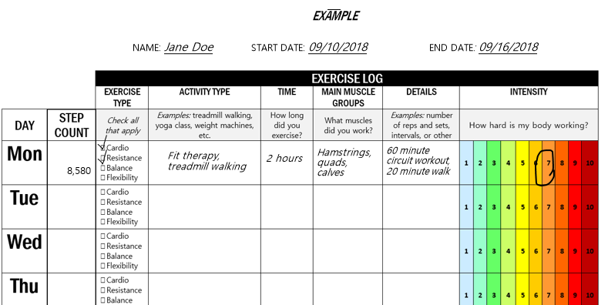


Track your activity and progress
Have a way to evaluate, track, and measure your progress.
Example: types of exercises, number of set & reps during each workout
MEASURABLE
Tools for tracking:
Written exercise log
Electronic fitness trackers
  Pedometer
  Fitness or ‘smart’ watch
  Cell phone application, etc.

Slide 22
Get creative and HAVE FUN!!
Tips:
Find types of exercise that you ENJOY!
Use the buddy system!
Incorporate technology ONLY if/when it feels right.
Reward yourself and share successes/challenges as you make progress towards your goals.
Community support – American Cancer Society ex. LiveStrong
Notes:
Get creative and have fun. Find types of exercise that you enjoy. Do you love walking your dog? Doing yoga? Dancing? Use your favorite activities as an opportunity to ‘sneak’ in some exercise and stay more active throughout the day! Don’t feel pressure to ‘hit the gym’, home-based exercise with minimal equipment can be equally as beneficial and may fit better into your routine. Use the buddy system-even the virtual buddy system! We’ve talked about this already. Incorporate technology ONLY if/when it feels right. DO NOT feel pressure to keep up with the latest trends in fitness and tech. The most beneficial exercise is the kind that you actually do. Technology can be very helpful but is NOT required. Reward yourself and share successes/challenges as you make progress towards your goals. We ALL face challenges, talking through them with a buddy or trusted exercise professional is key to your progress. Take time to ‘treat yourself’ at each new milestone and reflect on your progress. Take advantage of cancer-specific supports. There are lots of national and local exercise-related supports for cancer survivors– ask google! I’ve listed one great resource here: the American College of Sports Medicine (ACSM) Move Through Cancer ® Website: https://www.exerciseismedicine.org/support_page.php/moving-through-cancer/. I just want to take a moment to show you some great resources from this website. (ACSM Being Active When you have Cancer, Sit Less Move More, Exercise Guidelines Infographic, Exercise for Prevention and Treatment)

Slide 23
Reach out for support
Reach out to your health care provider prior to starting a new exercise program if
  If you are in active cancer treatment
  Current or previous Cardiac or pulmonary issues
  Recent infection or any health concern
  Recent fall or hospitalization
ReVital Cancer Rehabilitation
  Check our website www.revitalcancerrehab.com for more information about cancer rehabilitation
  services, including telerehab, and to find a therapy location near you.
American College of Sports Medicine
  Exercise is Medicine - https://www.exerciseismedicine.org/eim-in-action/moving-through-cancer/
Notes:
And, finally, reach out for support. Check out our website at www.kort.com or www.revitalcancerrehab.com for more information about cancer rehabilitation services, including telerehab and to find a therapy location near you. The American College of Sports Medicine Website is a great resource. I’ve already shown you some of the fantastic resources available from them, but you can also use the International Cancer Exercise Program Registry to find local programs and use the PRO finder to find a local health/fitness professional.

Slide 24


Slide 25
Thank you!
Karthik Jayaraman PT, DPT
Board Certified Clinical Specialist in Oncologic Physical Therapy
Director of BSWIR Oncology Residency Program
Center Manager| Physical Therapist
Dallas Sammons Cancer Center
3410 Worth Street Ste 800
Dallas, TX 75246
Email: Kjayaraman@BSWRehab.com | Office: 214.370.9774 Fax: 214.370.9761

Slide 26
References
Courneya, K. S., & Friedenreich, C. M. (2007). Physical Activity and Cancer Control. Seminars in Oncology Nursing, 23(4), 242–252. https://doi.org/10.1016/j.soncn.2007.08.002
Patel, A. V, Friedenreich, C. M., Moore, S. C., Hayes, S. C., Silver, J. K., Campbell, K. L., Winters-Stone, K., Gerber, L. H., George, S. M., Fulton, J. E., Denlinger, C., Morris, G. S., Hue, T., Schmitz, K. H., & Matthews, C. E. (2019). American College of Sports Medicine Roundtable Report on Physical Activity, Sedentary Behavior, and Cancer Prevention and Control. Medicine and Science in Sports and Exercise, 51(11), 2391–2402. https://doi.org/10.1249/MSS.0000000000002117
Campbell, K. L., Winters-Stone, K. M., Wiskemann, J., May, A. M., Schwartz, A. L., Courneya, K. S., Zucker, D. S., Matthews, C. E., Ligibel, J. A., Gerber, L. H., Morris, G. S., Patel, A. V, Hue, T. F., Perna, F. M., & Schmitz, K. H. (2019). Exercise Guidelines for Cancer Survivors: Consensus Statement from International Multidisciplinary Roundtable. Medicine and Science in Sports and Exercise, 51(11), 2375–2390. https://doi.org/10.1249/MSS.000000000000211

Slide 27
References
Siegel RL, Miller KD, Jemal A. Cancer statistics, 2019. CA: A Cancer Journal for Clinicians. 2019;69: 7-34.
Cheville A, Beck L, Petersen T, Marks R, Gamble G. The detection and treatment of cancer-related functional problems in an outpatient setting. Supportive Care in Cancer. 2009;17: 61-67.
Schmitz KH, Speck RM, Rye SA, DiSipio T, Hayes SC. Prevalence of breast cancer treatment sequelae over 6 years of follow-up. Cancer. 2012;118: 2217-2225.
Hayes SC, Johansson K, Stout NL, et al. Upper-body morbidity after breast cancer. Cancer. 2012;118: 2237-2249.
Paalman CH, van Leeuwen FE, Aaronson NK, et al. Employment and social benefits up to 10 years after breast cancer diagnosis: a population-based study. British Journal Of Cancer. 2016;114: 81.
Ballard-Barbash R, Friedenreich CM, Courneya KS, Siddiqi SM, McTiernan A, Alfano CM. Physical activity, biomarkers, and disease outcomes in cancer survivors: a systematic review. J Natl Cancer Inst. 2012;104: 815-840.

